Slide 1

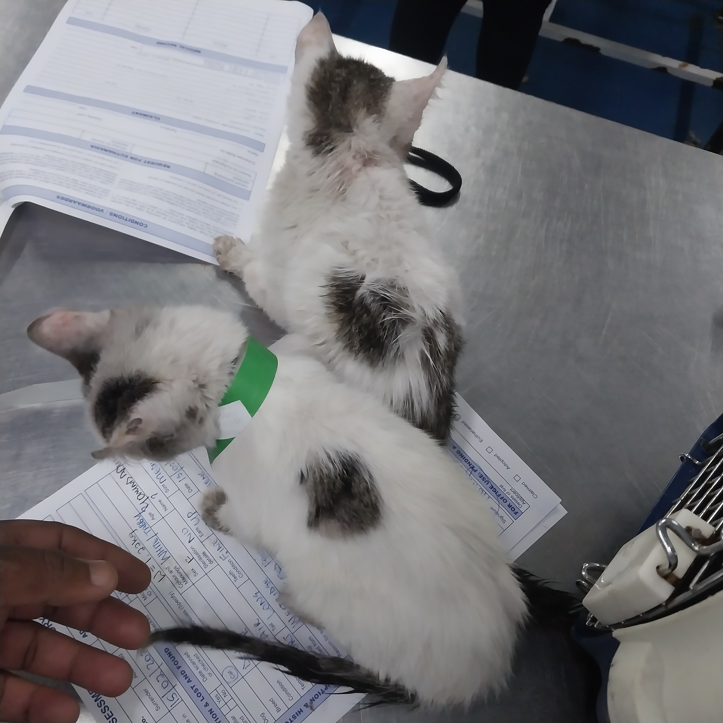
Photographic Evidence C
Date taken: 15 February 2024
Address: Cape of Good Hope SPCA, Grassy Park
Taken by: Inspector Jeffrey Mfini
Taken with: Samsung Galaxy A23 Cellular Phone Camera
Photograph 1: Showing the two kittens removed from 111 Cypress Way, Mitchells Plain. Note the kittens’ coats are dirty and ungroomed.

Slide 2
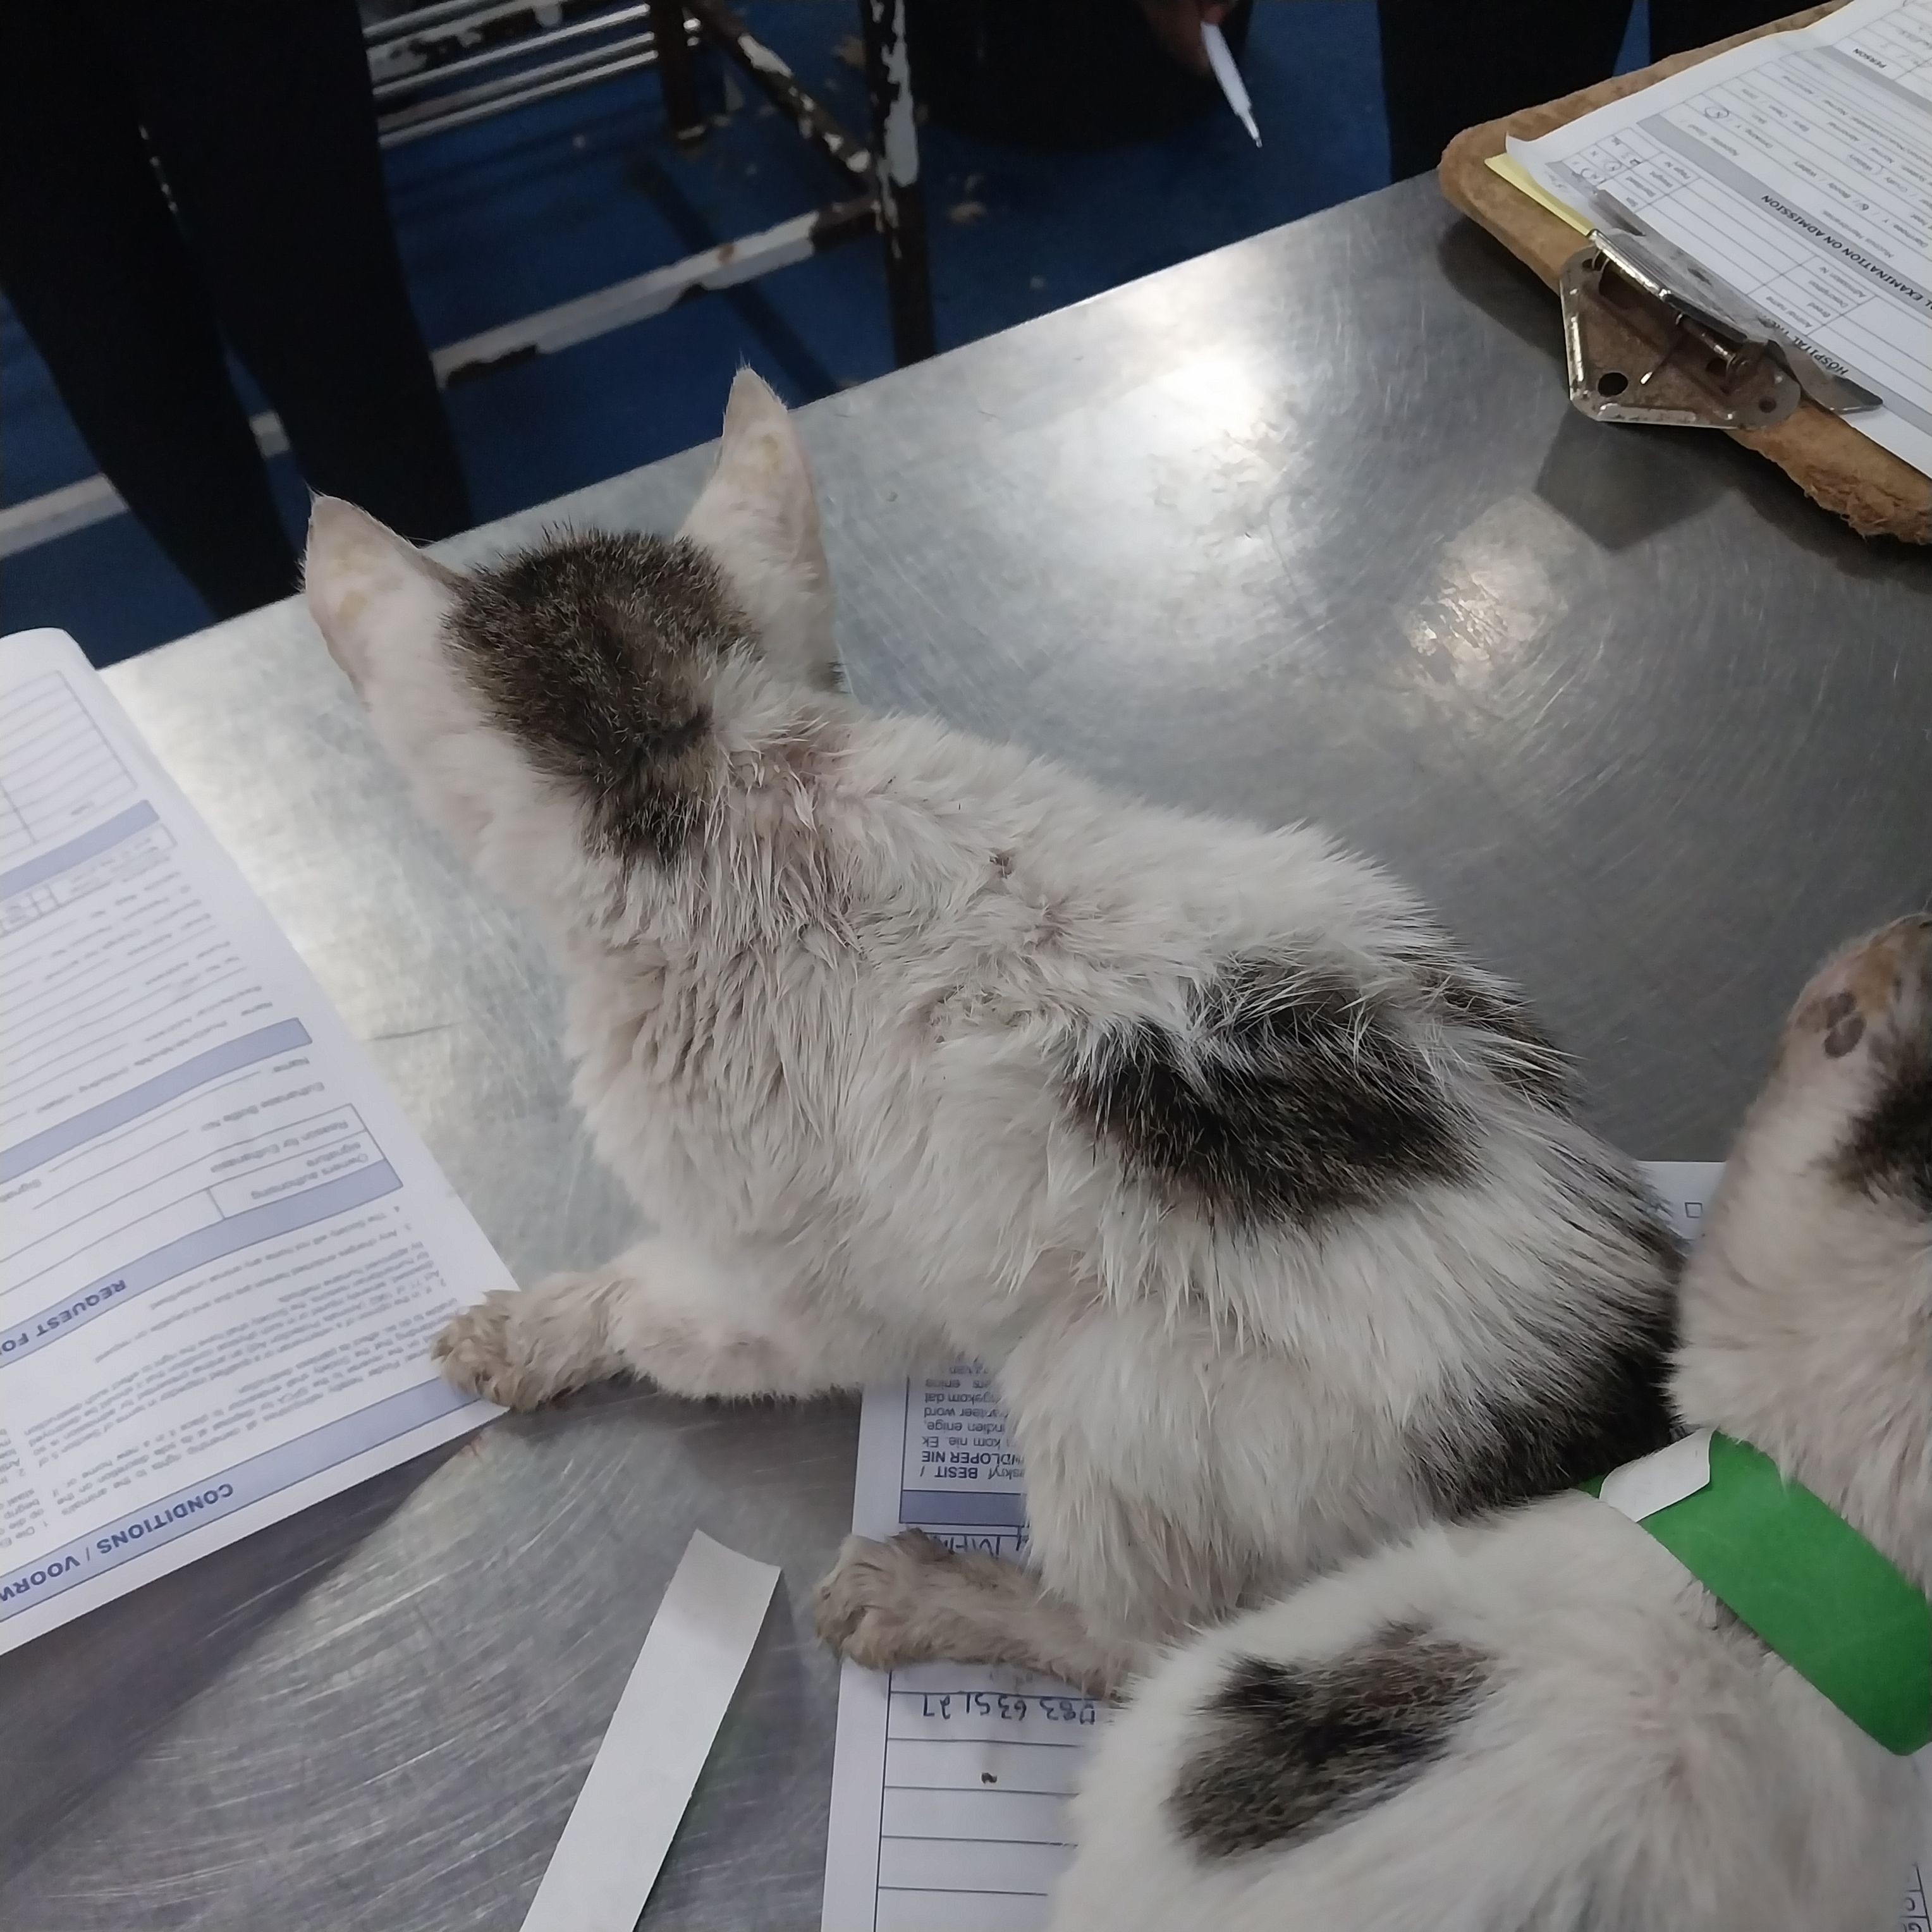
Photographic Evidence C
Date taken: 15 February 2024
Address: Cape of Good Hope SPCA, Grassy Park
Taken by: Inspector Jeffrey Mfini
Taken with: Samsung Galaxy A23 Cellular Phone Camera
Photograph 2: Showing a close up of one of the kittens seen in Photograph 1. Note the kitten’s dirty and ungroomed coat.

Slide 3
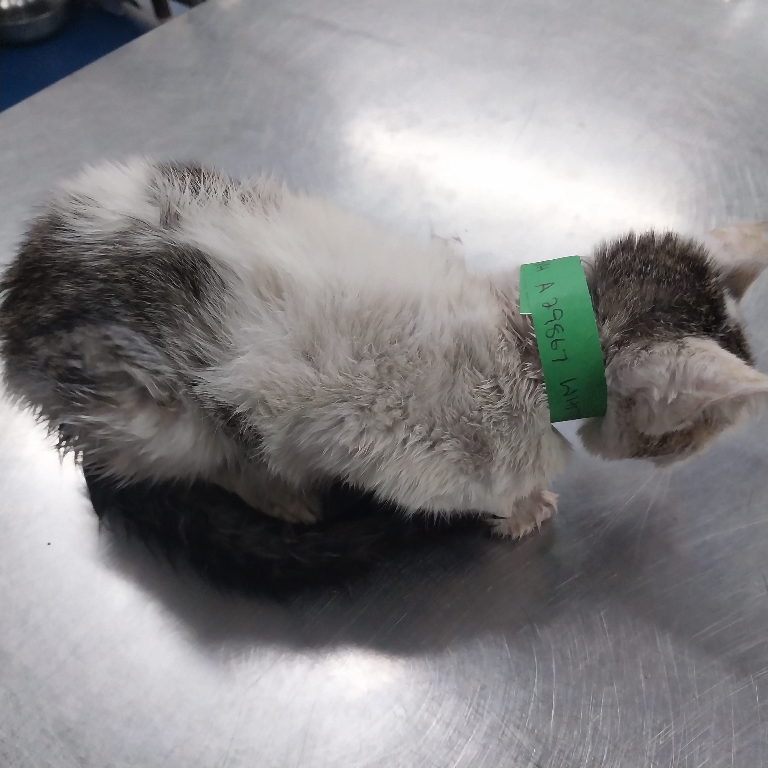
Photographic Evidence C
Date taken: 15 February 2024
Address: Cape of Good Hope SPCA, Grassy Park
Taken by: Inspector Jeffrey Mfini
Taken with: Samsung Galaxy A23 Cellular Phone Camera
Photograph 3: Showing the right side of the kitten seen in Photograph 2. Note the kitten’s dirty coat.

Slide 4
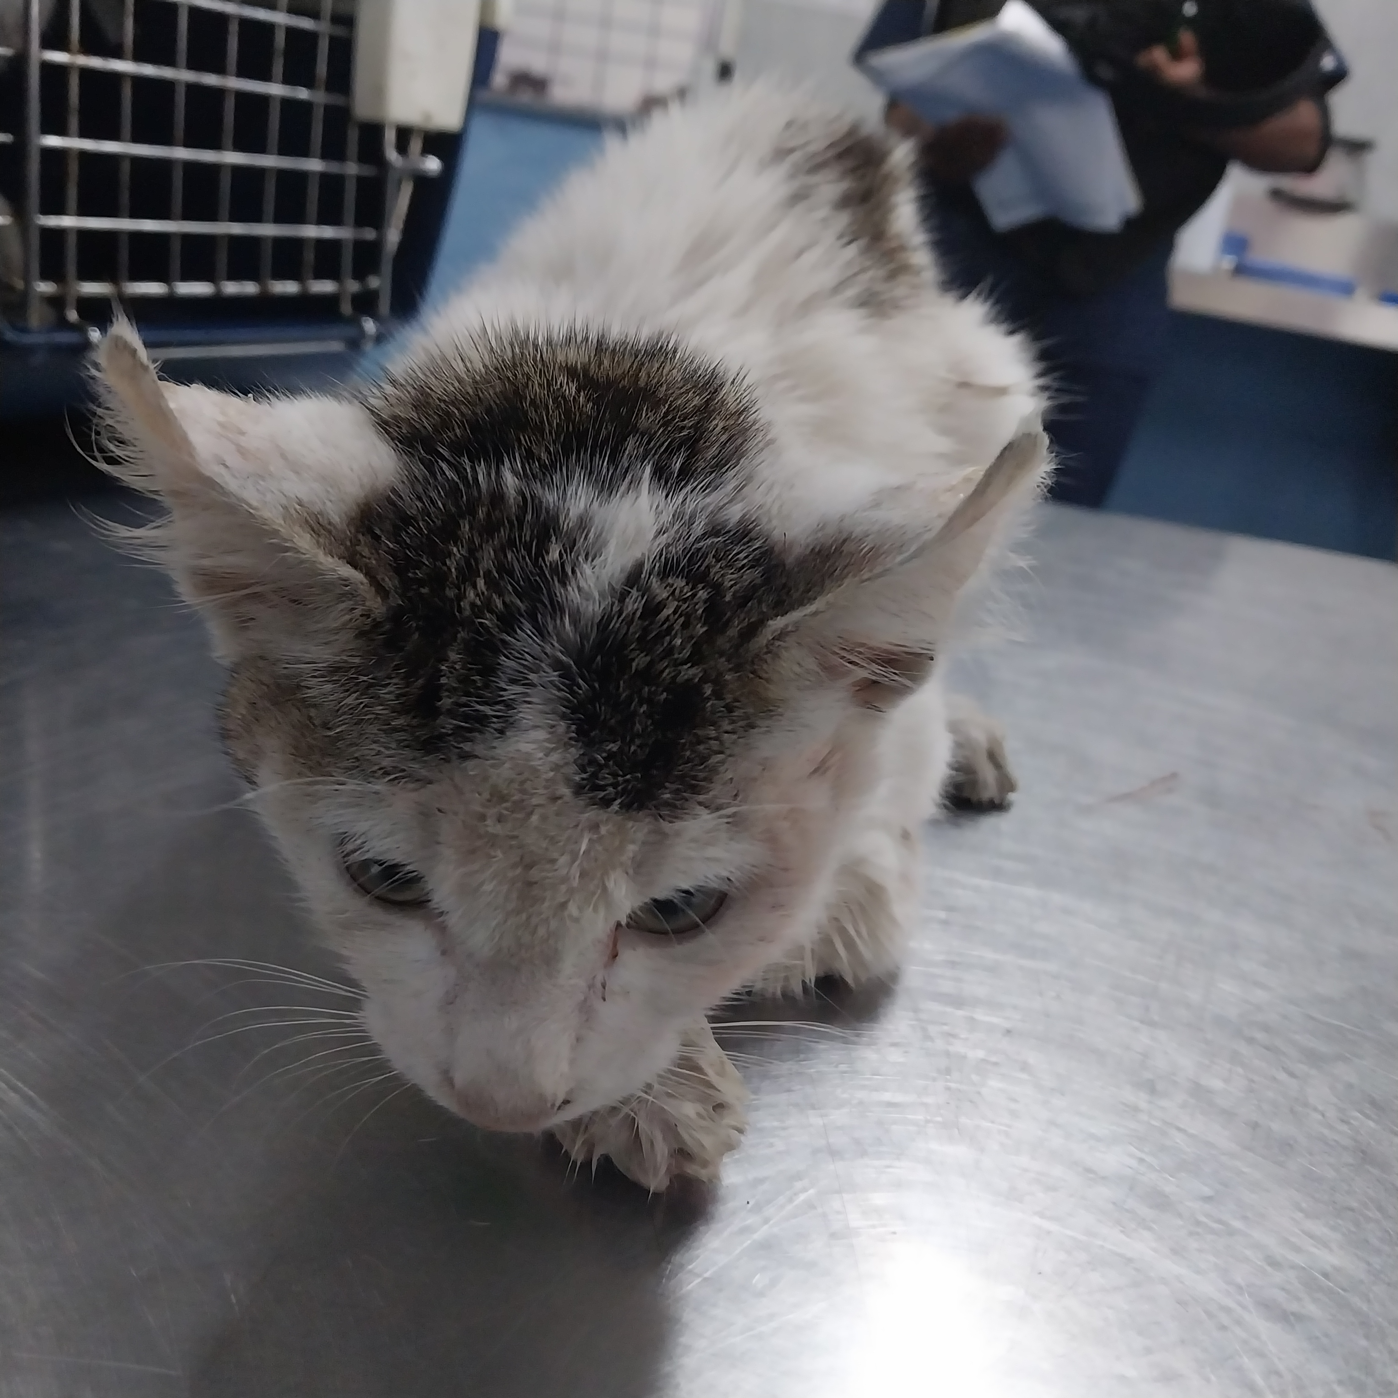
Photographic Evidence C
Date taken: 15 February 2024
Address: Cape of Good Hope SPCA, Grassy Park
Taken by: Inspector Jeffrey Mfini
Taken with: Samsung Galaxy A23 Cellular Phone Camera
Photograph 4: Showing the front of the sickly kitten seen in Photograph 3. Note the flea dirt by the kitten’s nose and the kitten’s pale membranes.

Slide 5
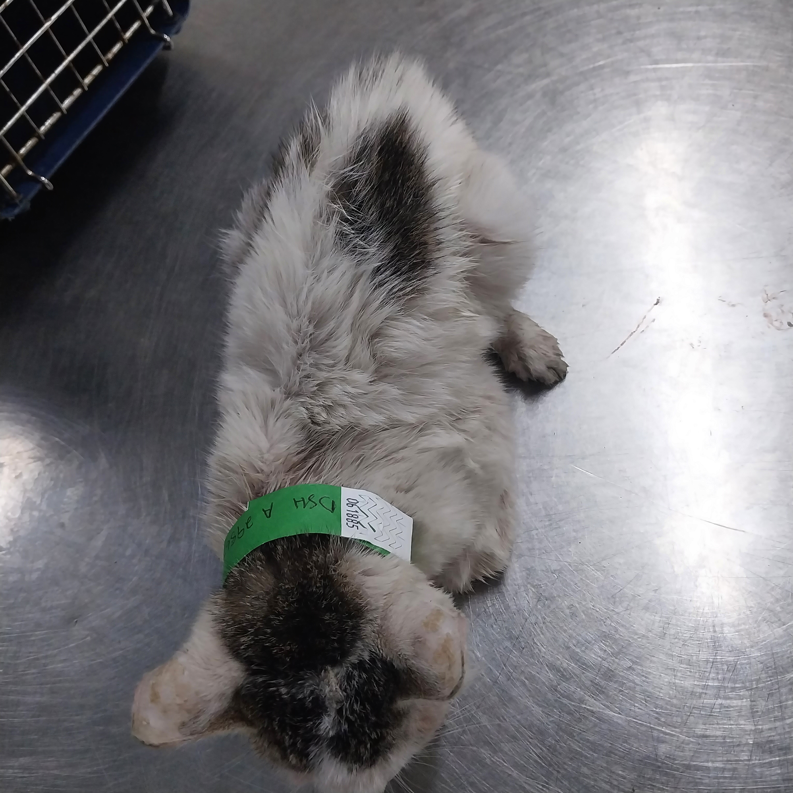
Photographic Evidence C
Date taken: 15 February 2024
Address: Cape of Good Hope SPCA, Grassy Park
Taken by: Inspector Jeffrey Mfini
Taken with: Samsung Galaxy A23 Cellular Phone Camera
Photograph 1: Showing the top of the kitten seen in Photograph 4. Note the kitten appears to be underweight and its dirty coat.

