Slide 1

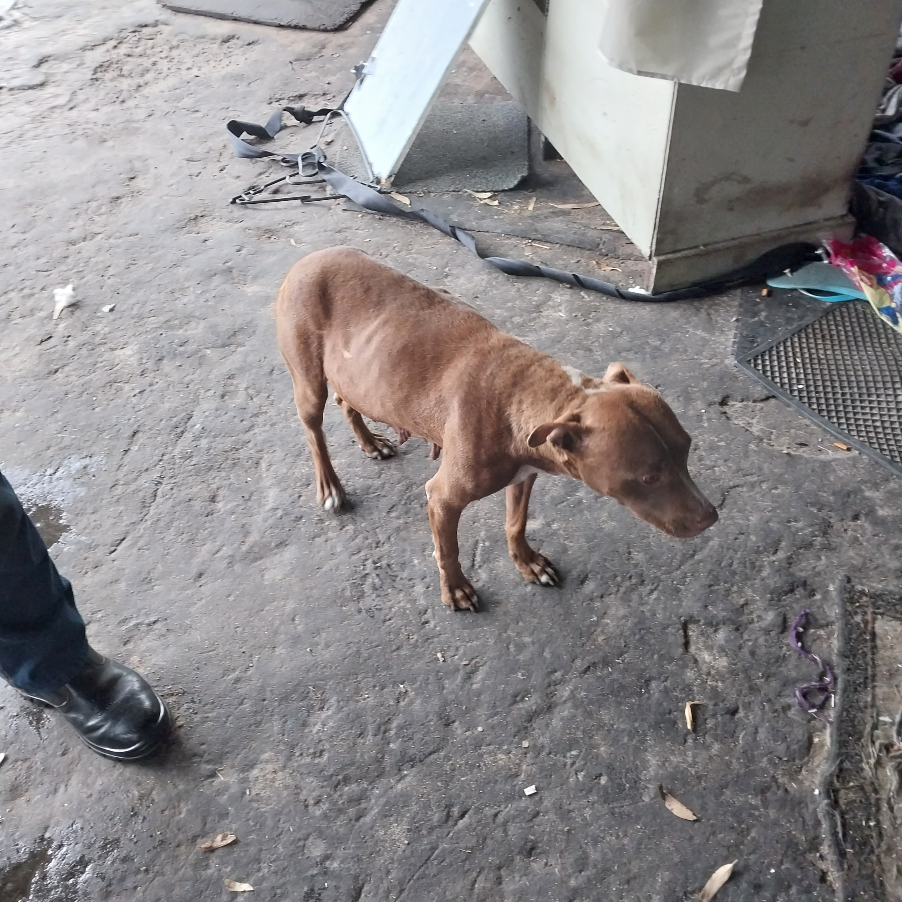
Photographic Evidence B
Date taken: 15 February 2024
Address: 111 Cypress Way, Mitchells Plain
Taken by: Inspector Jeffrey Mfini
Taken with: Samsung Galaxy A23 Cellular Phone Camera
Photograph 1: Showing the brown Pitbull seen in Photographic Evidence A. The Pitbull still has nursing puppies and appears to be heavily pregnant again. Note the dog’s coarse coat which can be a sign of poor condition.

Slide 2
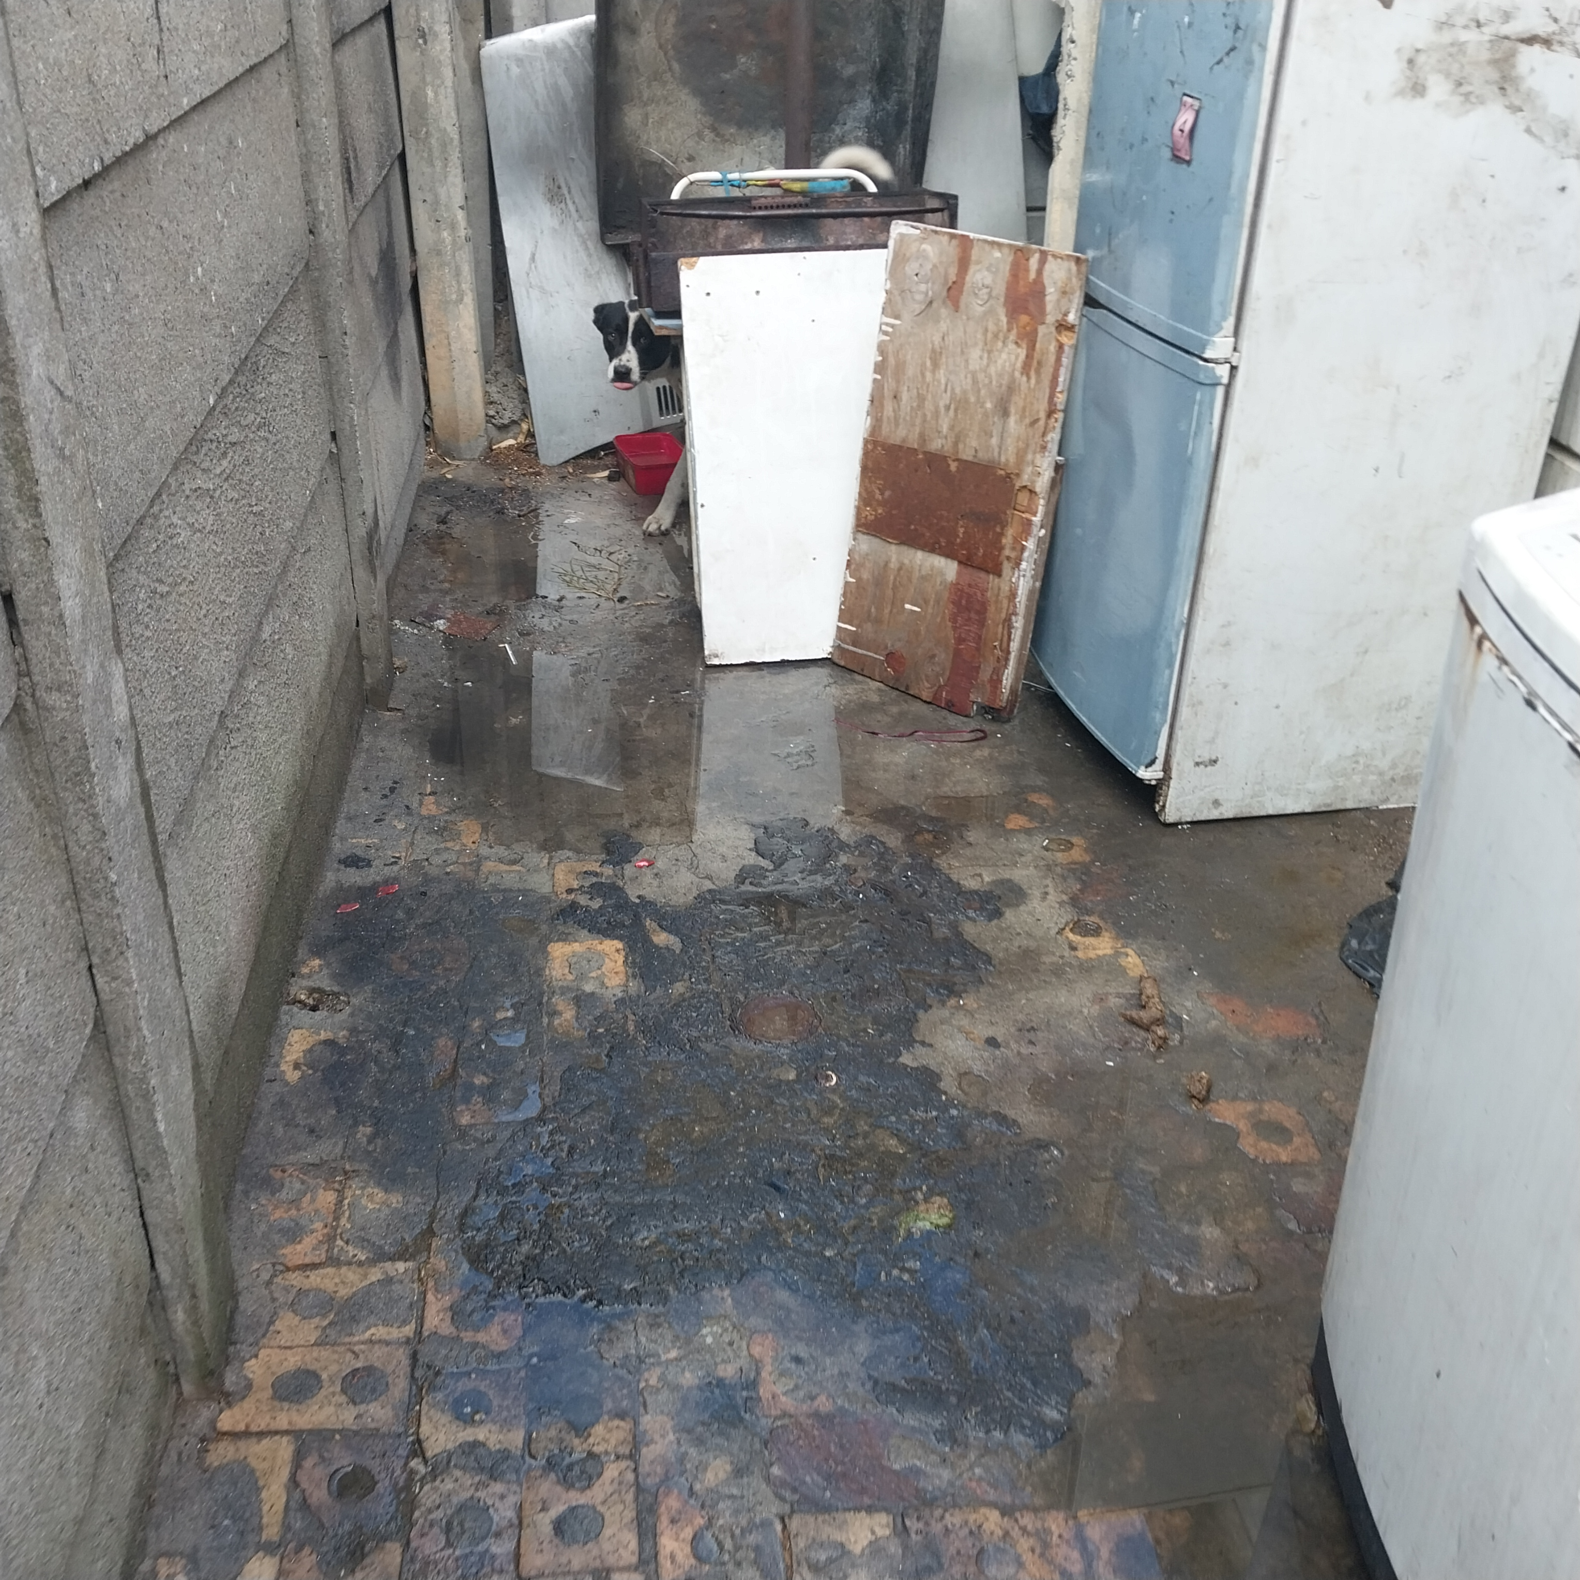
Photographic Evidence B
Date taken: 15 February 2024
Address: 111 Cypress Way, Mitchells Plain
Taken by: Inspector Jeffrey Mfini
Taken with: Samsung Galaxy A23 Cellular Phone Camera
Photograph 2: Showing the white and black dog seen in Photographic Evidence B. The dog is tethered among rubble. Note the area and rubble is wet from the rain.

Slide 3
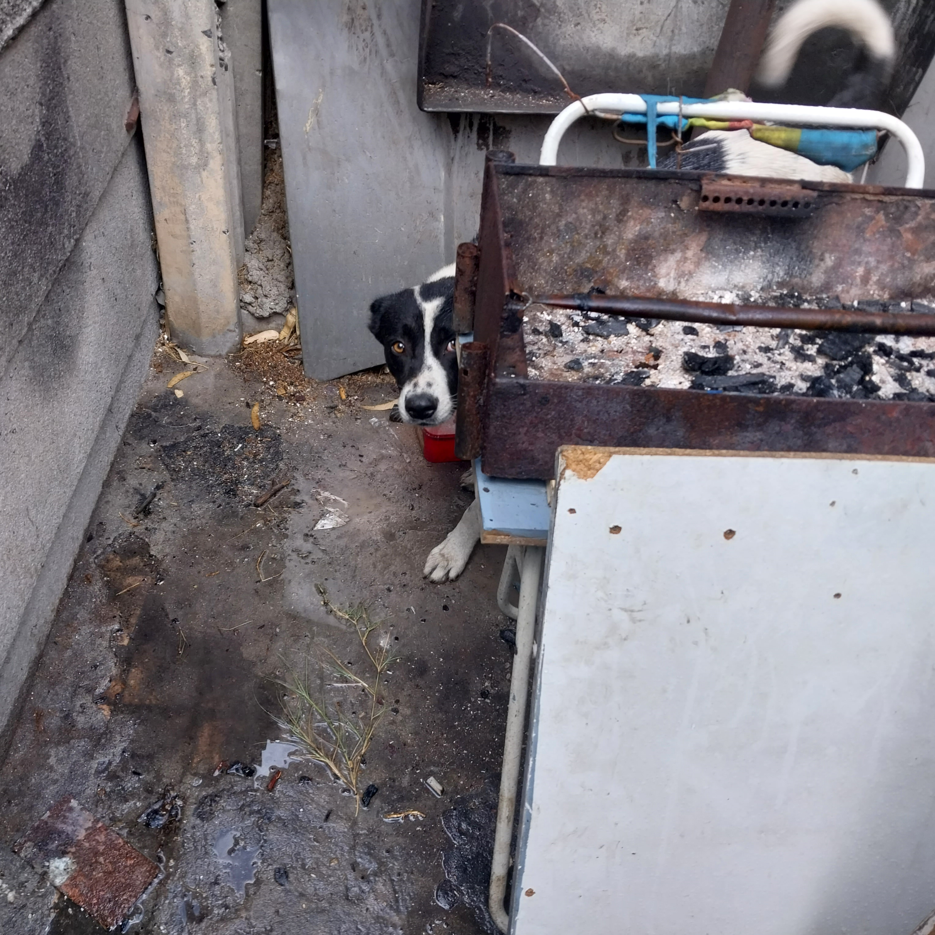
Photographic Evidence B
Date taken: 15 February 2024
Address: 111 Cypress Way, Mitchells Plain
Taken by: Inspector Jeffrey Mfini
Taken with: Samsung Galaxy A23 Cellular Phone Camera
Photograph 3: Showing a close up of the dog seen in Photograph 2. The dog is tethered in a wet area containing rubble. Note the dog does not have access to adequate space.

Slide 4
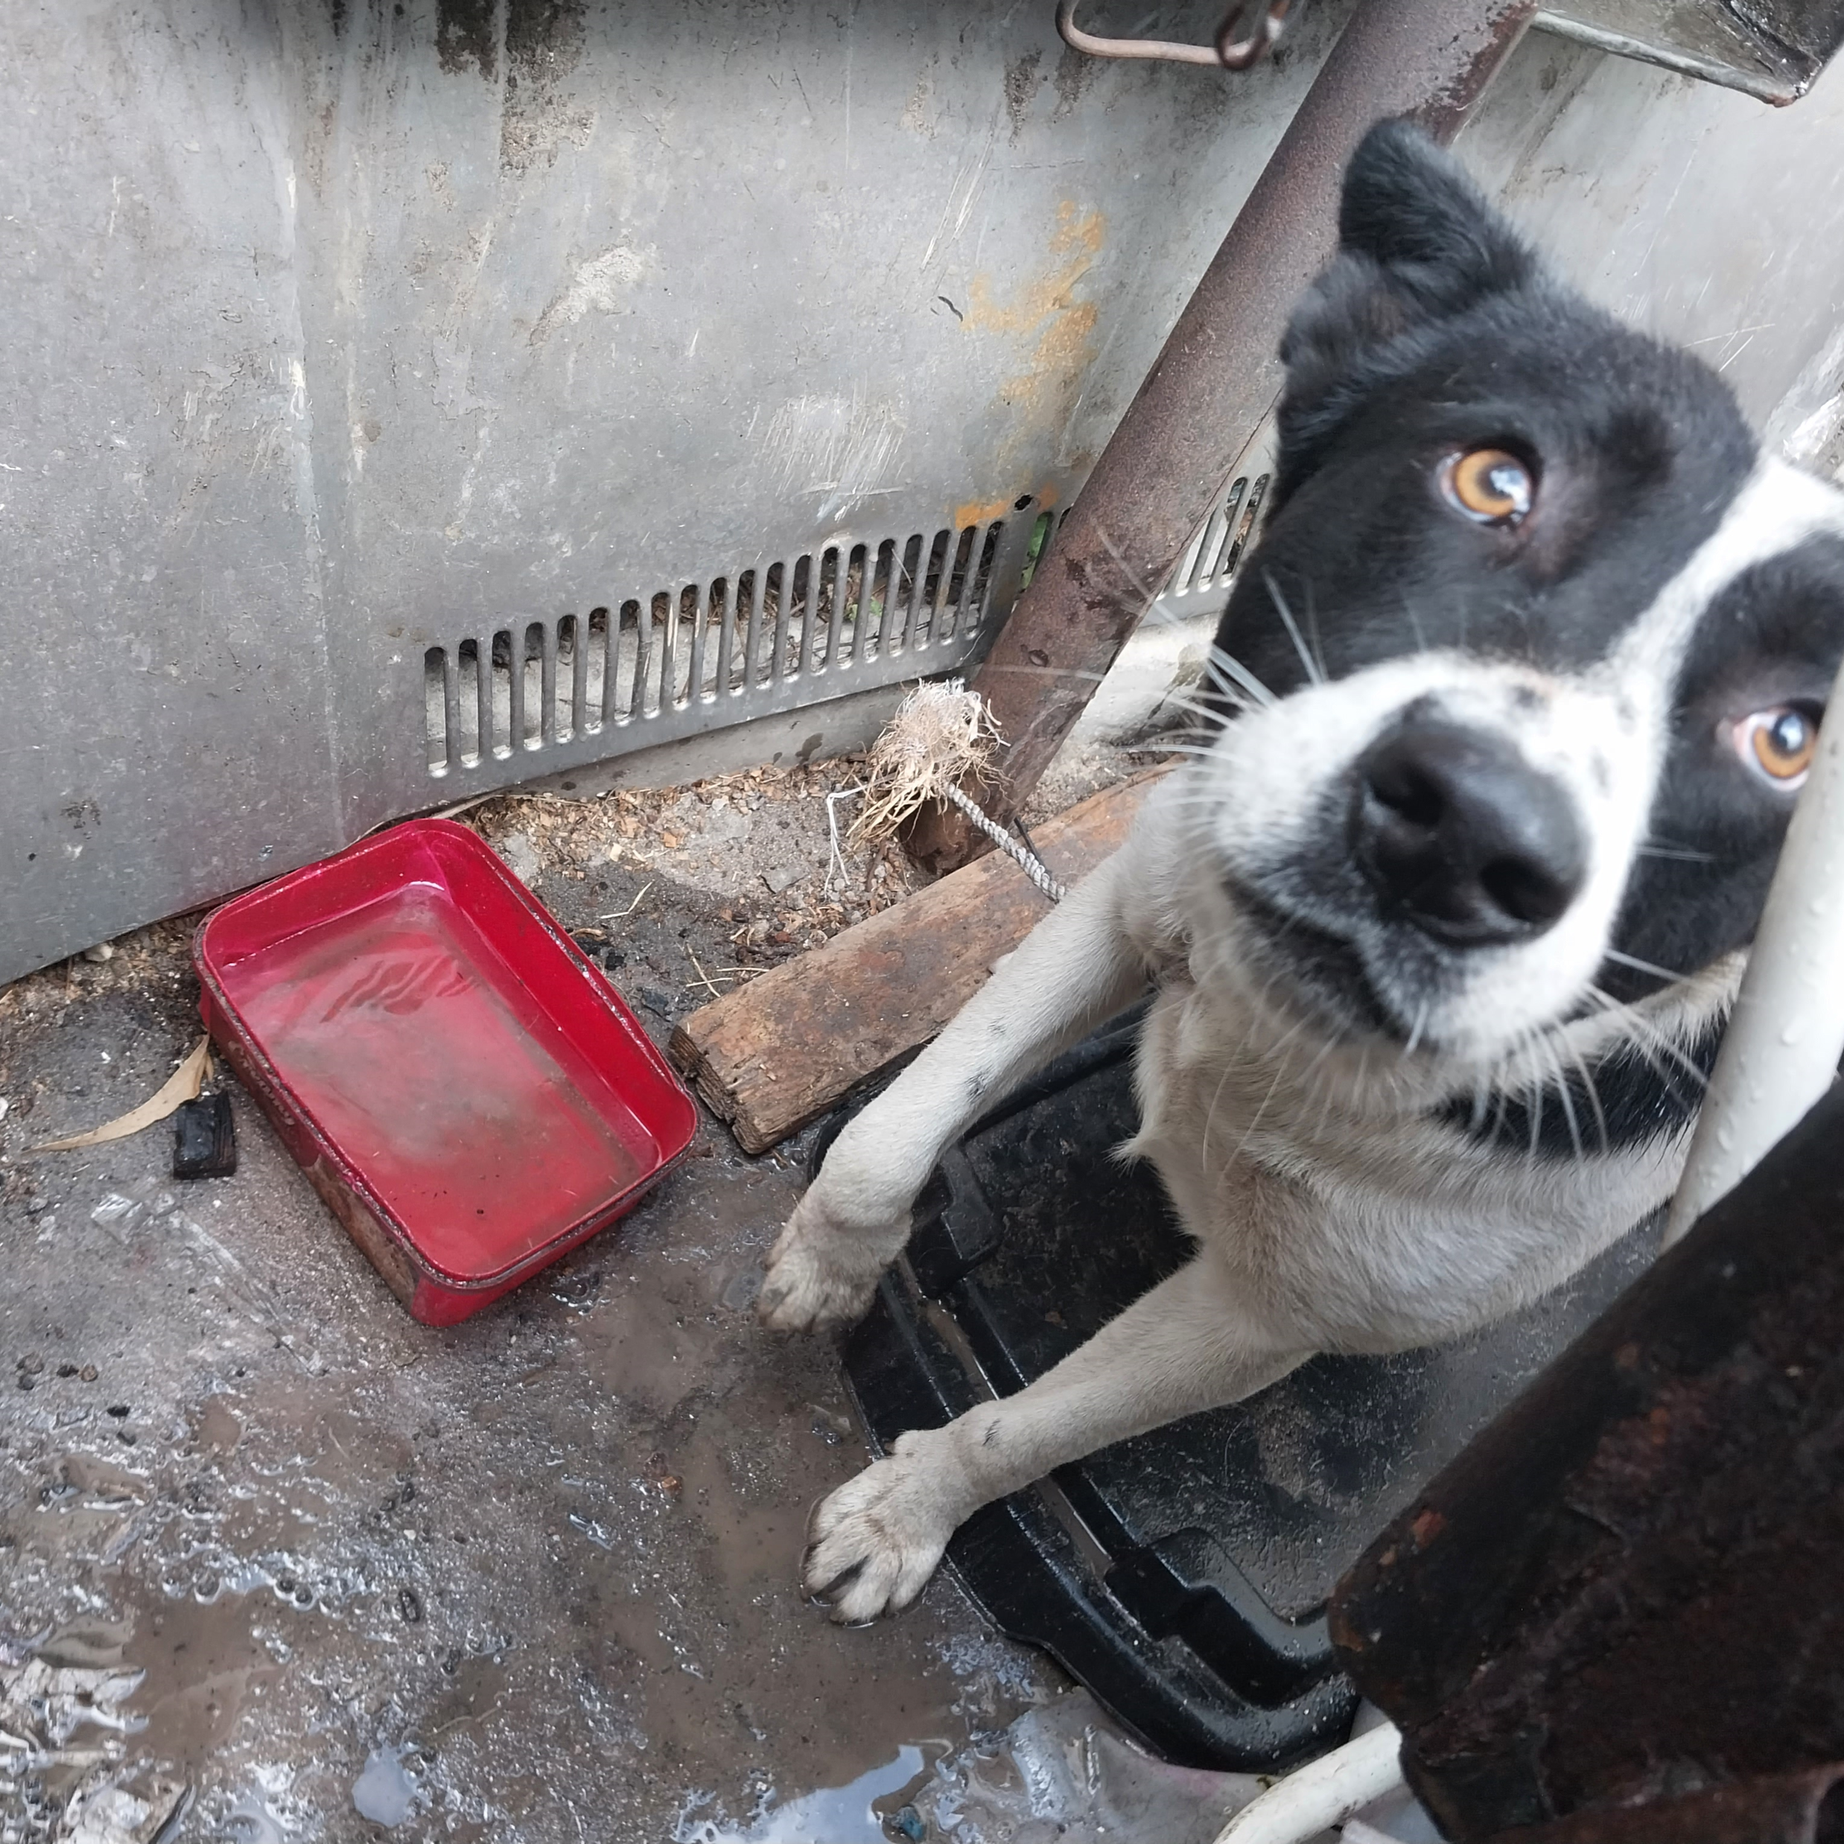
Photographic Evidence B
Date taken: 15 February 2024
Address: 111 Cypress Way, Mitchells Plain
Taken by: Inspector Jeffrey Mfini
Taken with: Samsung Galaxy A23 Cellular Phone Camera
Photograph 4: Showing the dog seen in Photographs 2 to 3. Note the dog is wet and tethered with a short rope. The dog is wet because it does not have access to adequate shelter when its raining. Note the dog does not have access to adequate space.

Slide 5
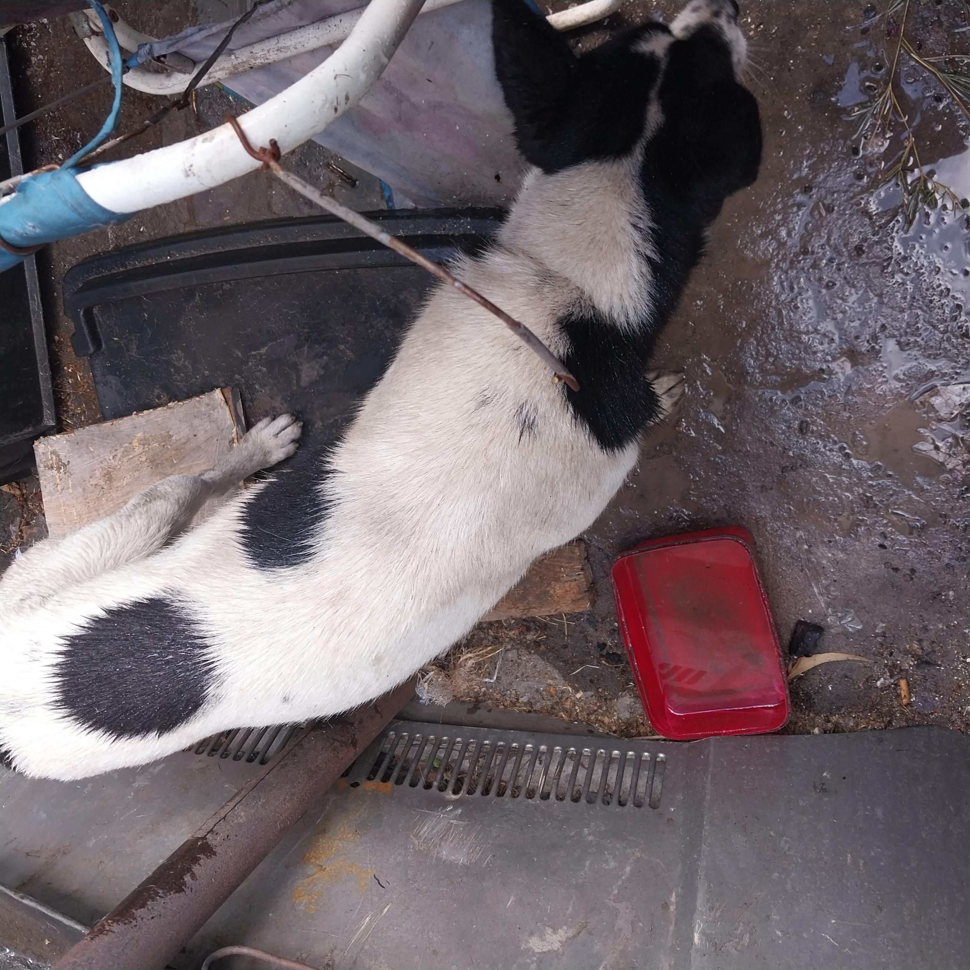
Photographic Evidence B
Date taken: 15 February 2024
Address: 111 Cypress Way, Mitchells Plain
Taken by: Inspector Jeffrey Mfini
Taken with: Samsung Galaxy A23 Cellular Phone Camera
Photograph 5: Showing the dog seen in Photograph 4. Note the dog is wet and tethered with a short rope. The dog is wet because it does not have access to adequate shelter when its raining. Note the dog does not have access to adequate space.

Slide 6
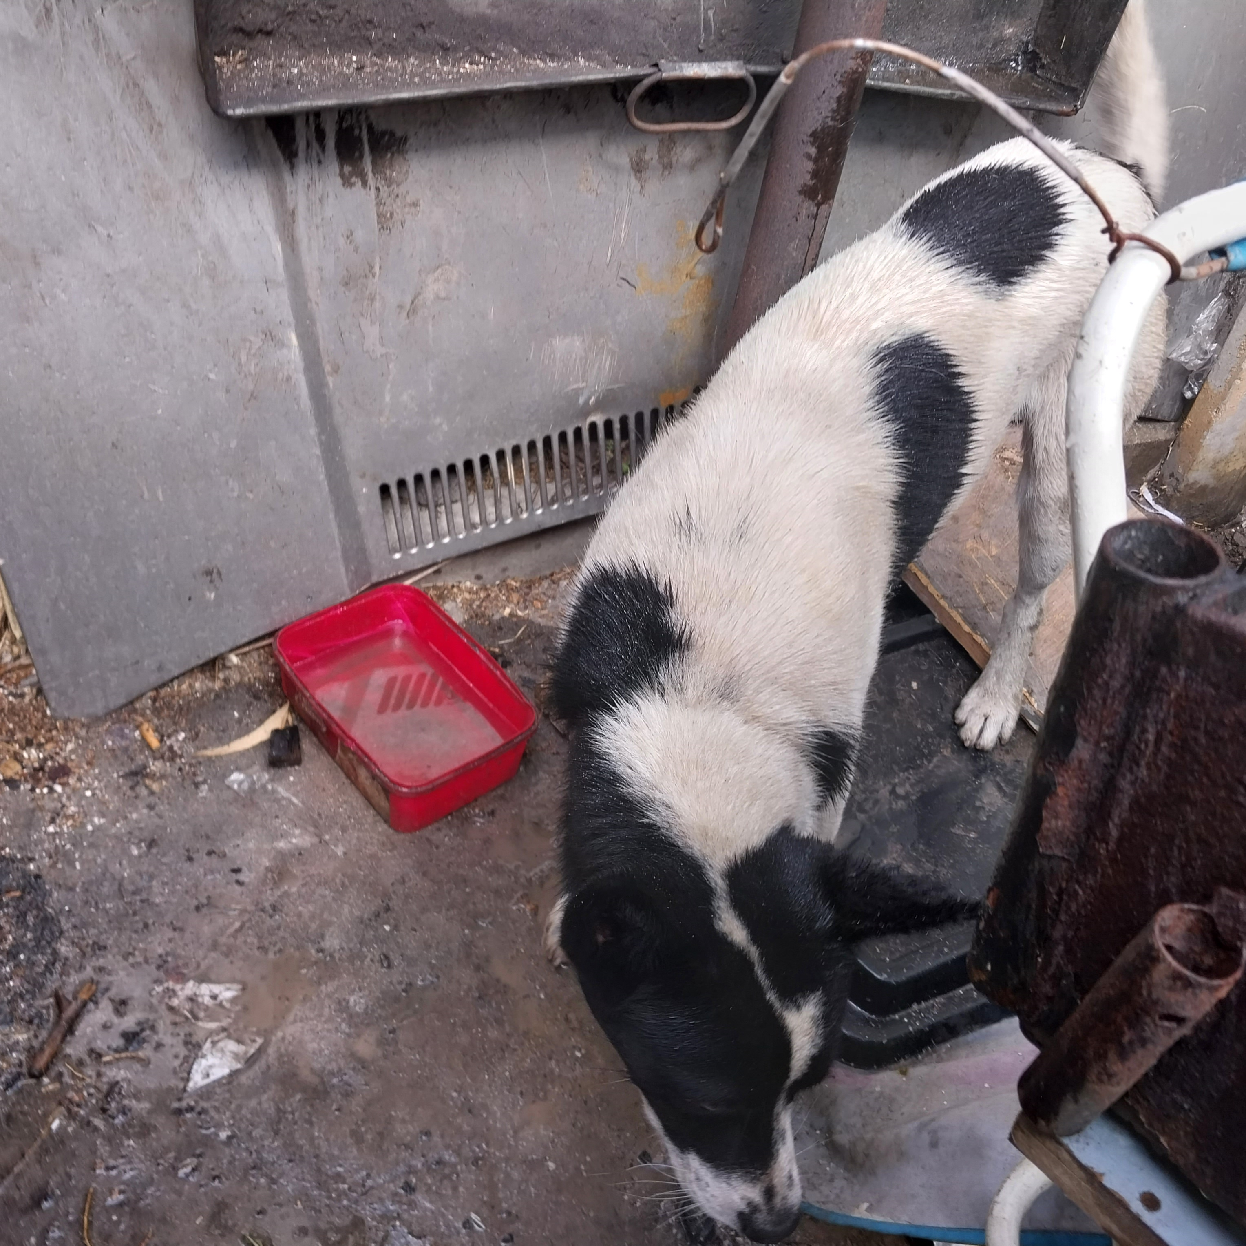
Photographic Evidence B
Date taken: 15 February 2024
Address: 111 Cypress Way, Mitchells Plain
Taken by: Inspector Jeffrey Mfini
Taken with: Samsung Galaxy A23 Cellular Phone Camera
Photograph 6: Showing a wet white and black dog tethered without access to shelter. Note the dog is wet because it does not have shelter from the rain. Note the dog does not have access to adequate space.

Slide 7
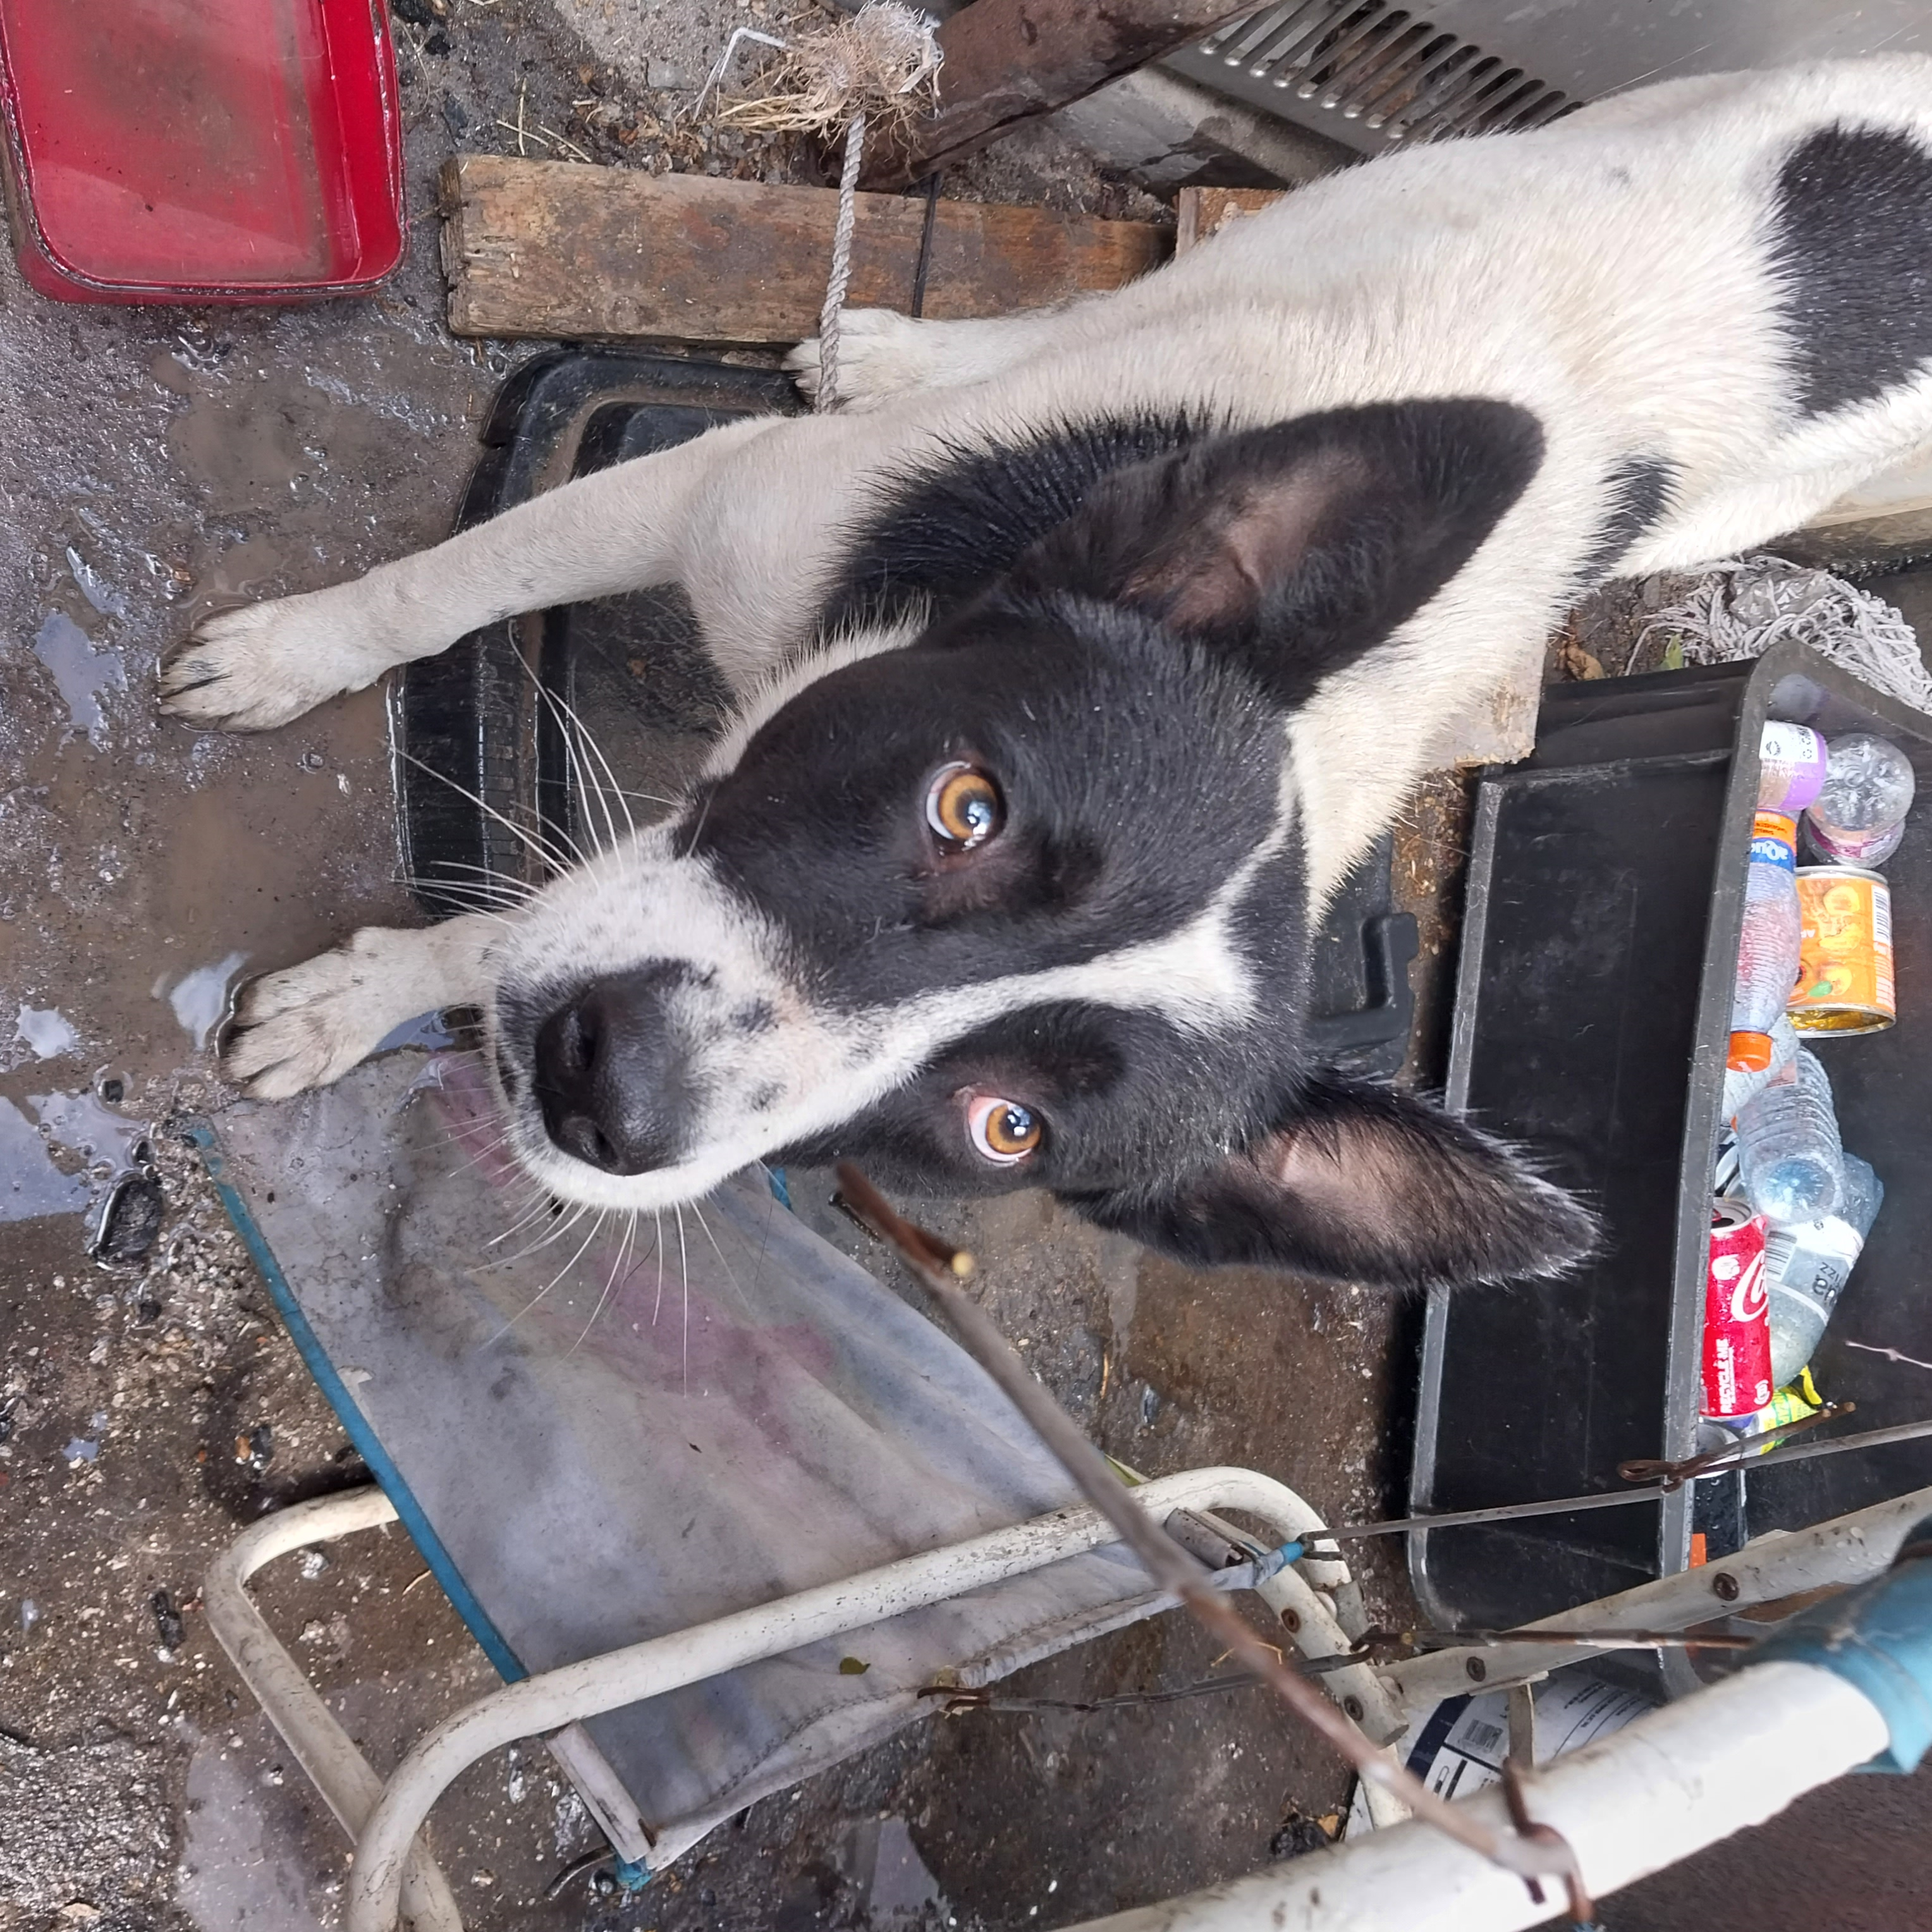
Photographic Evidence B
Date taken: 15 February 2024
Address: 111 Cypress Way, Mitchells Plain
Taken by: Inspector Jeffrey Mfini
Taken with: Samsung Galaxy A23 Cellular Phone Camera
Photograph 7: Showing a wet white and black dog tethered among rubble and without access to shelter. Note the dog is wet because it does not have shelter from the rain. Note the dog does not have access to adequate space.

Slide 8
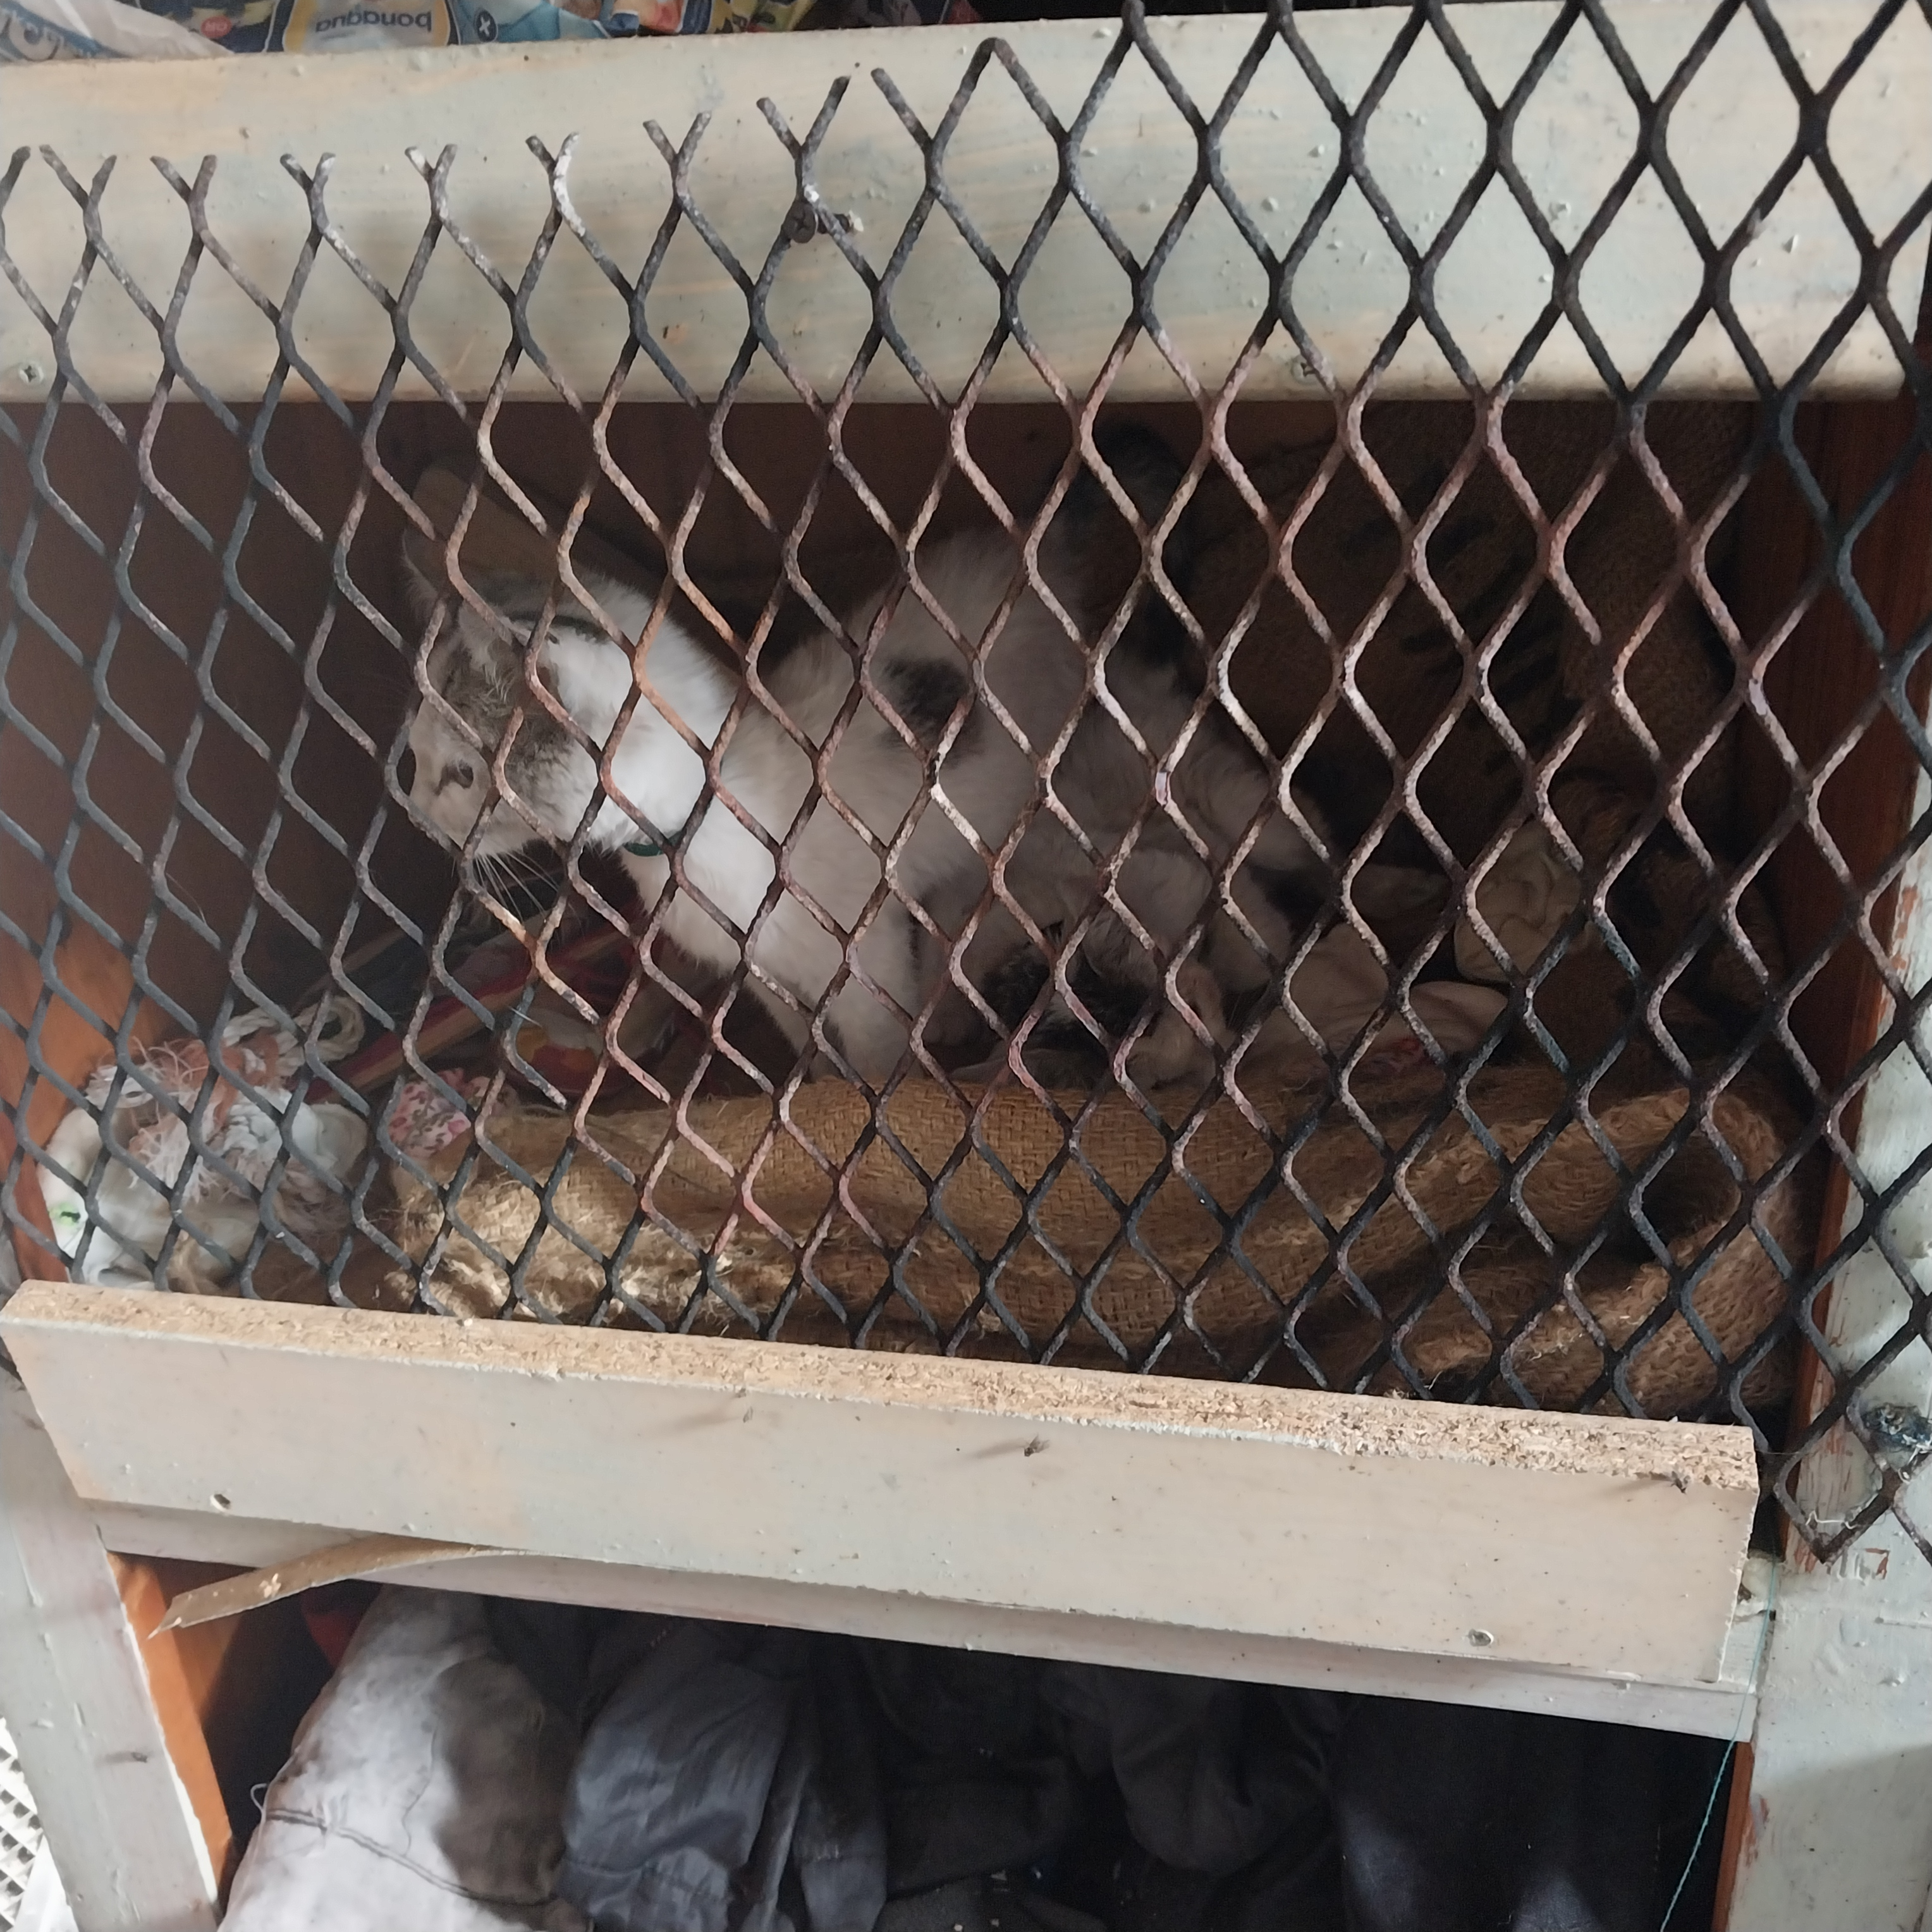
Photographic Evidence B
Date taken: 15 February 2024
Address: 111 Cypress Way, Mitchells Plain
Taken by: Inspector Jeffrey Mfini
Taken with: Samsung Galaxy A23 Cellular Phone Camera
Photograph 8: Showing kittens confined to a small cage on the property. Note there is no water provided to the kittens inside the cage. Note one of the kittens is lying down in the cage.

Slide 9
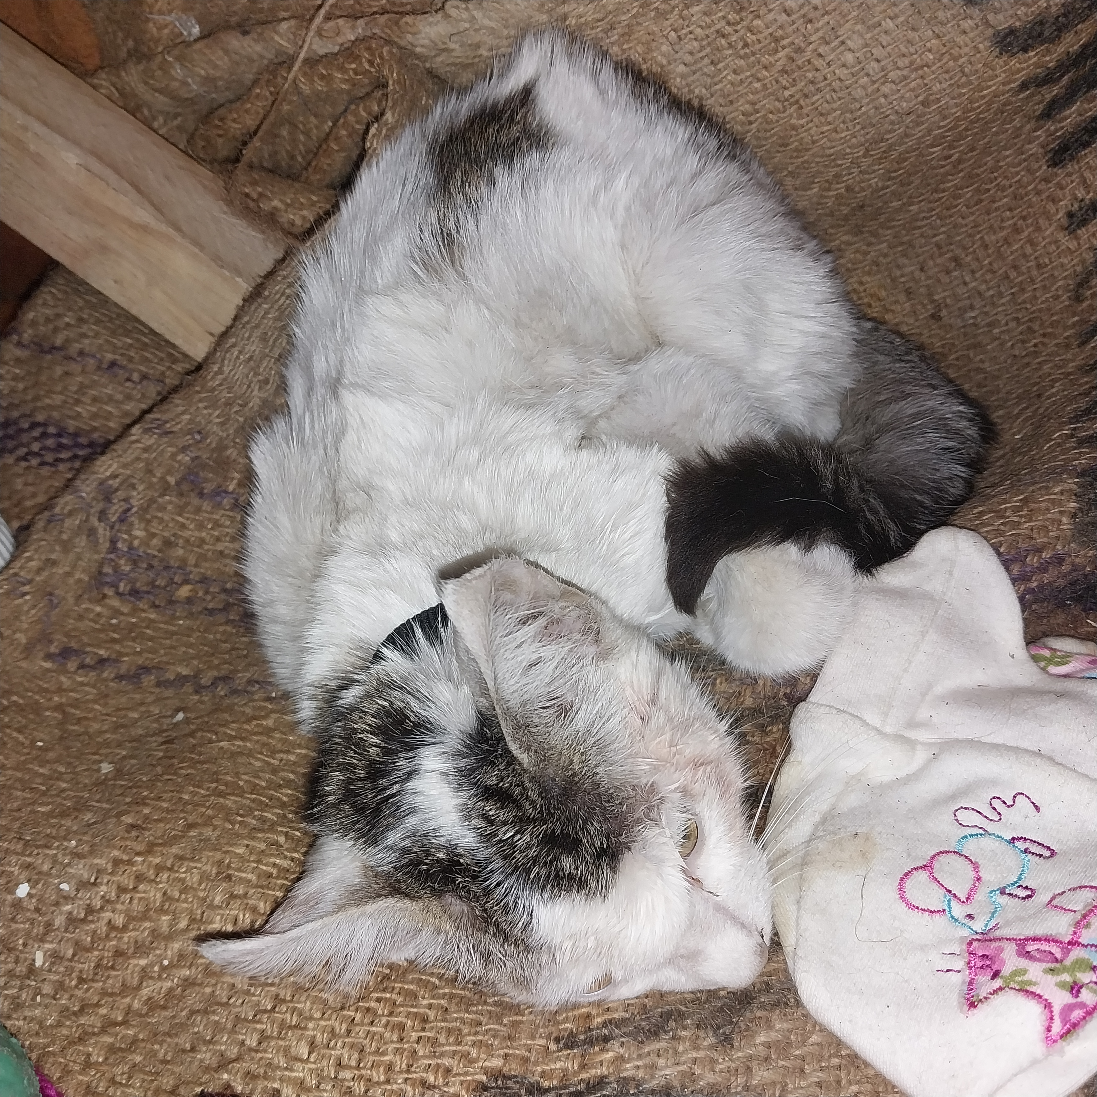
Photographic Evidence B
Date taken: 15 February 2024
Address: 111 Cypress Way, Mitchells Plain
Taken by: Inspector Jeffrey Mfini
Taken with: Samsung Galaxy A23 Cellular Phone Camera
Photograph 9: Showing a close up of one of the kittens in the cage seen in Photograph 8. Note the kitten appears sickly. Note the flea dirt all around the cat.

Slide 10
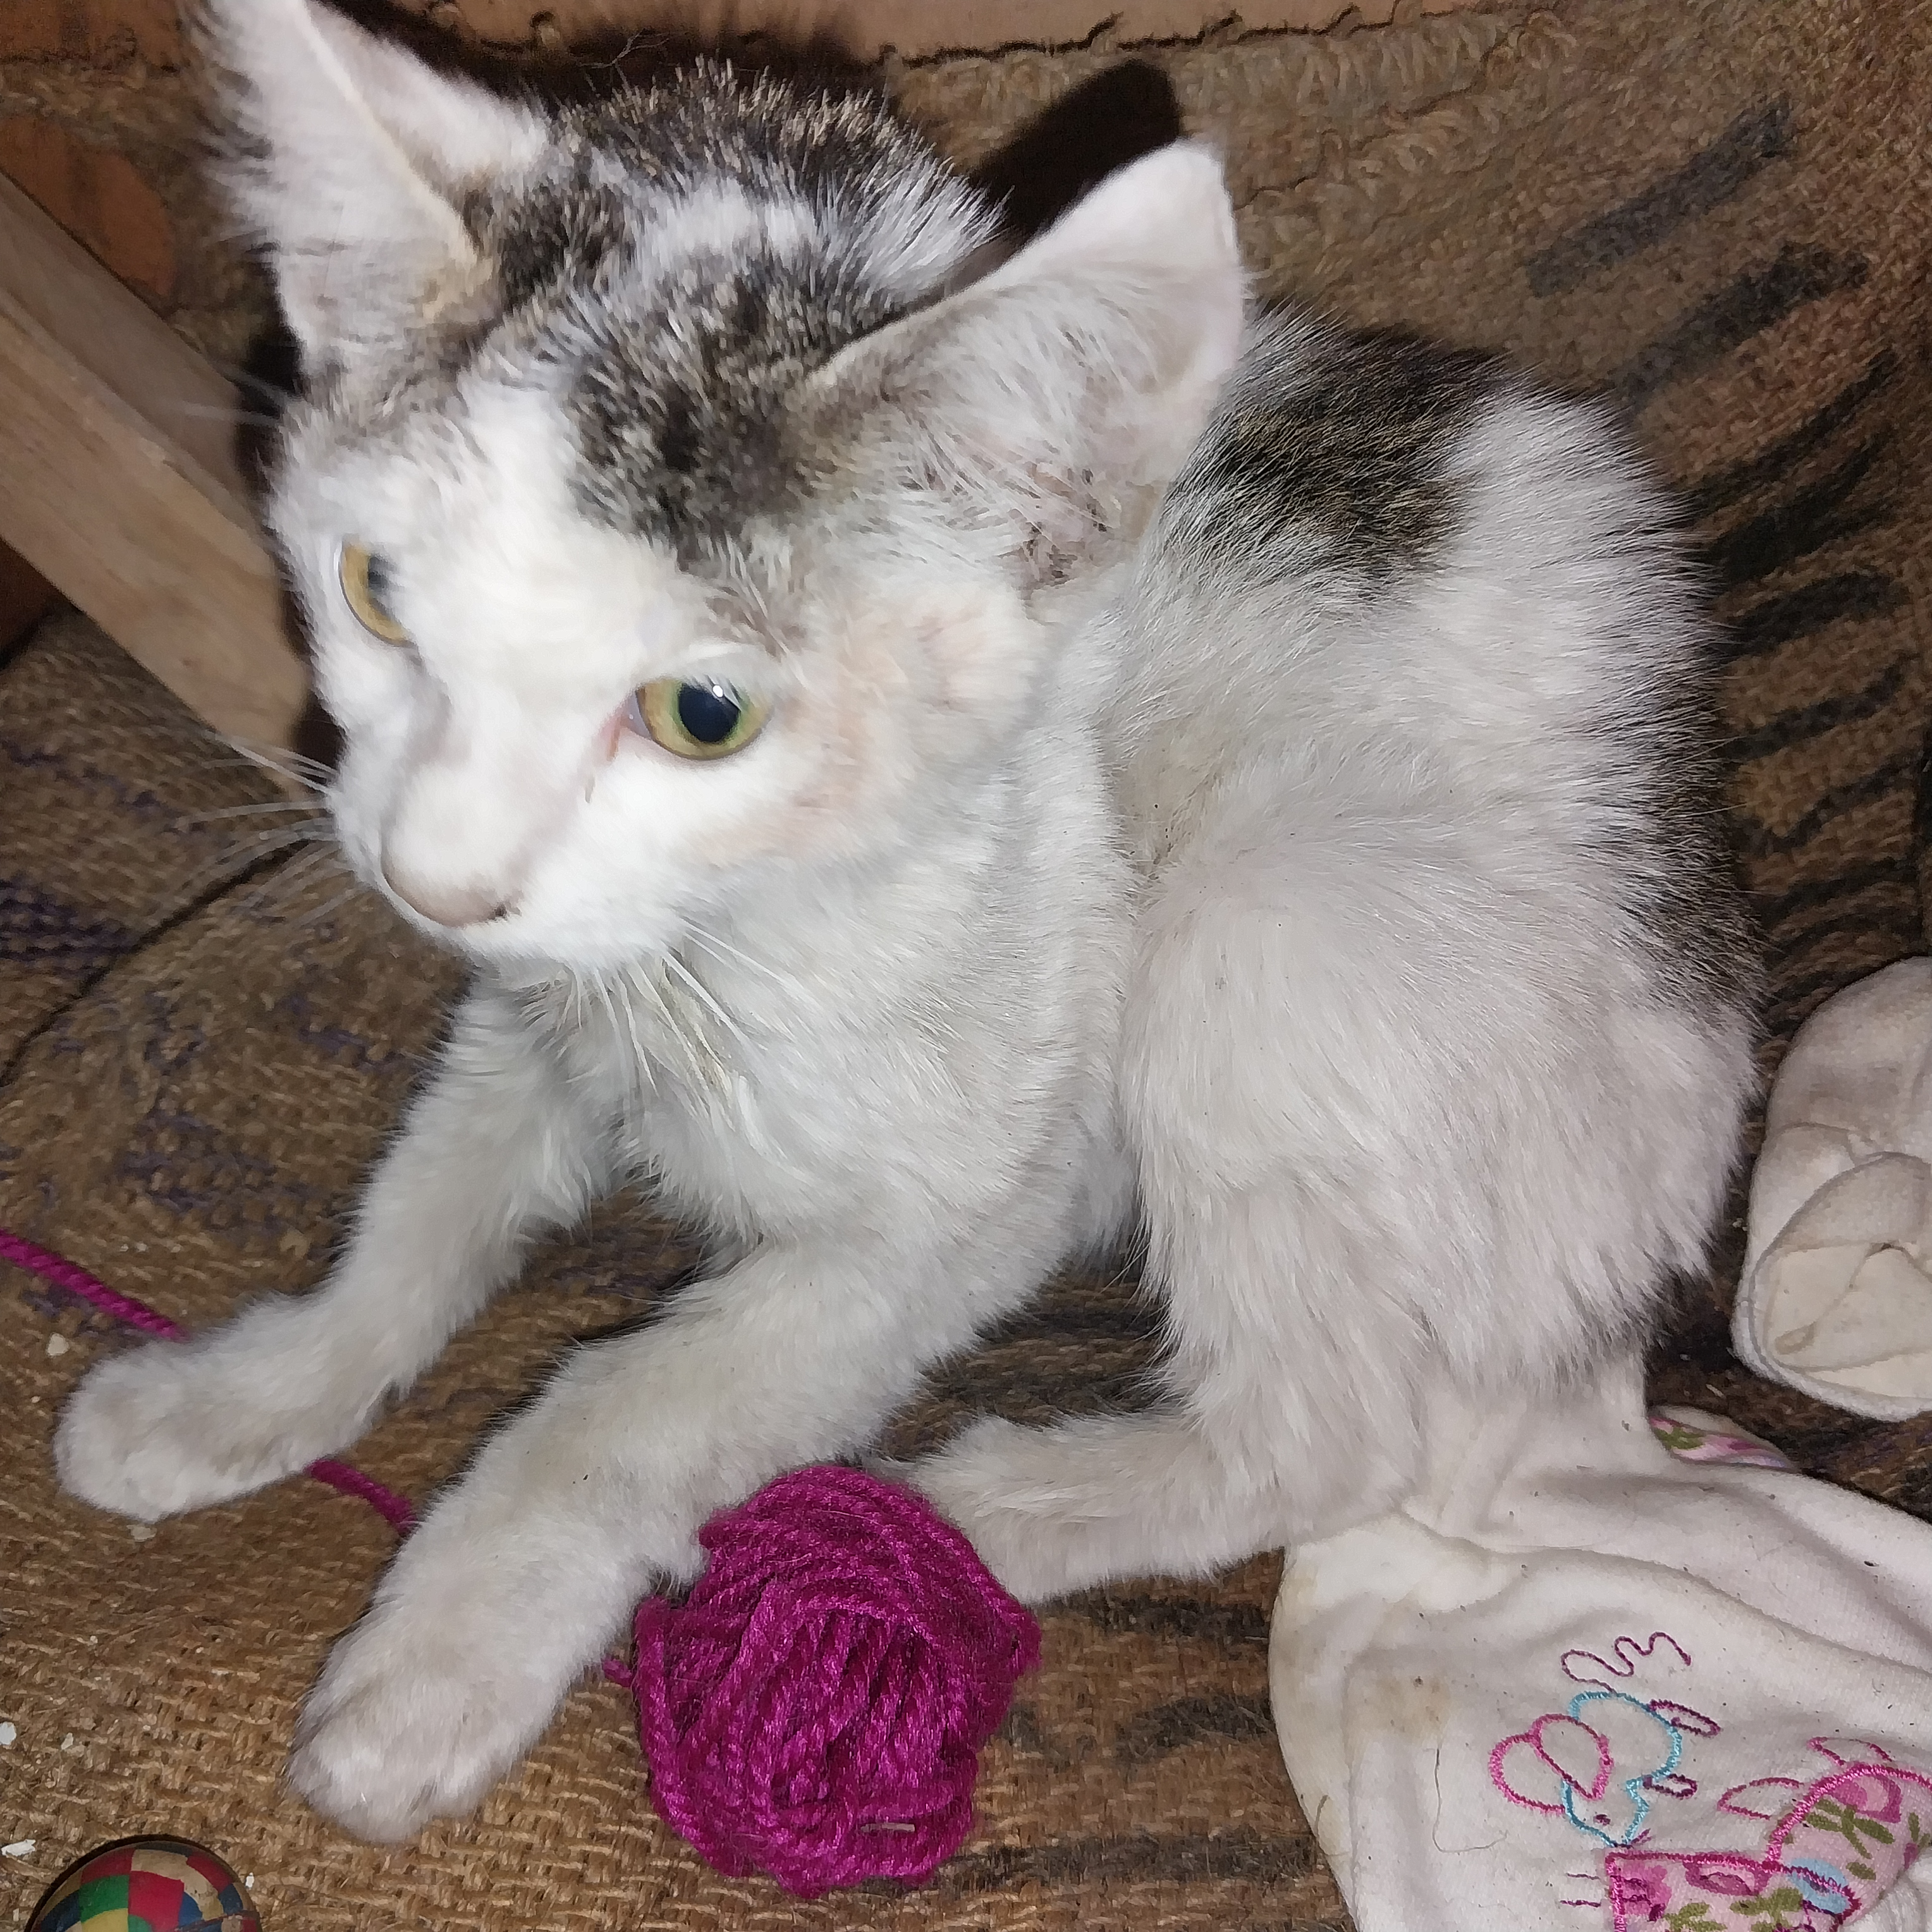
Photographic Evidence B
Date taken: 15 February 2024
Address: 111 Cypress Way, Mitchells Plain
Taken by: Inspector Jeffrey Mfini
Taken with: Samsung Galaxy A23 Cellular Phone Camera
Photograph 10: Showing the rough coat and pale membranes of the sickly kitten seen in Photograph 9. Note the flea dirt in the kitten’s ear and by its nose.

