Slide 1

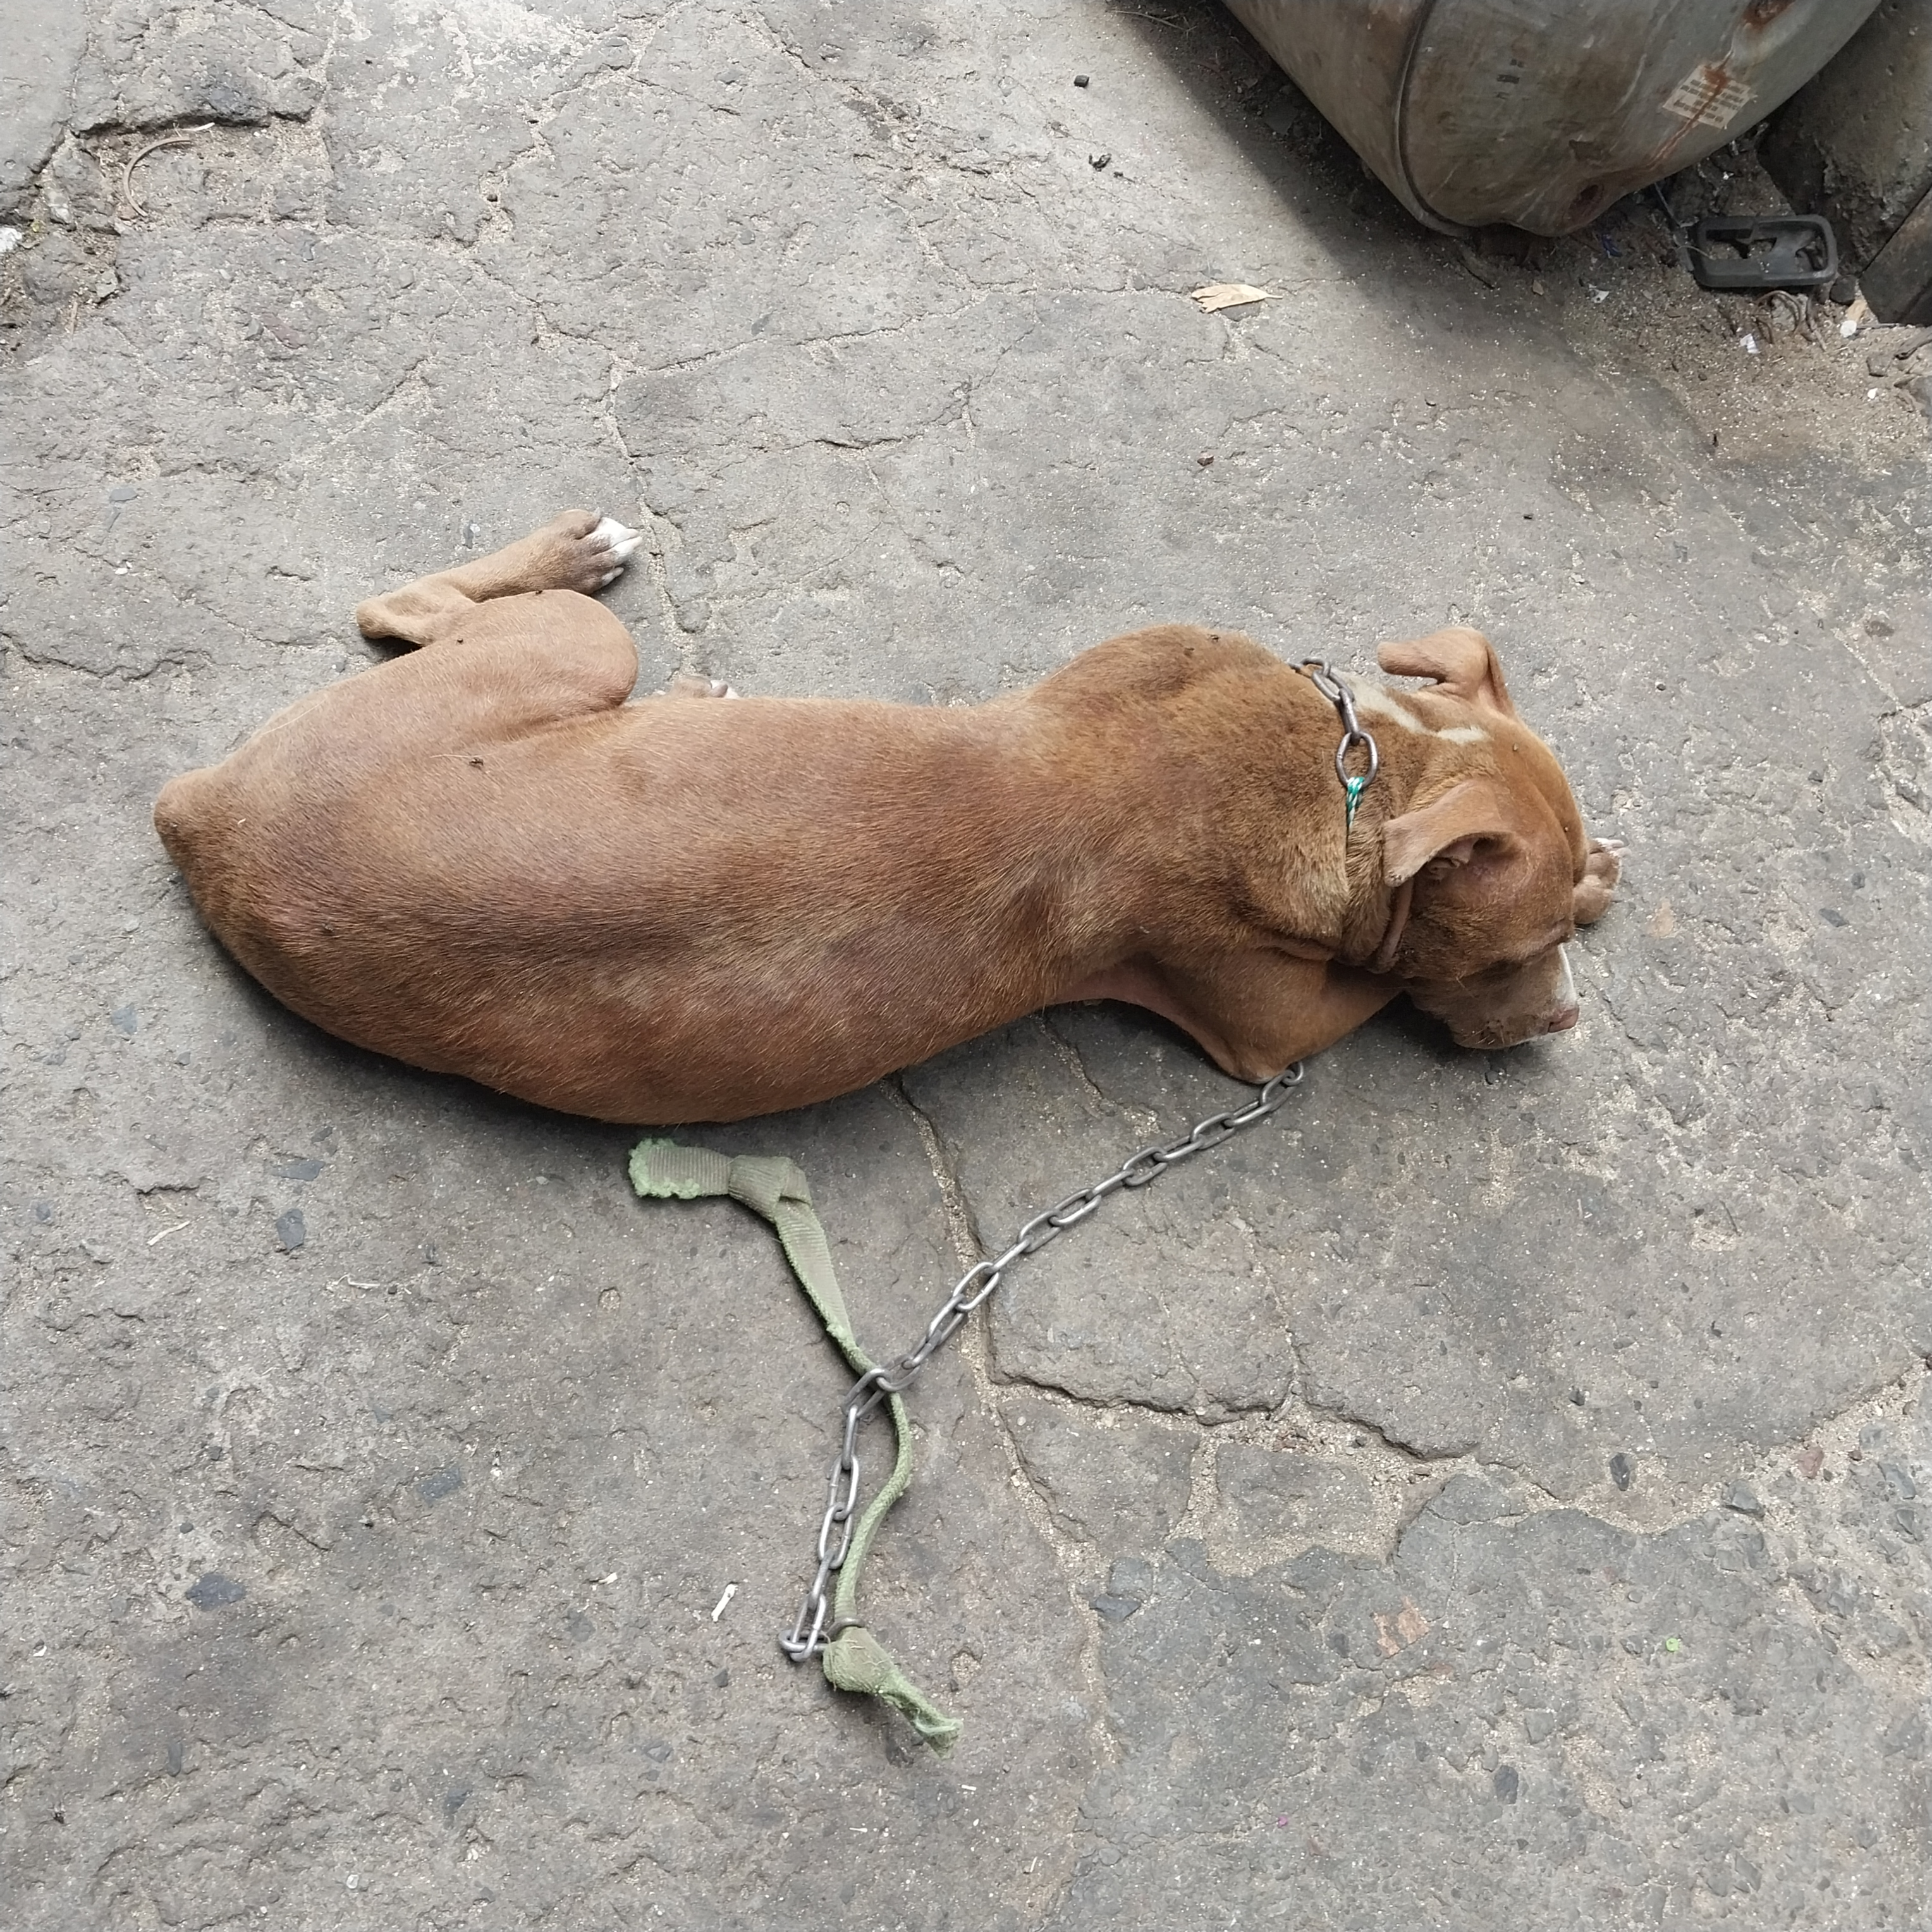
Photographic Evidence A
Date taken: 09 February 2024
Address: 111 Cypress Way, Mitchells Plain
Taken by: Inspector Jeffrey Mfini
Taken with: Samsung Galaxy A23 Cellular Phone Camera
Photograph 1: Showing a brown Pitbull with a chain secured around her neck. Note the flies on the Pitbull.

Slide 2
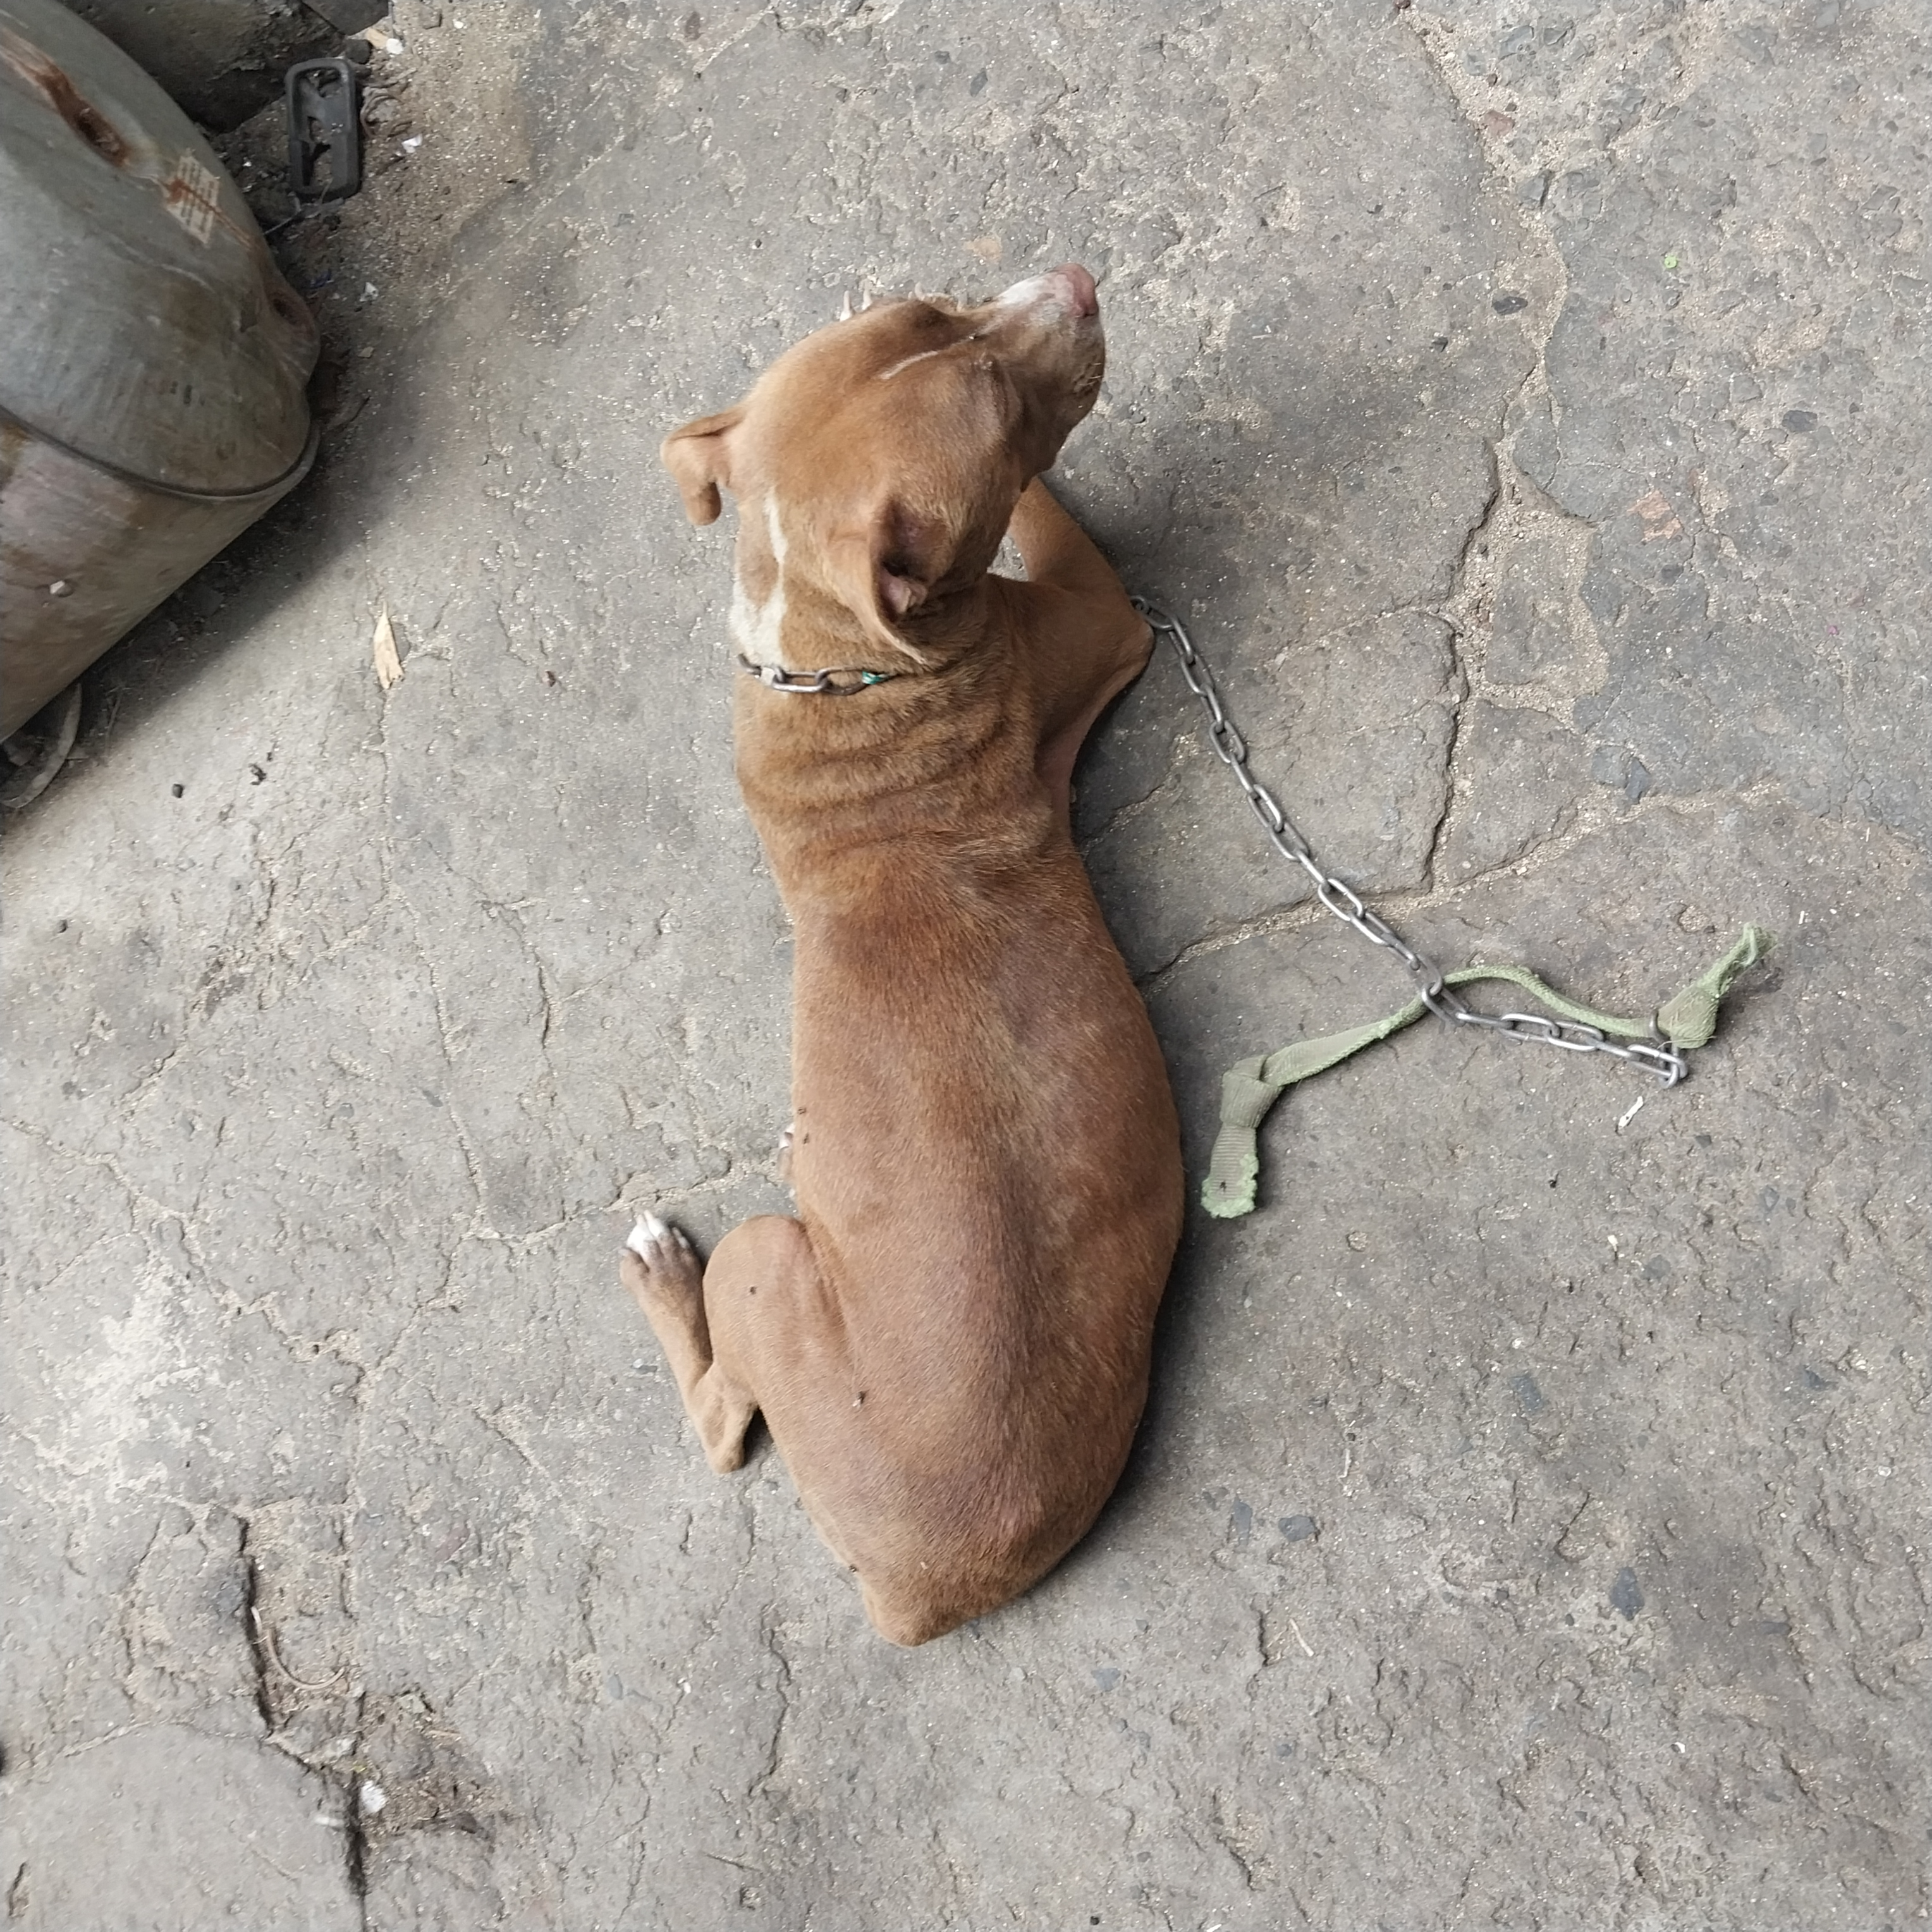
Photographic Evidence A
Date taken: 09 February 2024
Address: 111 Cypress Way, Mitchells Plain
Taken by: Inspector Jeffrey Mfini
Taken with: Samsung Galaxy A23 Cellular Phone Camera
Photograph 2: Showing a brown Pitbull with a chain secured around her neck. Note the flies on the Pitbull’s left side, hind leg, and face.

Slide 3
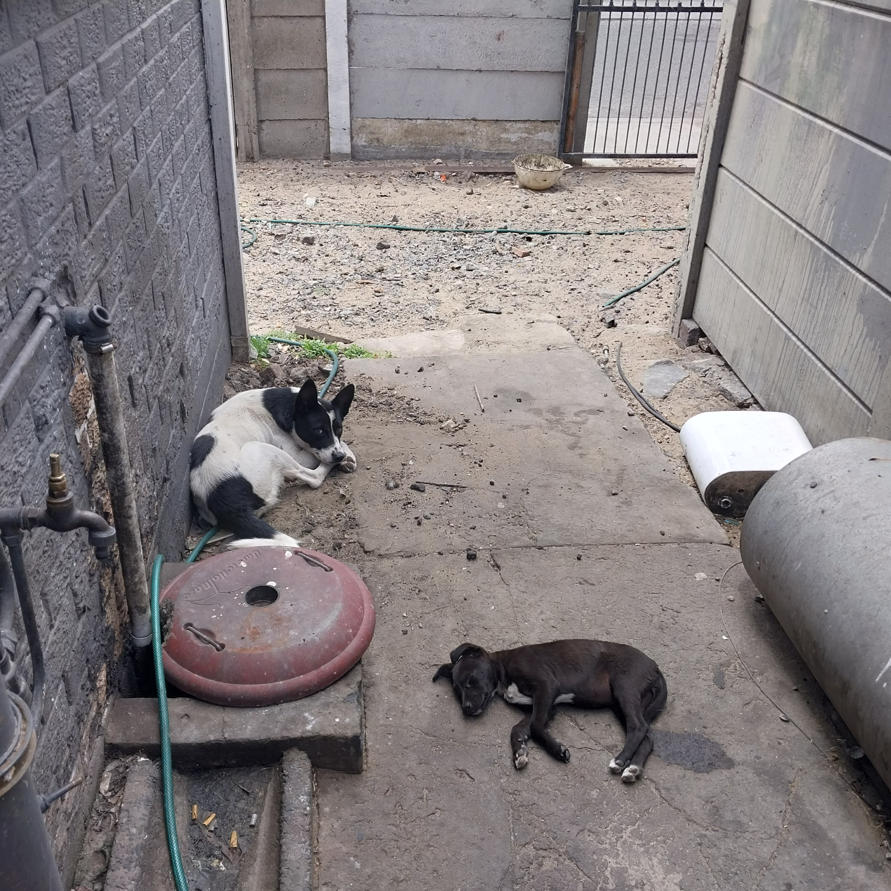
Photographic Evidence A
Date taken: 09 February 2024
Address: 111 Cypress Way, Mitchells Plain
Taken by: Inspector Jeffrey Mfini
Taken with: Samsung Galaxy A23 Cellular Phone Camera
Photograph 3: Showing another adult white and black dog inside the property.

Slide 4
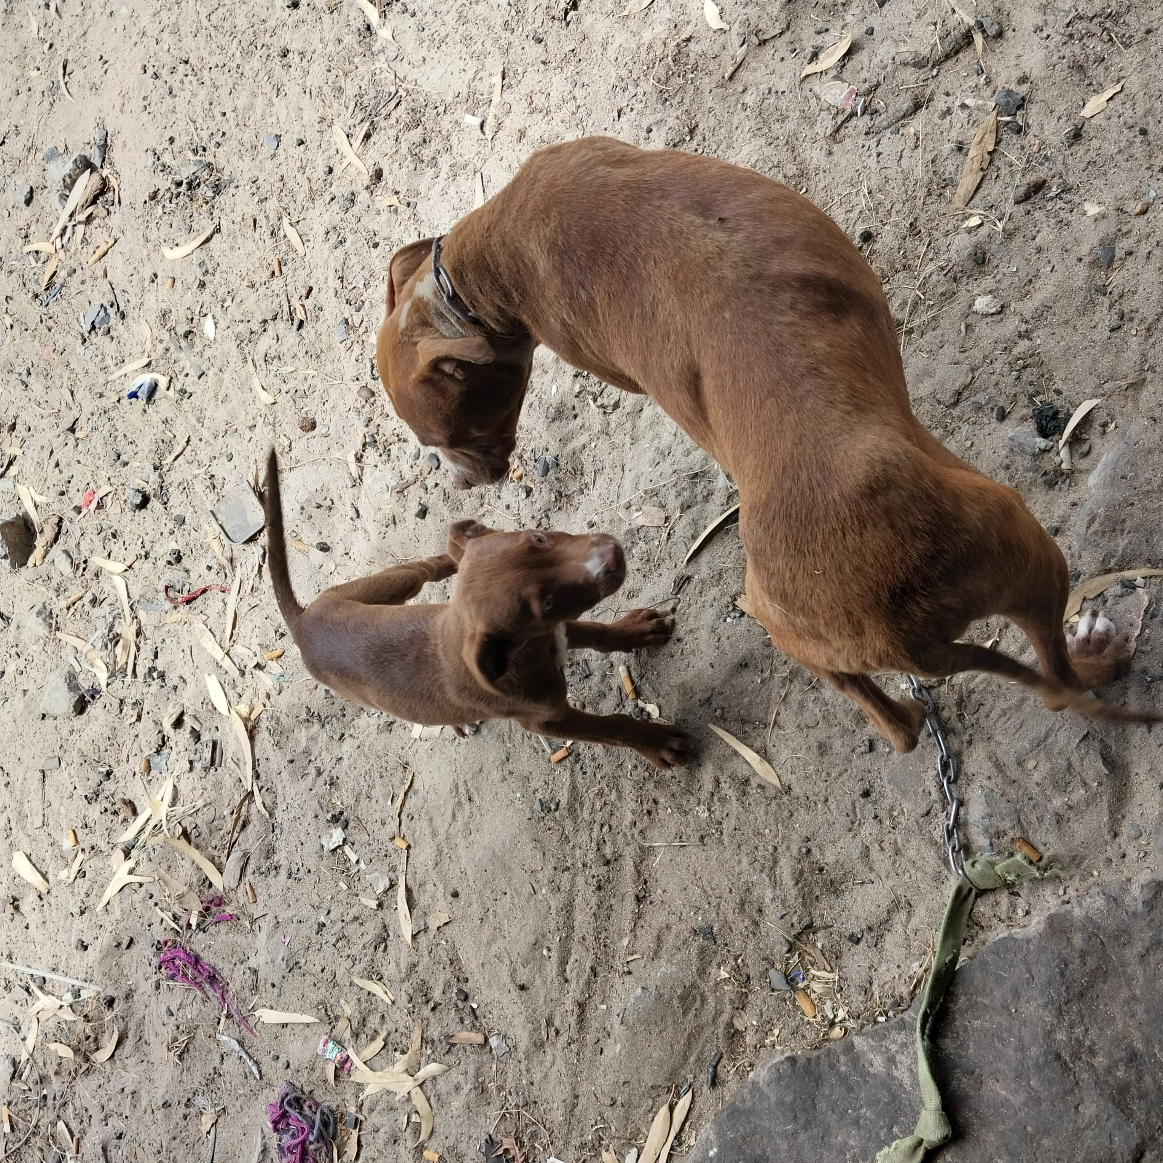
Photographic Evidence A
Date taken: 09 February 2024
Address: 111 Cypress Way, Mitchells Plain
Taken by: Inspector Jeffrey Mfini
Taken with: Samsung Galaxy A23 Cellular Phone Camera
Photograph 4: Showing the brown Pitbull seen in Photographs 1 and 2 with one of her puppies. Note the dog’s dirty and rough coat.

Slide 5
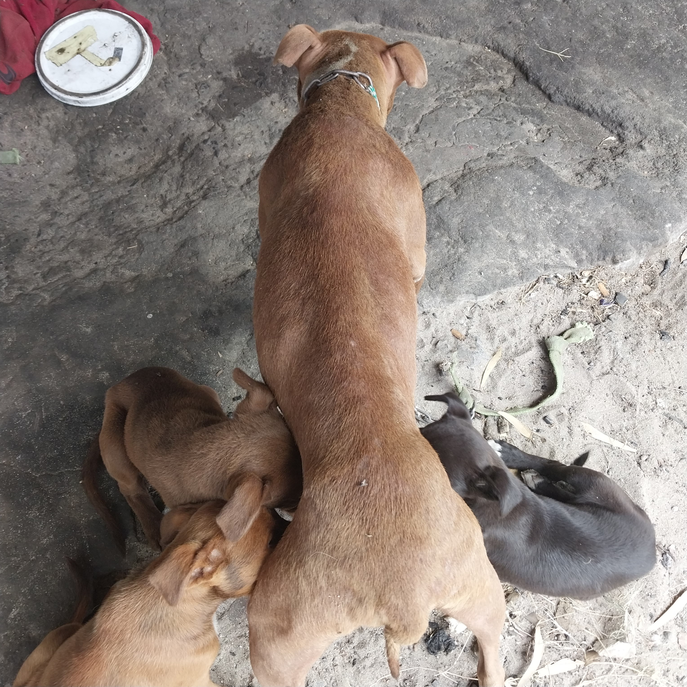
Photographic Evidence A
Date taken: 09 February 2024
Address: 111 Cypress Way, Mitchells Plain
Taken by: Inspector Jeffrey Mfini
Taken with: Samsung Galaxy A23 Cellular Phone Camera
Photograph 5: Showing the Pitbull seen in Photograph 5 with three of her puppies. Her coat is rough and dirty and there is a chain around her neck. Note the flies on her.

Slide 6
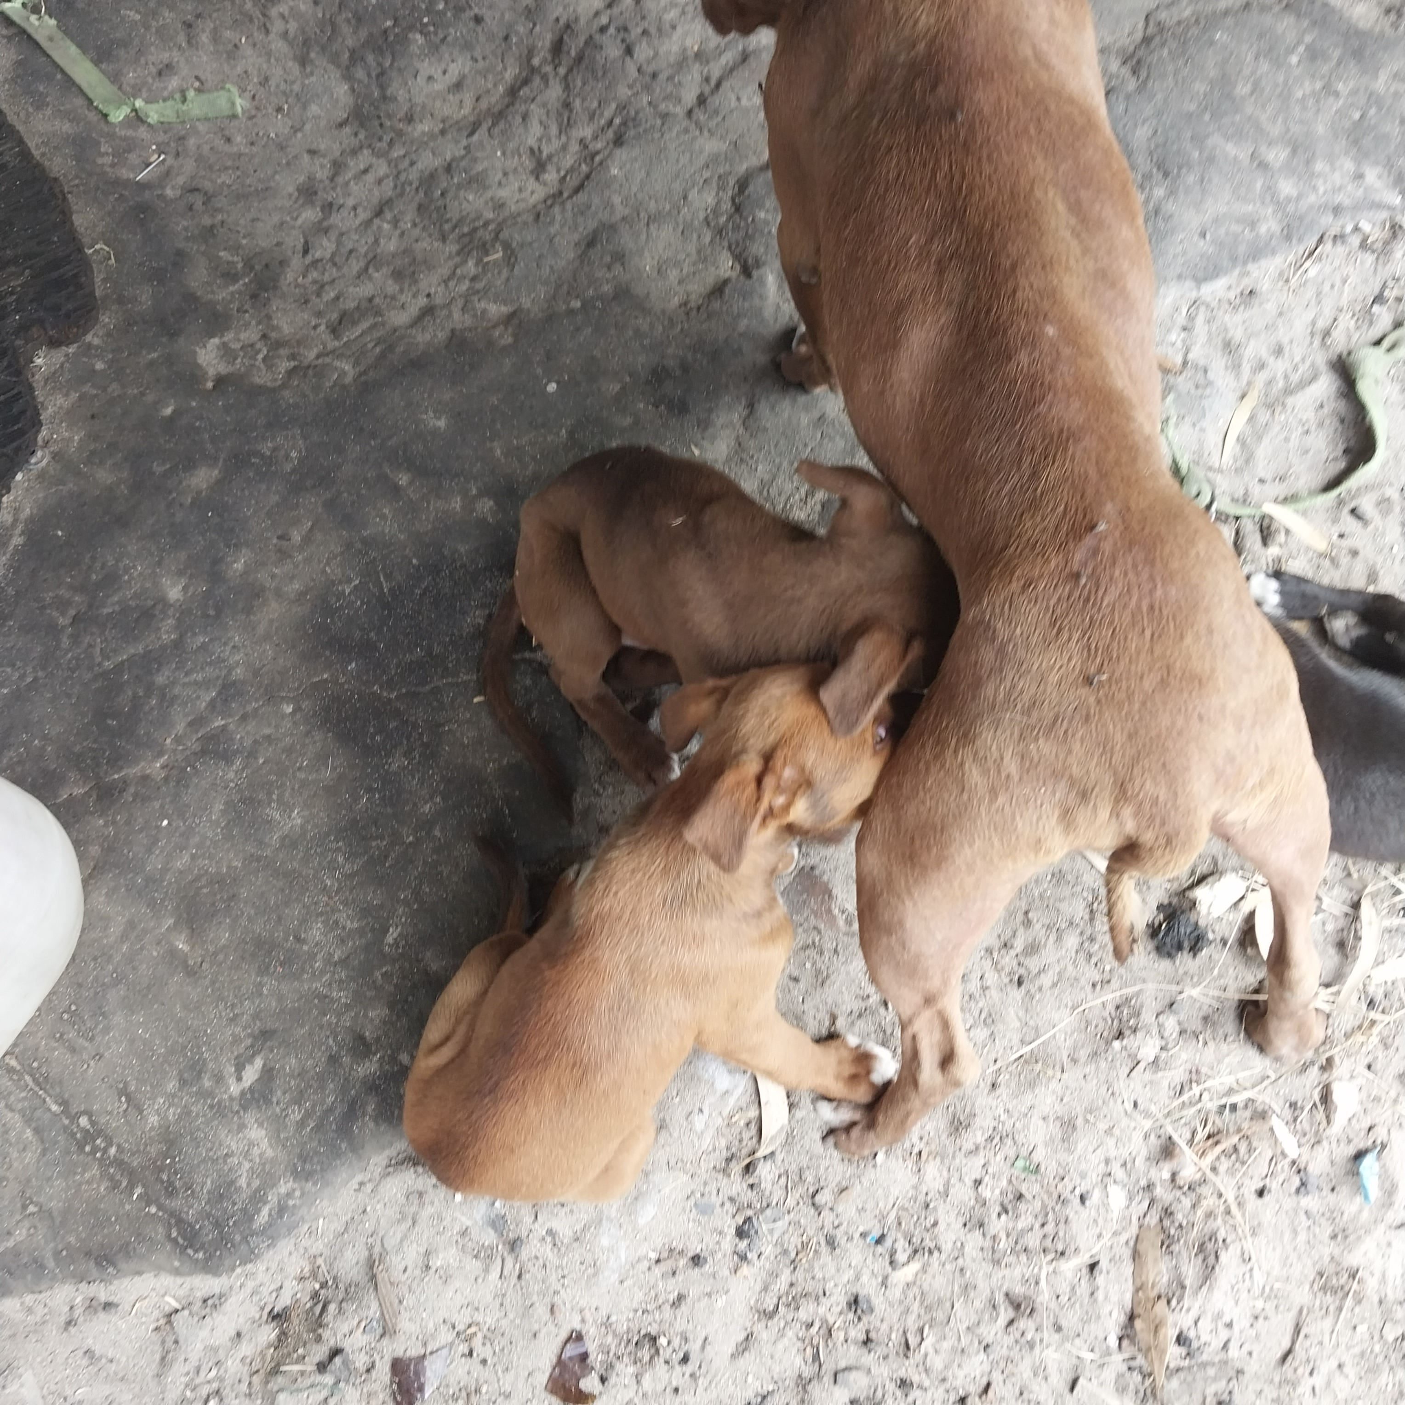
Photographic Evidence A
Date taken: 09 February 2024
Address: 111 Cypress Way, Mitchells Plain
Taken by: Inspector Jeffrey Mfini
Taken with: Samsung Galaxy A23 Cellular Phone Camera
Photograph 6: Showing the Pitbull seen in Photograph 5 with three of her puppies. Her coat is rough and dirty and there is a chain around her neck. Note the flies on her.

Slide 7
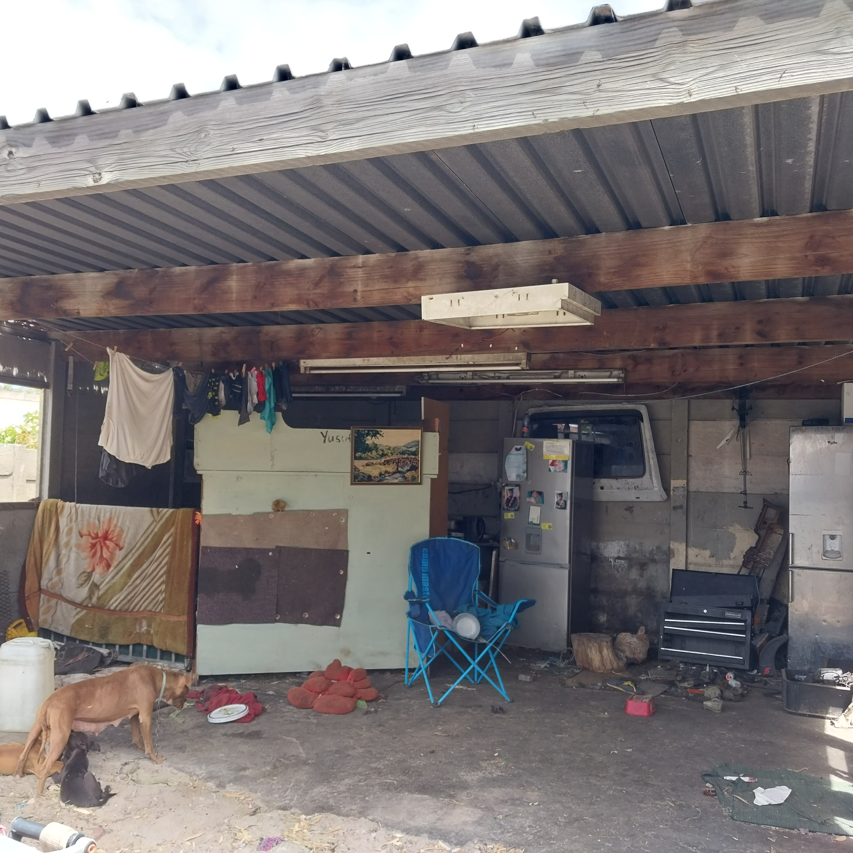
Photographic Evidence A
Date taken: 09 February 2024
Address: 111 Cypress Way, Mitchells Plain
Taken by: Inspector Jeffrey Mfini
Taken with: Samsung Galaxy A23 Cellular Phone Camera
Photograph 7: Showing the Pitbull seen in Photographs 5 to 7 and the dirty living area in which the dogs are kept.

