Slide 1

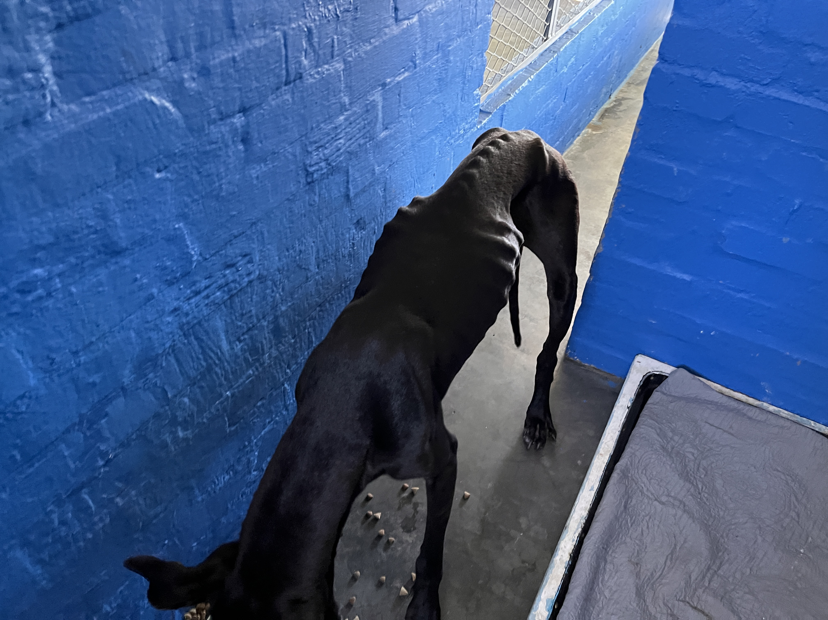
Photographic Evidence - D
Date taken: 07 December 2023
Address: Cape of Good Hope SPCA
Taken by: Chief Inspector Jaco Pieterse
Taken with: iPhone 13 Cellular Phone Camera
Photograph 1: Depicting an emaciated black dog which was removed from 19 Brookford Road in Lotus River. Note the dog’s severely protruding ribcage, severely protruding spinal ridges, and protruding hip bones. The dog lacks fat and muscle.

Slide 2
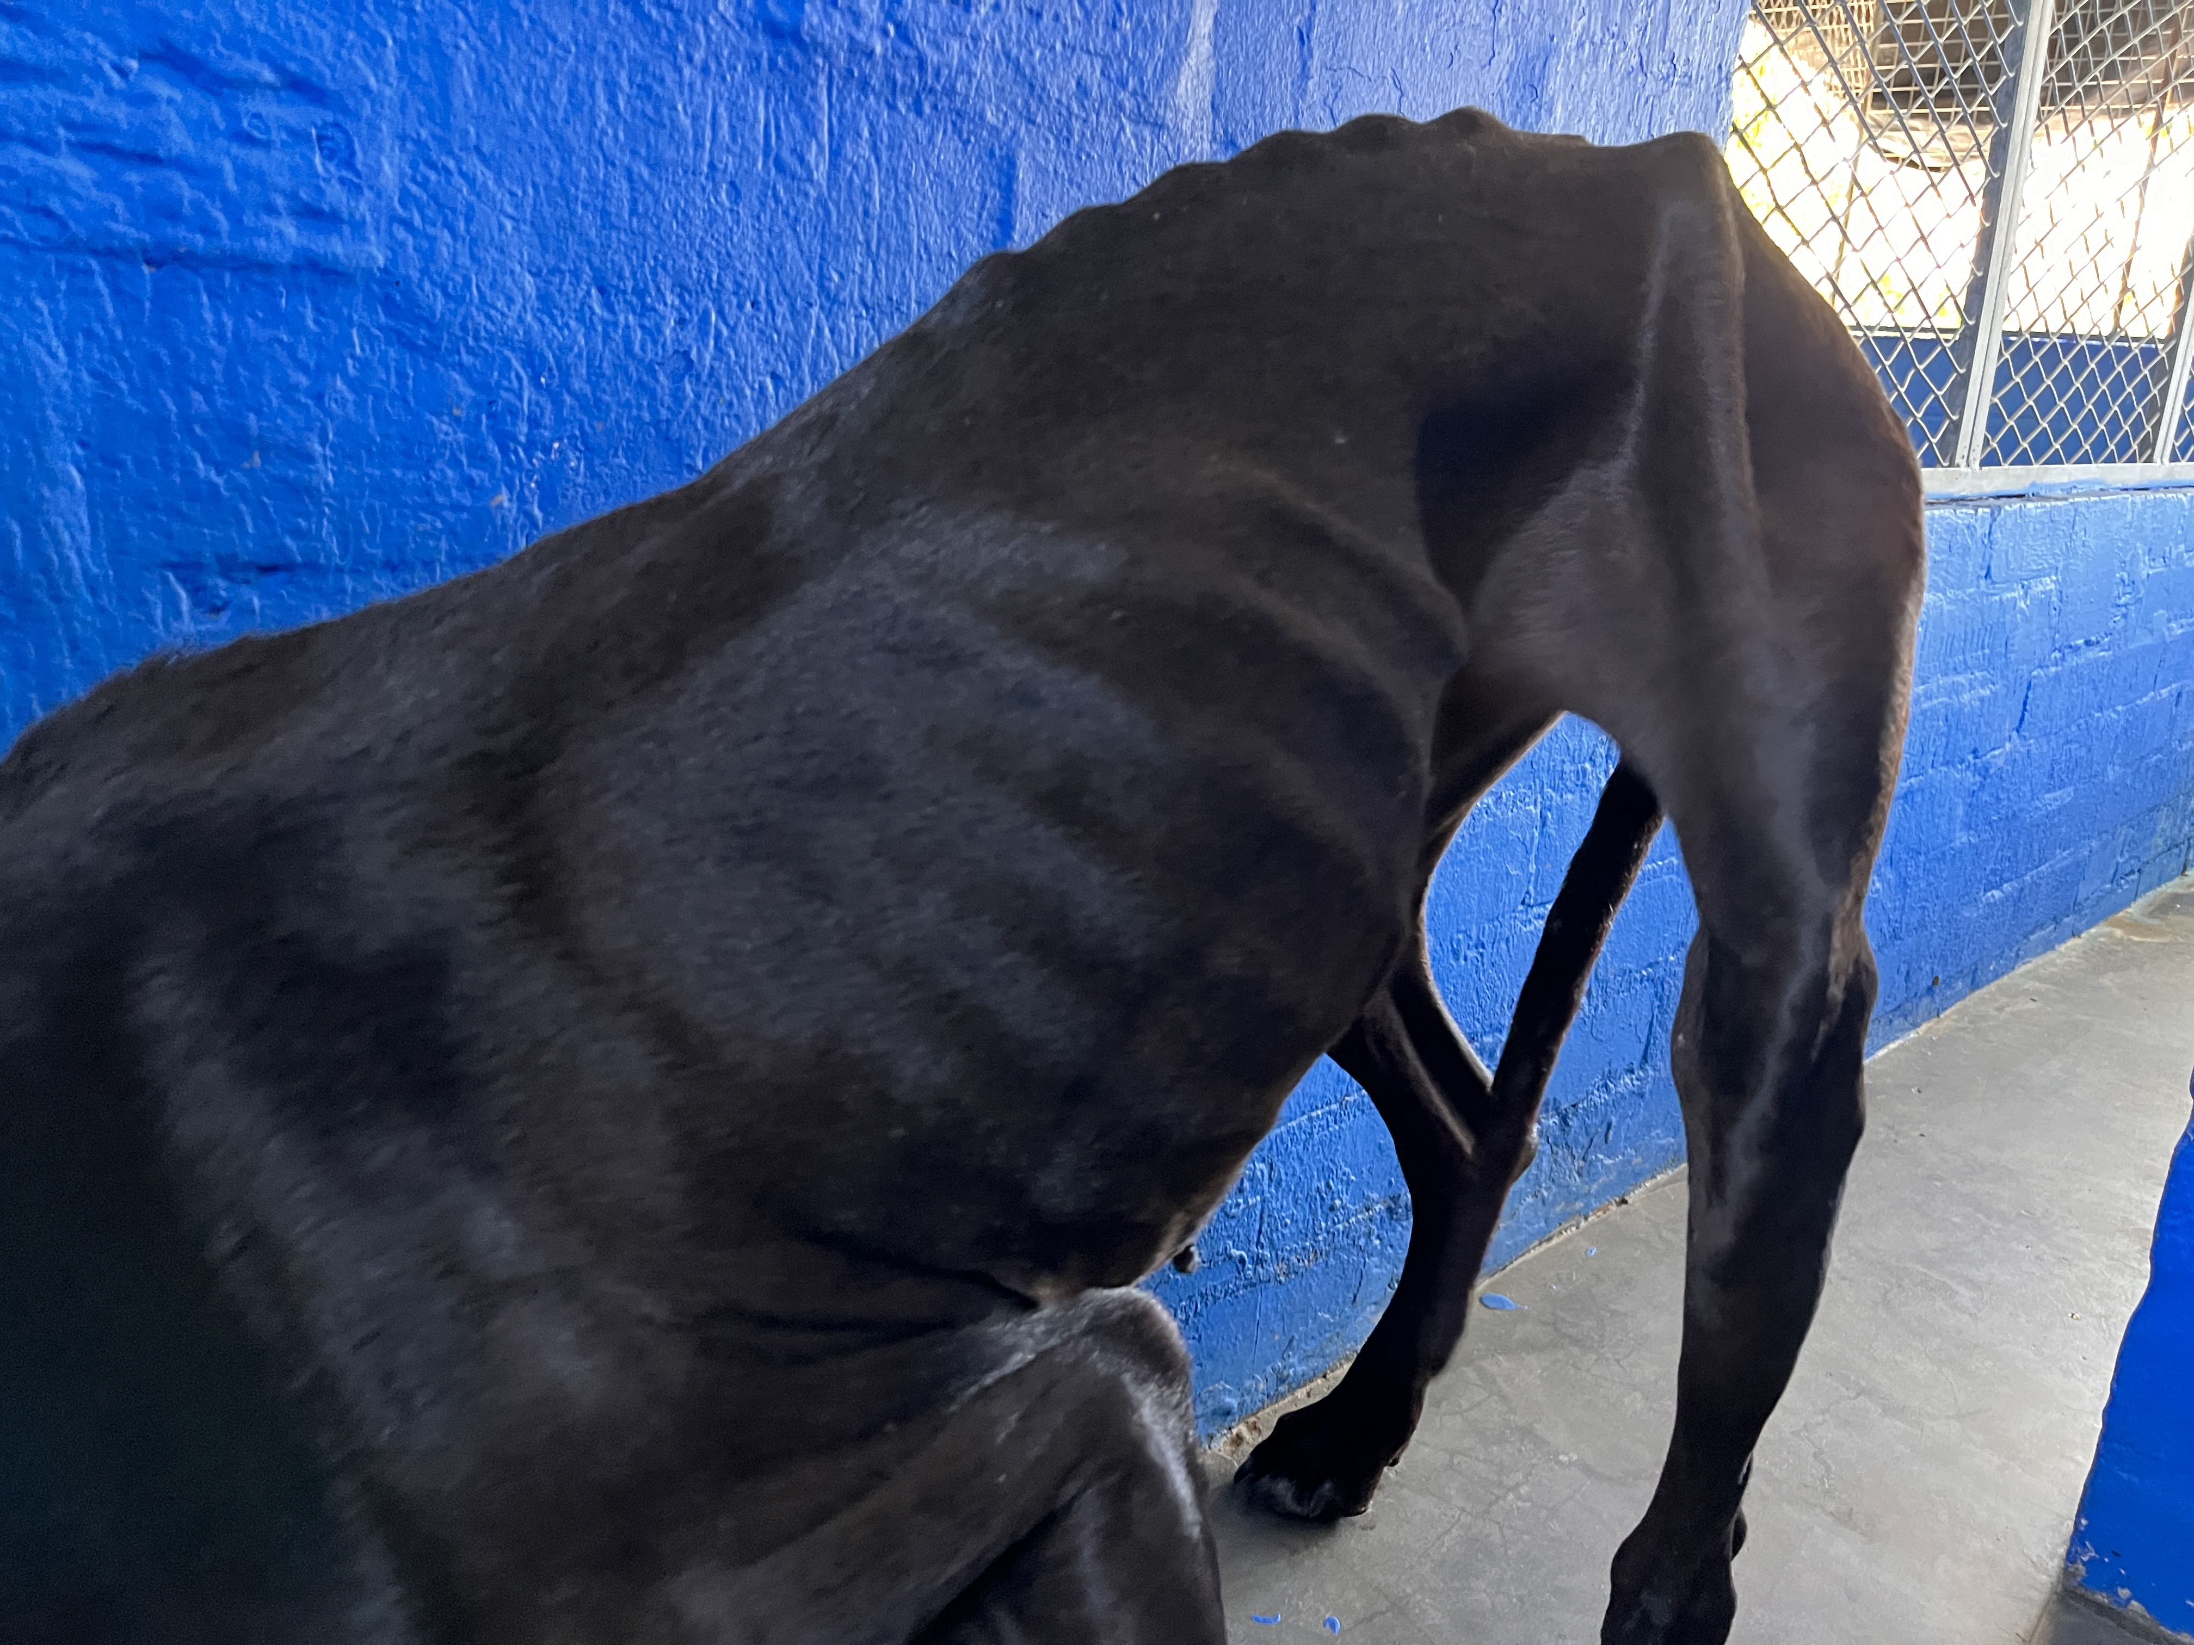
Photographic Evidence - D
Date taken: 07 December 2023
Address: Cape of Good Hope SPCA
Taken by: Chief Inspector Jaco Pieterse
Taken with: iPhone 13 Cellular Phone Camera
Photograph 2: Depicting a close up photograph of the dog seen in Photograph 1. Note the dog’s severe abdominal tuck, the dog’s severe protruding leg bone and severe muscle atrophy in its hind leg.

Slide 3
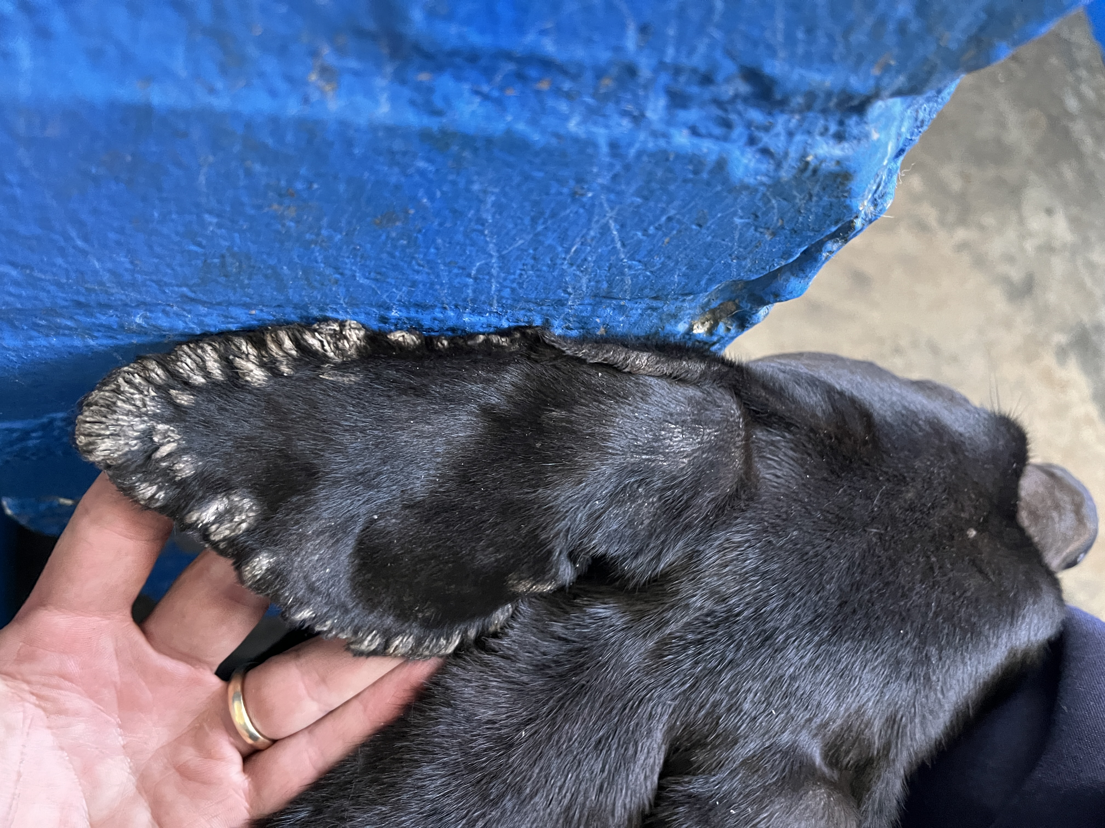
Photographic Evidence - D
Date taken: 07 December 2023
Address: Cape of Good Hope SPCA
Taken by: Chief Inspector Jaco Pieterse
Taken with: iPhone 13 Cellular Phone Camera
Photograph 3: Depicting what appears to be healed fly strike on the left ear of the dog seen in Photographs 1 & 2.

Slide 4
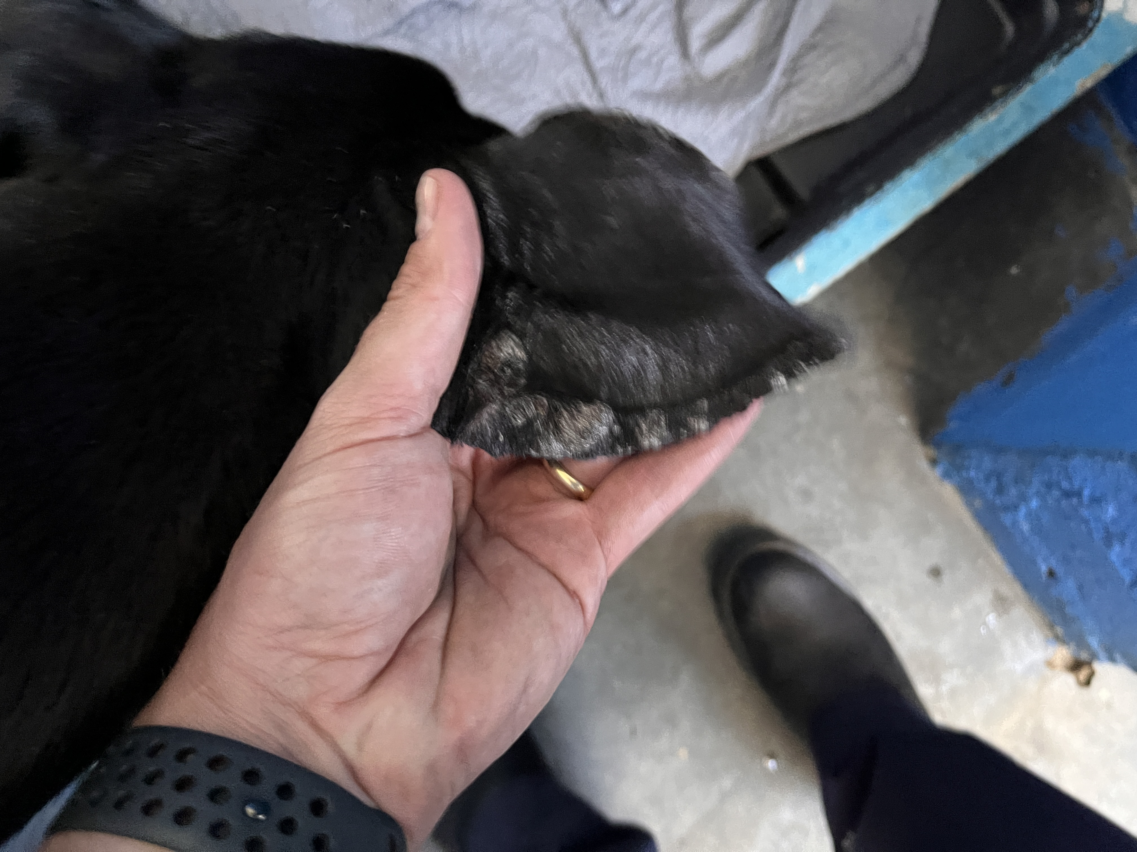
Photographic Evidence - D
Date taken: 07 December 2023
Address: Cape of Good Hope SPCA
Taken by: Chief Inspector Jaco Pieterse
Taken with: iPhone 13 Cellular Phone Camera
Photograph 4: Depicting what appears to be hair loss and healed fly strike on the right ear of the dog seen in Photographs 1 to 3.

Slide 5
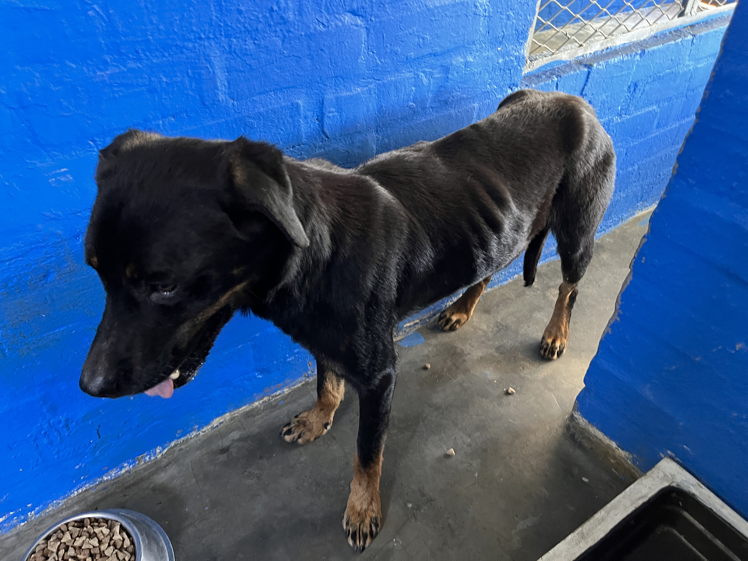
Photographic Evidence - D
Date taken: 07 December 2023
Address: Cape of Good Hope SPCA
Taken by: Chief Inspector Jaco Pieterse
Taken with: iPhone 13 Cellular Phone Camera
Photograph 5: Depicting a severely underweight black with brown dog which was removed from 19 Brookford Road in Lotus River. Note the dog’s protruding ribcage and protruding pelvic bones.

Slide 6
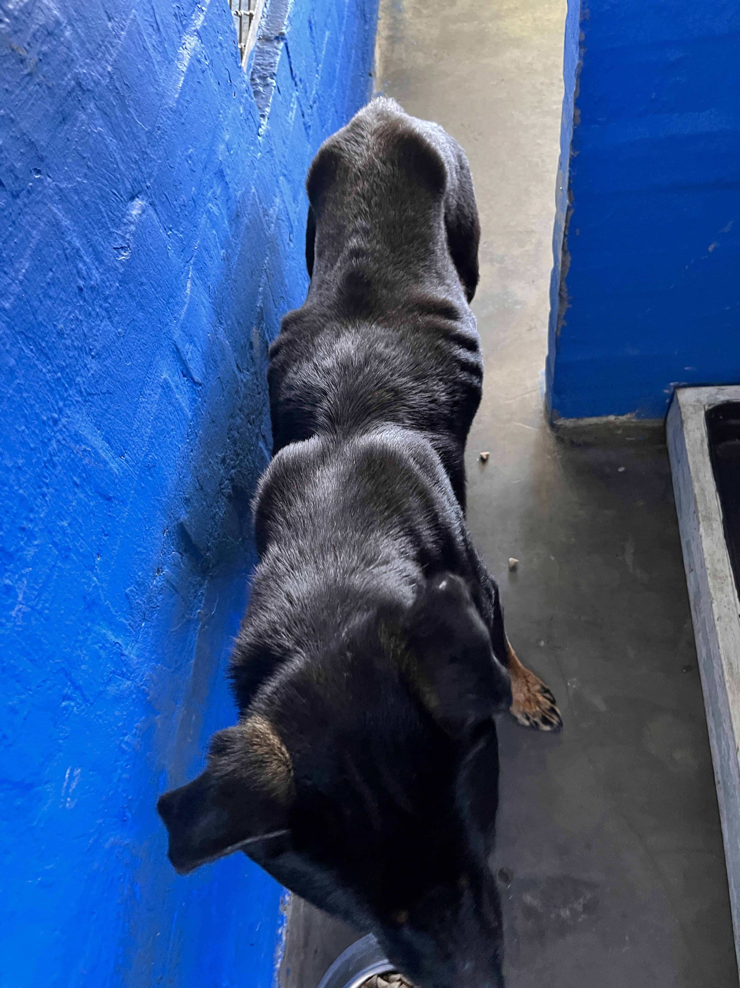
Photographic Evidence - D
Date taken: 07 December 2023
Address: Cape of Good Hope SPCA
Taken by: Chief Inspector Jaco Pieterse
Taken with: iPhone 13 Cellular Phone Camera
Photograph 6: Depicting a the protruding shoulders, spine and pelvic bones of the dog seen in Photograph 5. Note the dog’s severe lack of fat and muscle and that its groin is significantly more narrow than the width of its ribcage indicating just how underweight it is.

Slide 7
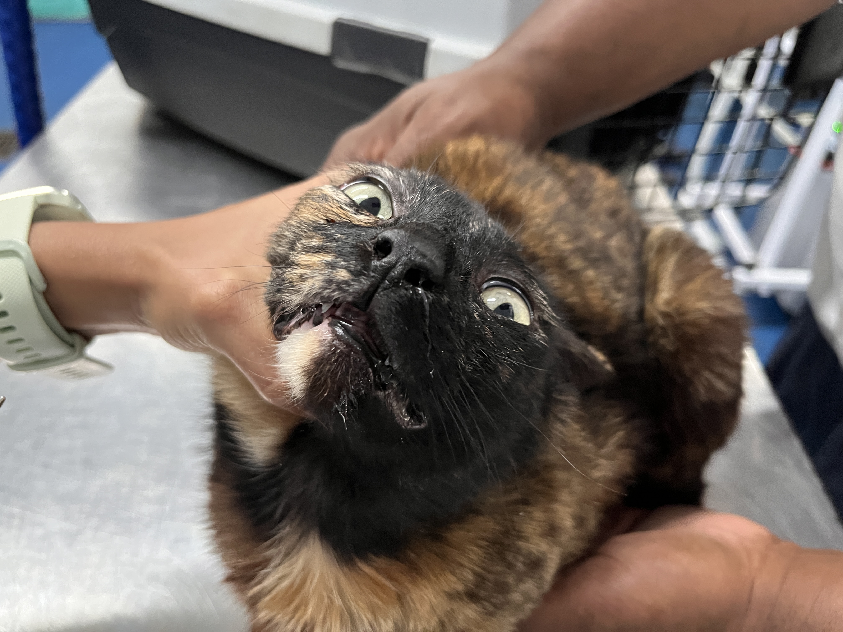
Photographic Evidence - D
Date taken: 07 December 2023
Address: Cape of Good Hope SPCA
Taken by: Chief Inspector Jaco Pieterse
Taken with: iPhone 13 Cellular Phone Camera
Photograph 7: Depicting a tortoise shell coloured cat with nasal discharge and excessive saliva. The cat was removed from 19 Brookford Road in lotus River.

Slide 8
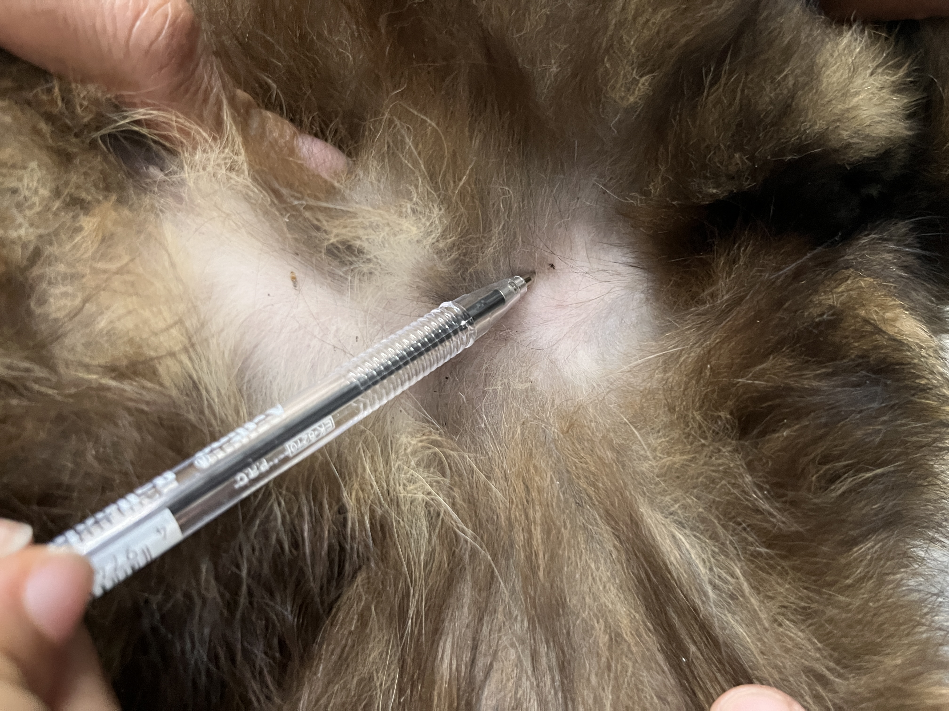
Photographic Evidence - D
Date taken: 07 December 2023
Address: Cape of Good Hope SPCA
Taken by: Chief Inspector Jaco Pieterse
Taken with: iPhone 13 Cellular Phone Camera
Photograph 8: Depicting some flea feacal matter found on the cat seen in Photograph 7.

Slide 9
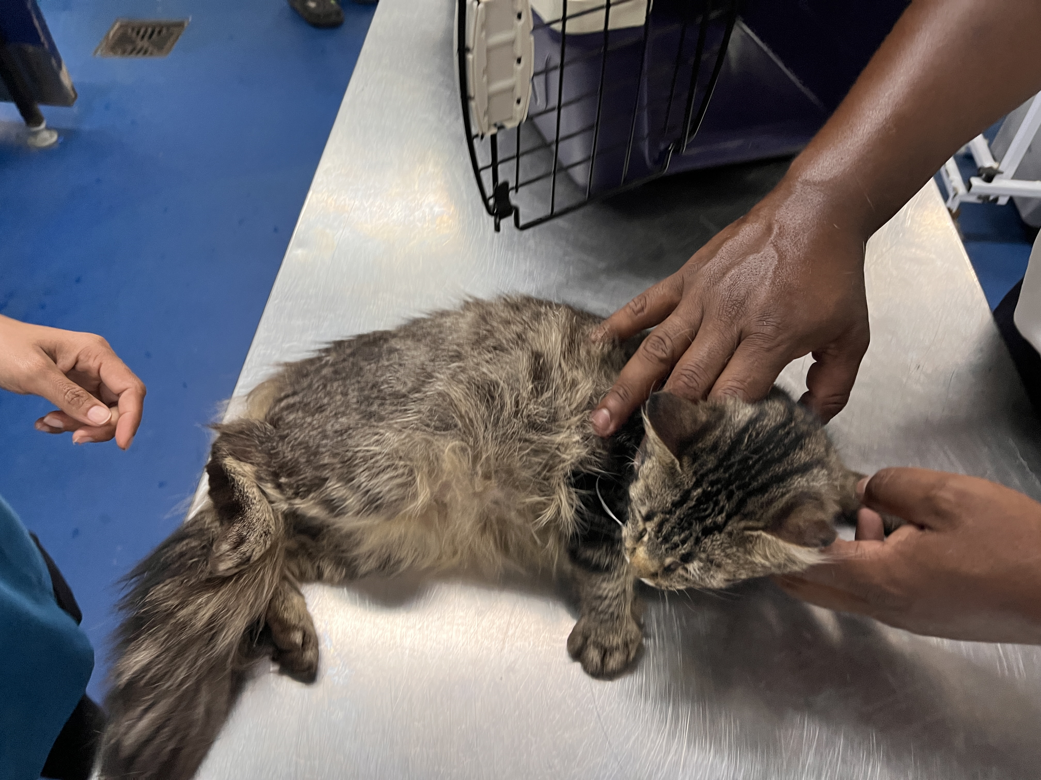
Photographic Evidence - D
Date taken: 07 December 2023
Address: Cape of Good Hope SPCA
Taken by: Chief Inspector Jaco Pieterse
Taken with: iPhone 13 Cellular Phone Camera
Photograph 9: Depicting a long-haired cat which was removed from 19 Brookford Road in Lotus River. Note the cat appears to have a condition affecting its right hind foot evident by the unusual position and posture of the foot and hind leg.

Slide 10
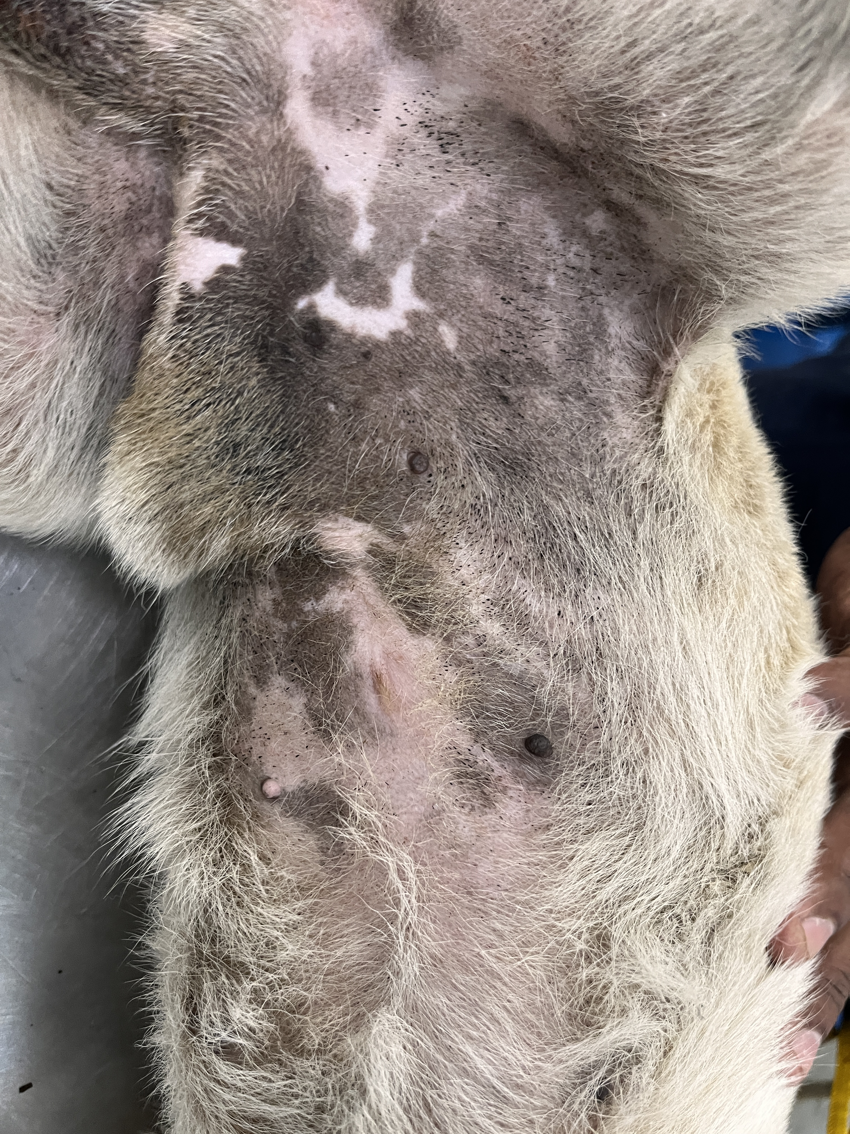
Photographic Evidence - D
Date taken: 07 December 2023
Address: Cape of Good Hope SPCA
Taken by: Chief Inspector Jaco Pieterse
Taken with: iPhone 13 Cellular Phone Camera
Photograph 10: Depicting flea faecal matter on the abdomen and skin of the small dog removed from 19 Brookford Road in Lotus River.

