Slide 1

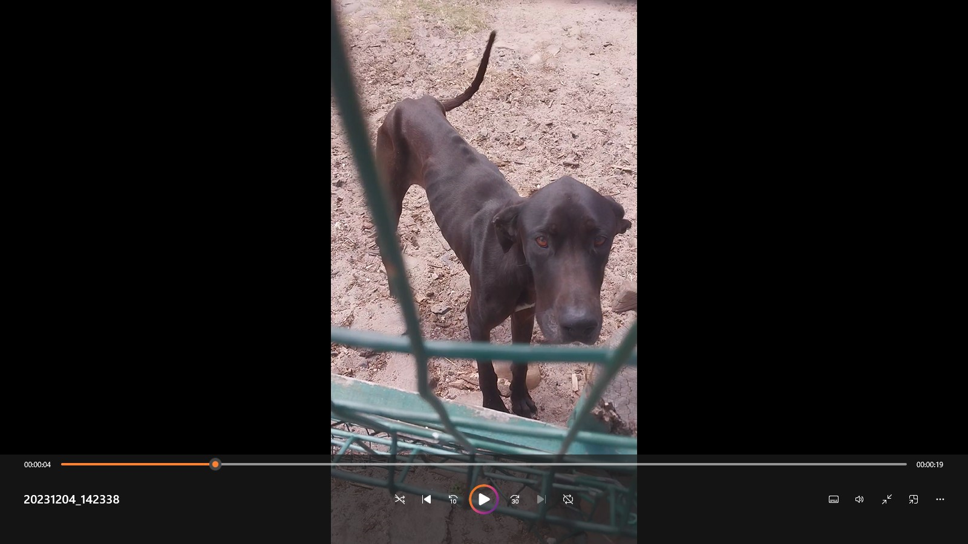
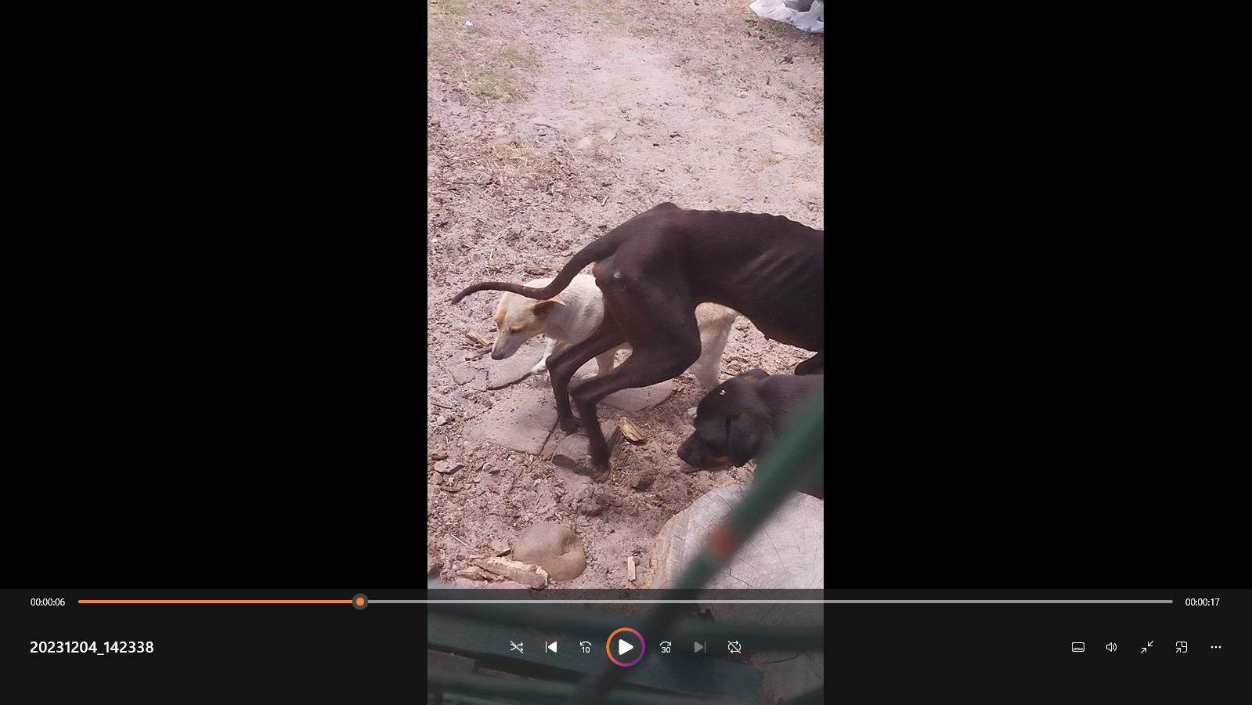
Photographic Evidence - C
Date taken: 04 December 2023
Address: 19 Brookford Road, Lotus River
Taken by: Inspector Theo Arendolf
Taken with: Samsung Galaxy A23 Cellular Phone Camera
1
2
Screenshots 1 & 2: Screenshots of video “20231204_142338” captured at time stamps 00:00:04 and 00:00:06 depicting an emaciated dog with excessively protruding bones (ribcage, spinal ridges, pelvic and hip bones). Note the severe muscle wastage in the right hind leg of the dog and the healed pressure sore on the right side of the dog depicted in Screenshot 1.

Slide 2
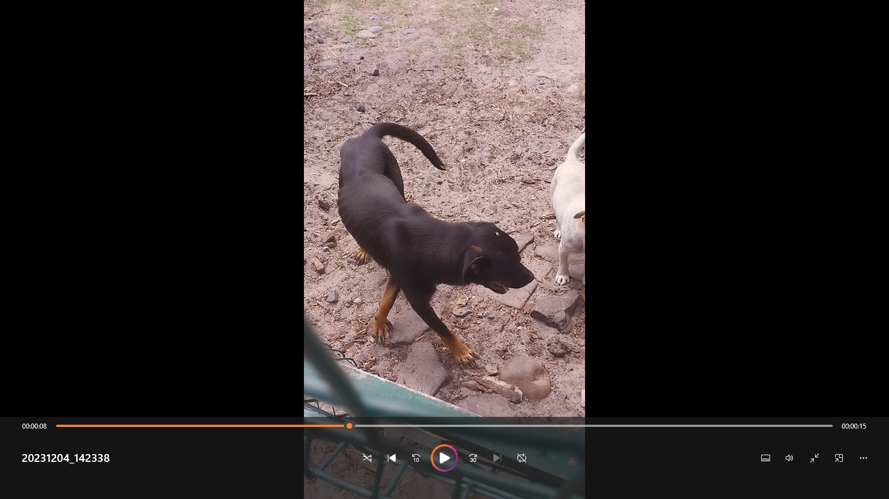
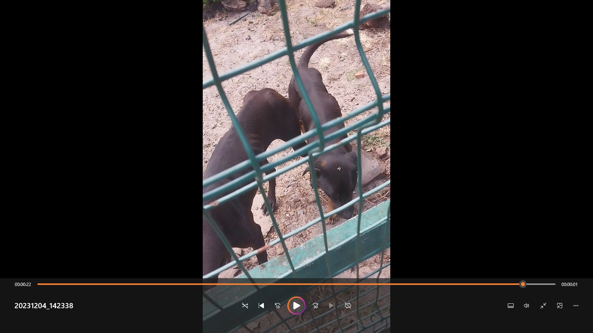
Photographic Evidence - C
Date taken: 04 December 2023
Address: 19 Brookford Road, Lotus River
Taken by: Inspector Theo Arendolf
Taken with: Samsung Galaxy A23 Cellular Phone Camera
3
4
Screenshots 3 & 4: Screenshots of video “20231204_142338” captured at time stamps 00:00:08 and 00:00:22 depicting two severely underweight black dogs (one of which was depicted in Screenshots 1 &2). Note the protruding rib cage of the second dog depicted in Screenshot 3 and the visible ribs and protruding hip and pelvic bones of both dogs as seen in Screenshot 4.

