Slide 1

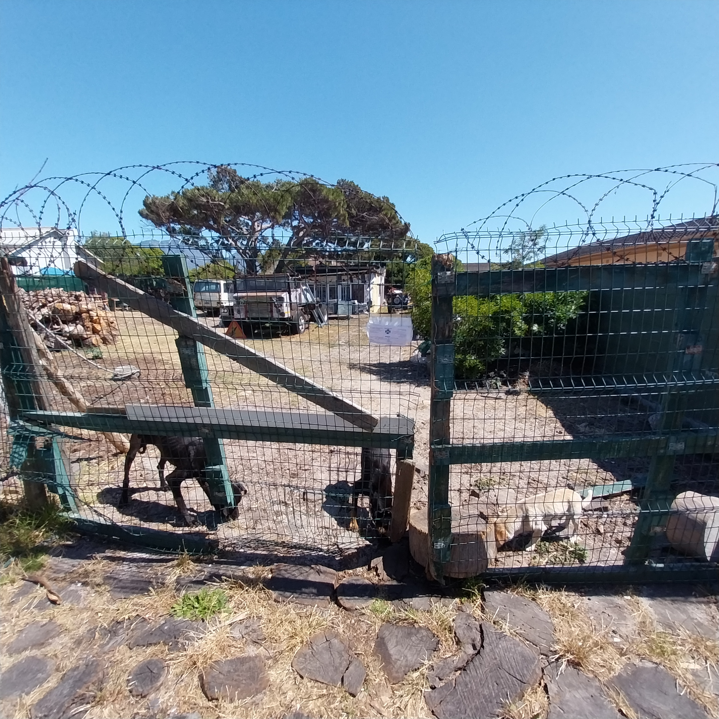
Photographic Evidence - B
Date taken: 27 November 2023
Address: 19 Brookford Road, Lotus River
Taken by: Inspector Theo Arendolf
Taken with: Samsung Galaxy A23 Cellular Phone Camera
Photograph 1: Depicting three (3) dogs on the above-mentioned property eating the dog biscuits provided to them. Note the visible ribs of all three (3) dogs as well as a warning sealed inside plastic stuck on the main gate of the property. The gate has been opened and kept open with a large piece of wood.

Slide 2
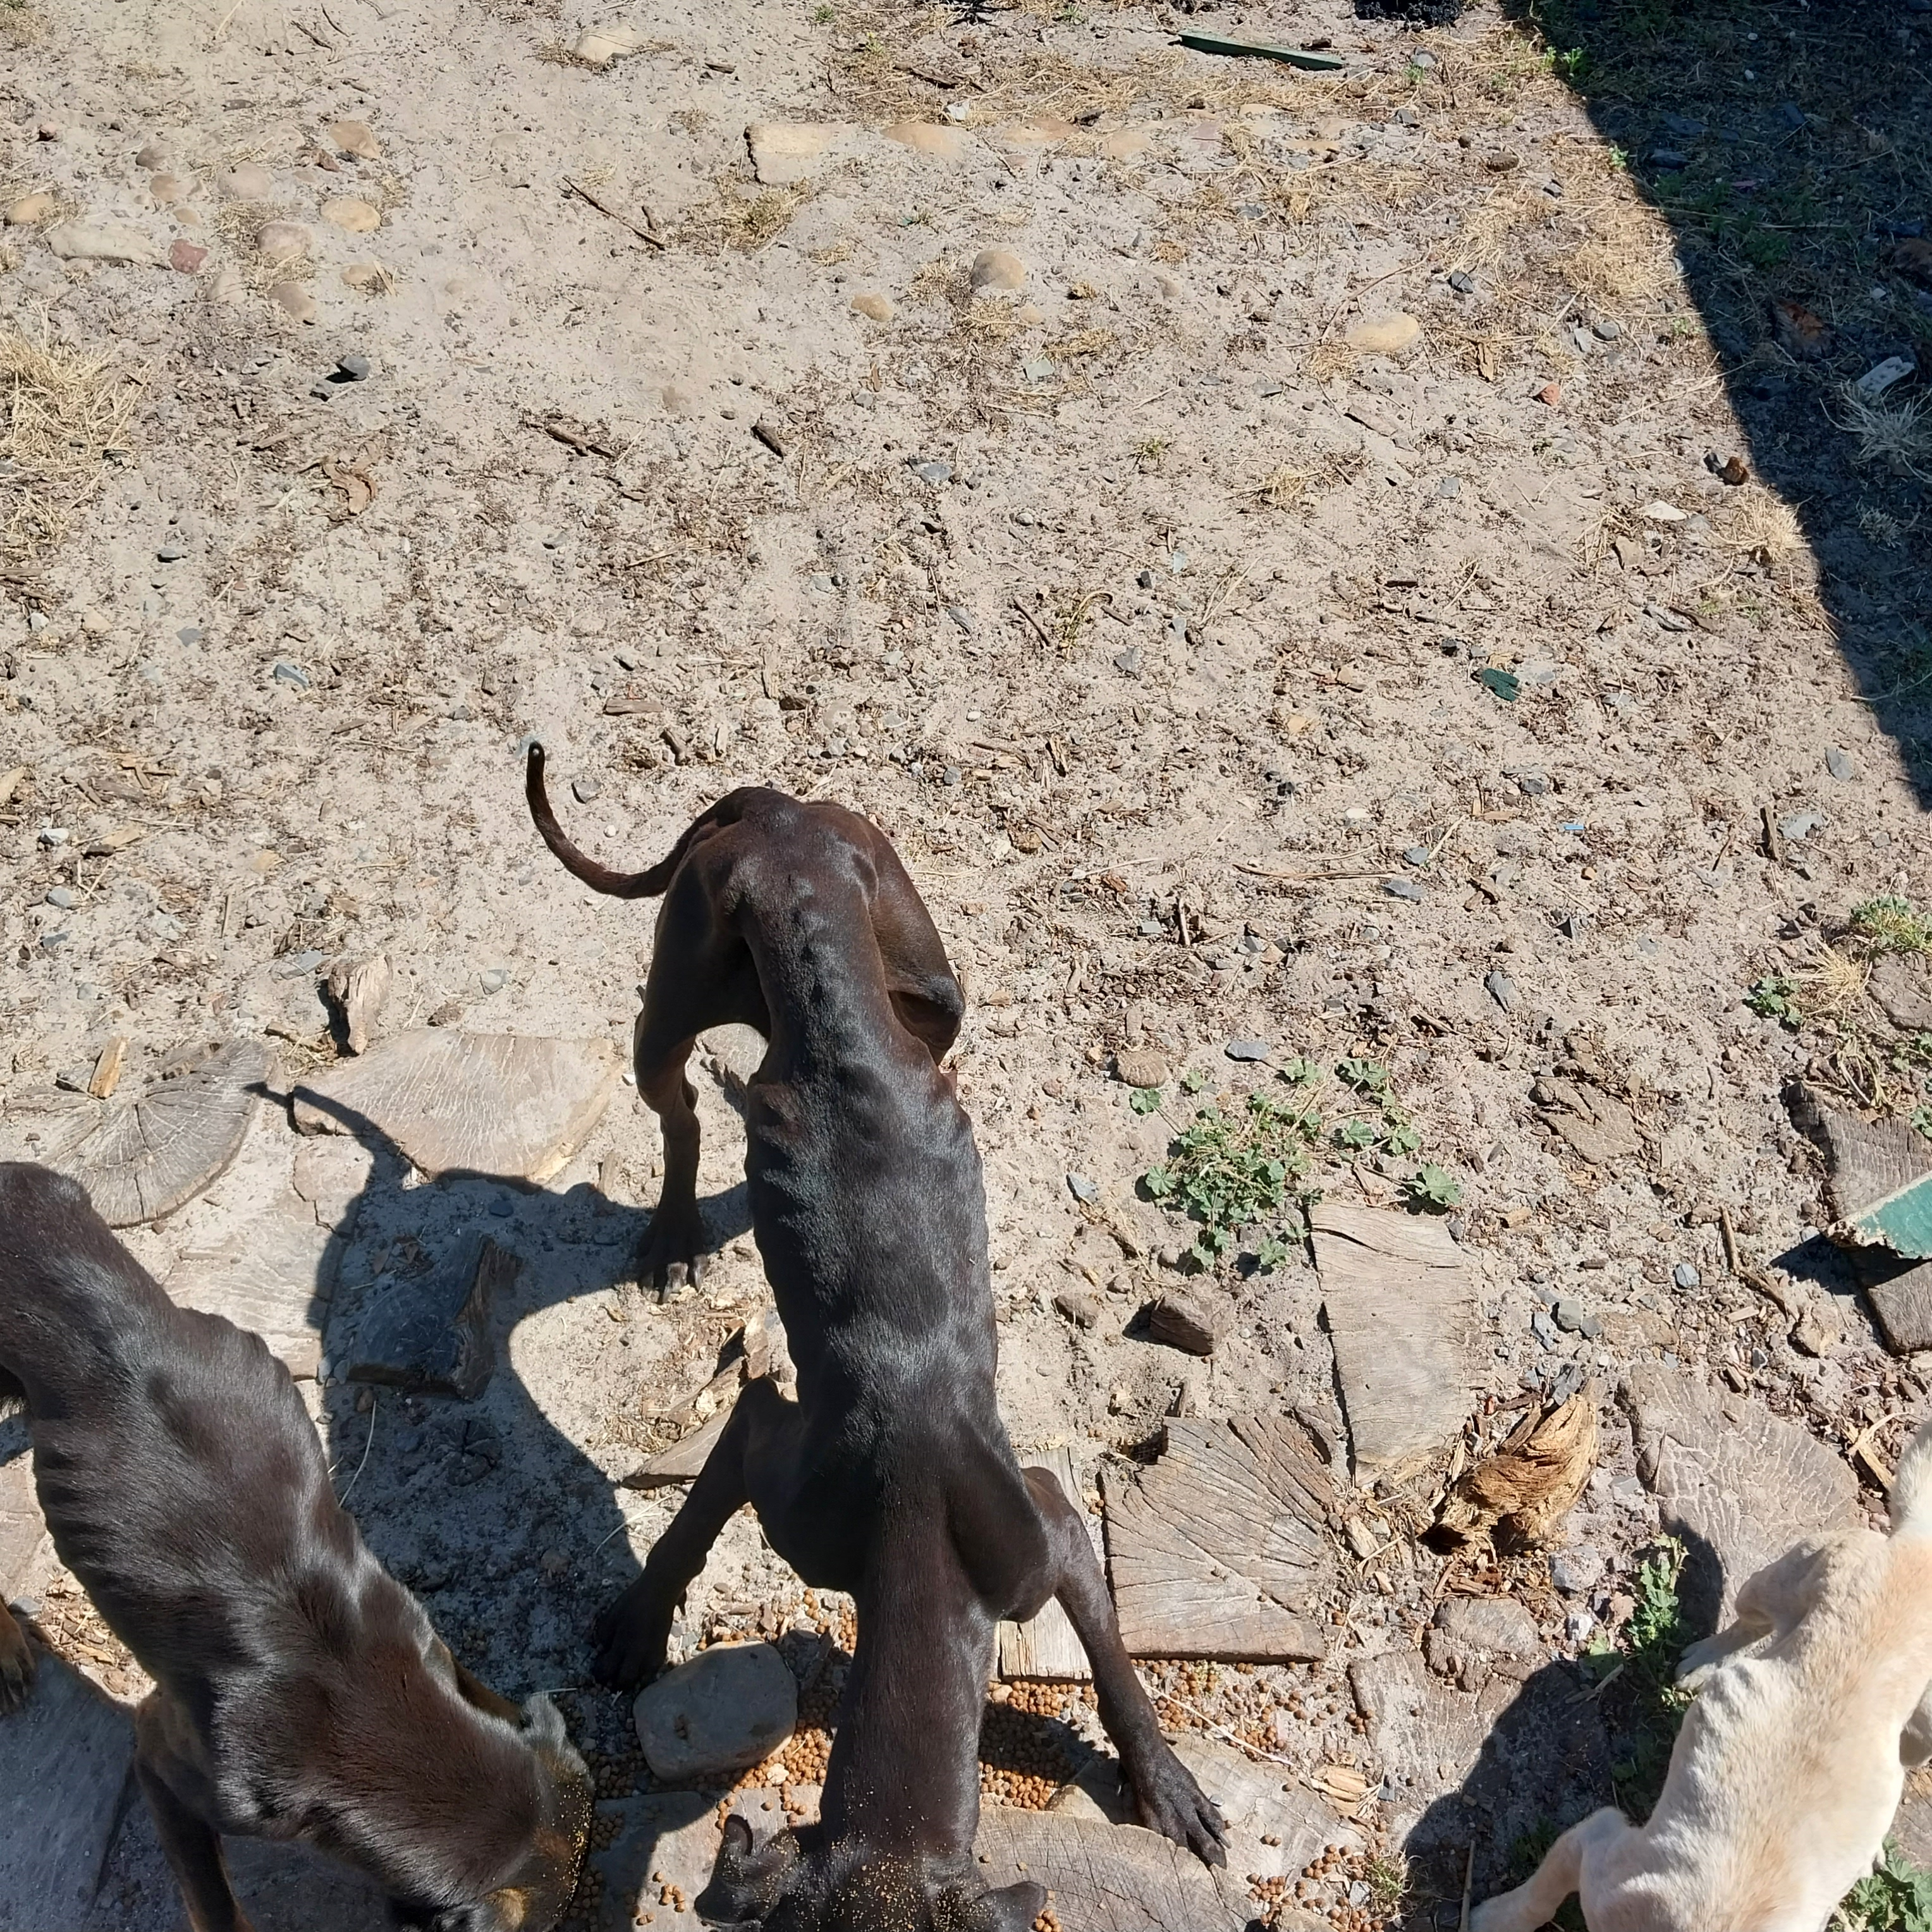
Photographic Evidence - B
Date taken: 27 November 2023
Address: 19 Brookford Road, Lotus River
Taken by: Inspector Theo Arendolf
Taken with: Samsung Galaxy A23 Cellular Phone Camera
Photograph 2: Depicting the protruding rib cages and bones of the three (3) dogs seen in Photograph 1. Note that all three (3) dogs lack fat and muscle and their groins are significantly more narrow than the width of their ribcages. All three (3) dogs are severely underweight.

Slide 3
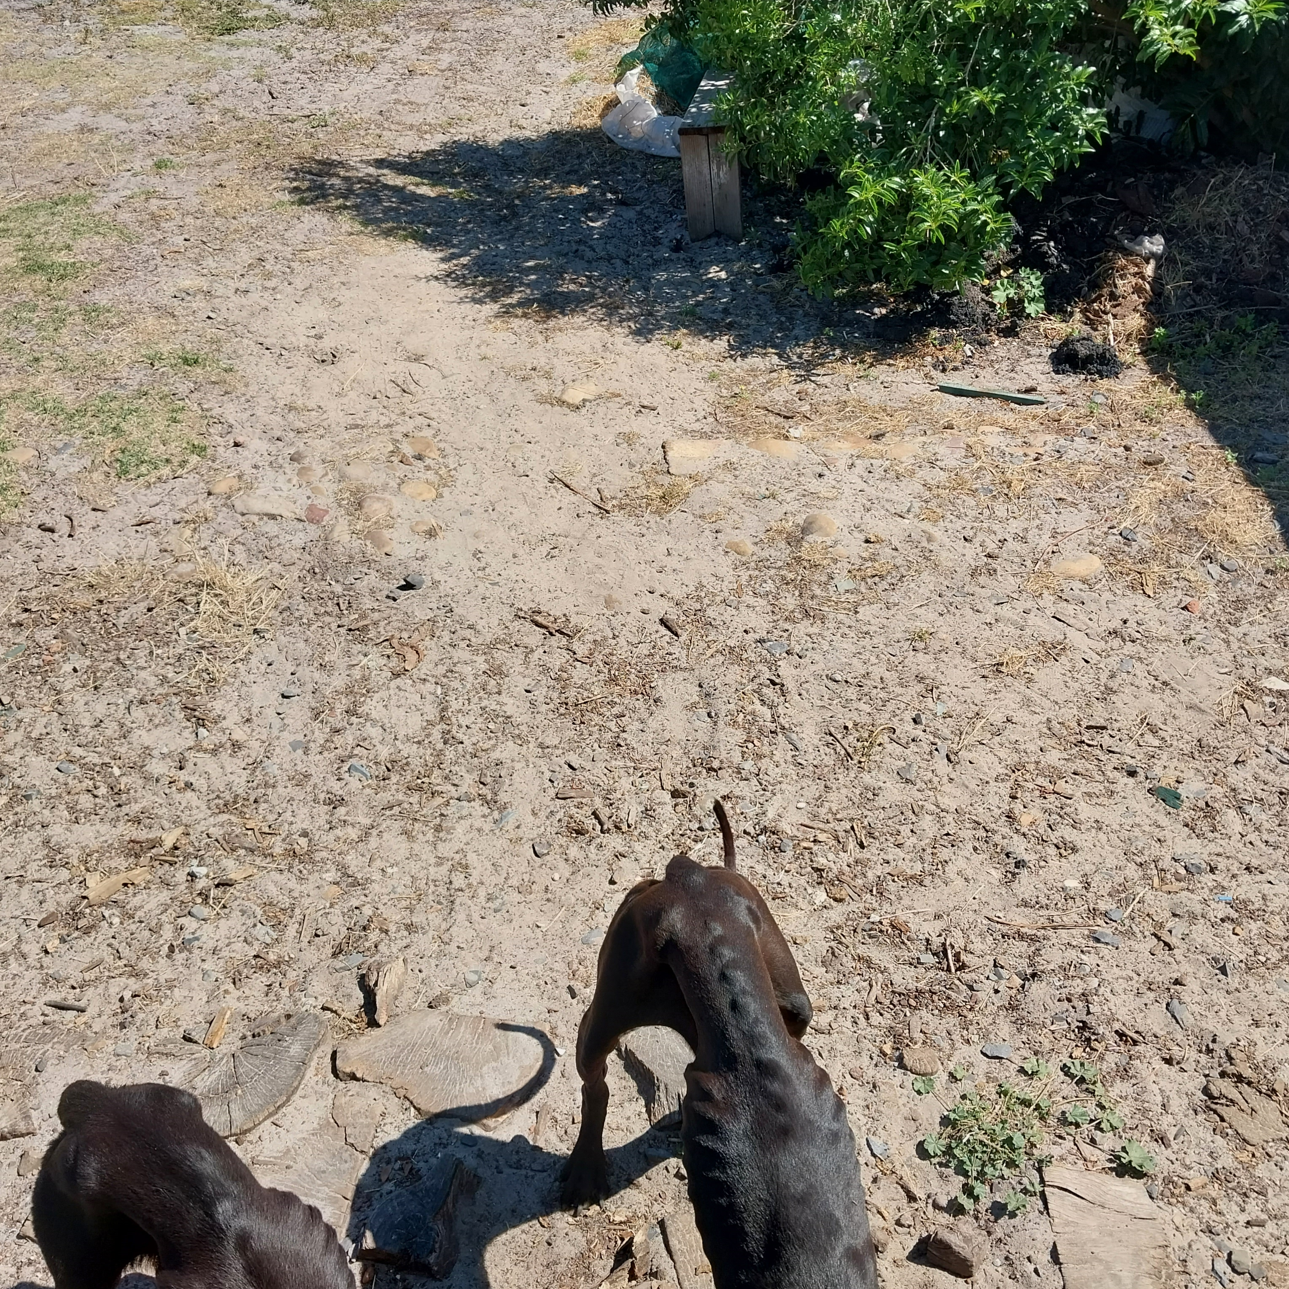
Photographic Evidence - B
Date taken: 27 November 2023
Address: 19 Brookford Road, Lotus River
Taken by: Inspector Theo Arendolf
Taken with: Samsung Galaxy A23 Cellular Phone Camera
Photograph 3: Depicting the severely protruding ribcages, spinal ridges, and hip and pelvic bones of the severely underweight black dogs seen in Photographs 1 and 2. Note they have no fat or muscle and their groins are significantly more narrow than the width of their ribcages indicating they are severely underweight.

Slide 4
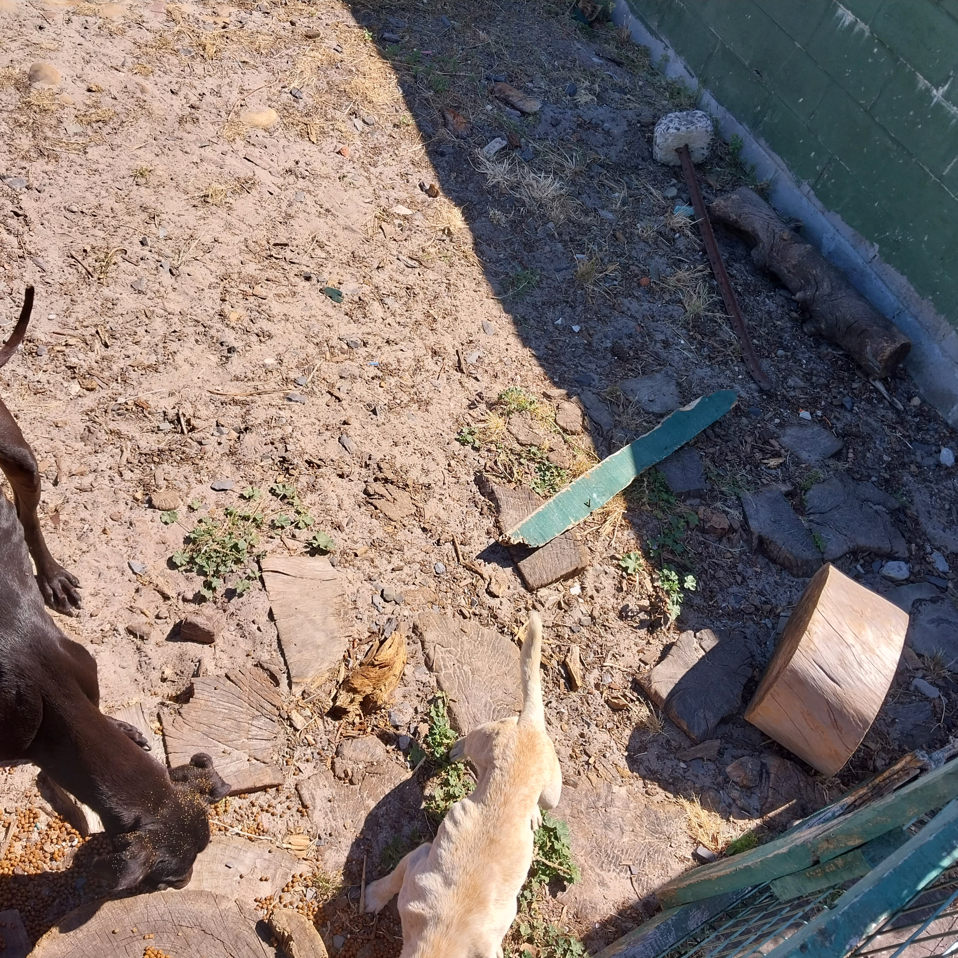
Photographic Evidence - B
Date taken: 27 November 2023
Address: 19 Brookford Road, Lotus River
Taken by: Inspector Theo Arendolf
Taken with: Samsung Galaxy A23 Cellular Phone Camera
Photograph 4: Depicting the severely protruding ribcages of one (1) of the larger underweight black dogs and the small underweight white dog seen in Photographs 1 and 2. Note that the white dog’s groin is significantly more narrow than the width of its groin indicating how underweight the dog is.

Slide 5
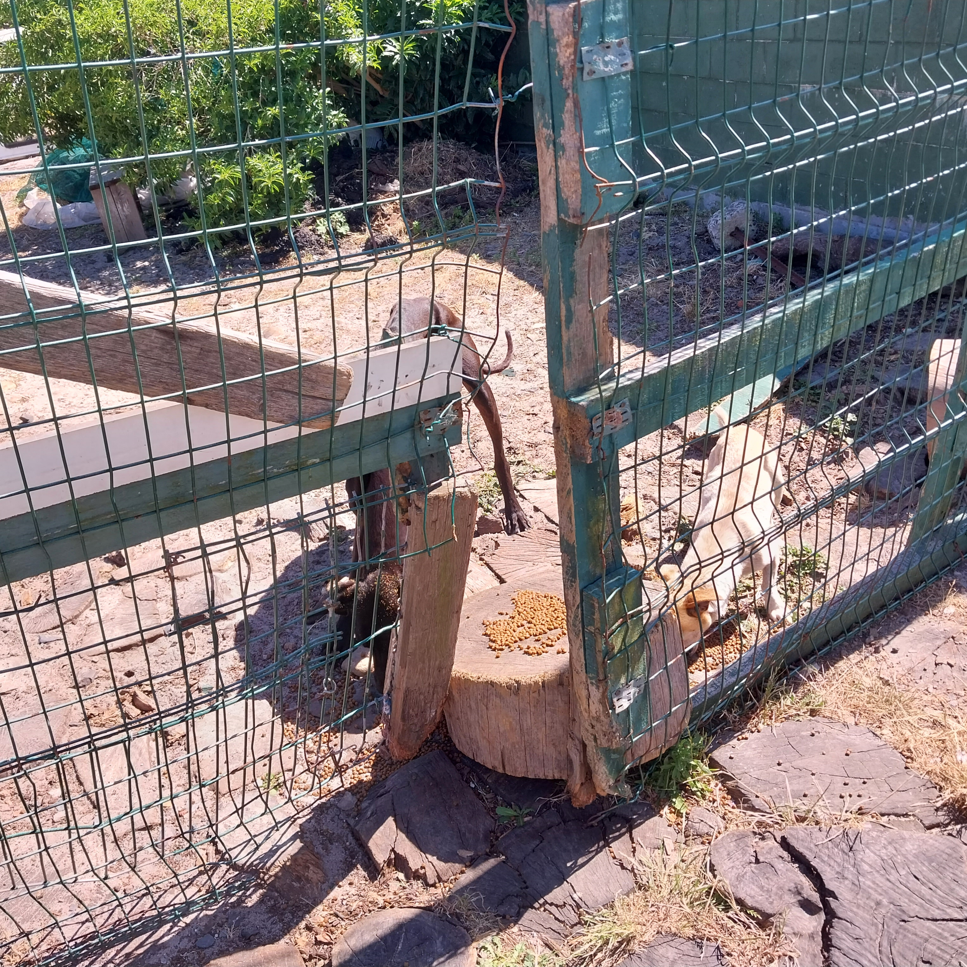
Photographic Evidence - B
Date taken: 27 November 2023
Address: 19 Brookford Road, Lotus River
Taken by: Inspector Theo Arendolf
Taken with: Samsung Galaxy A23 Cellular Phone Camera
Photograph 5: Depicting the two (2) seen in Photograph 4 eating the food provided to them. Note the protruding ribcage of the small white dog as well as the protruding spinal ridges and pelvic bones of the larger black dog. The dogs are underweight evident by their protruding bones and their severe lack of fat and muscle.

