Slide 1

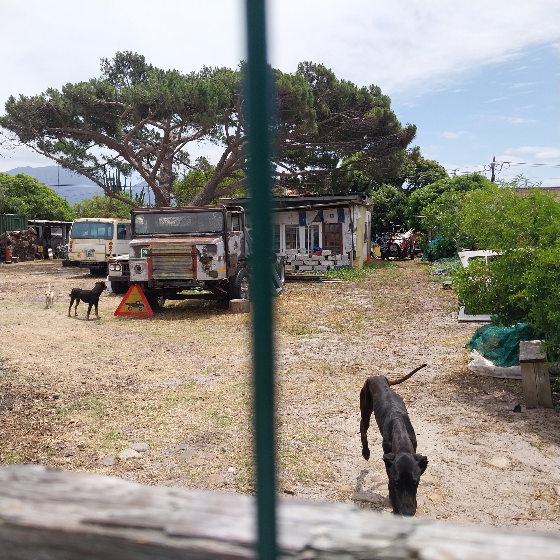
Photographic Evidence - A
Date taken: 24 November 2023
Address: 19 Brookford Road, Lotus River
Taken by: Inspector Theo Arendolf
Taken with: Samsung Galaxy A23 Cellular Phone Camera
Photograph 1: Depicting the protruding ribcages, the protruding pelvic and hipbones as well as the lack of fat and muscle on two black dogs found on the above-mentioned property.

Slide 2
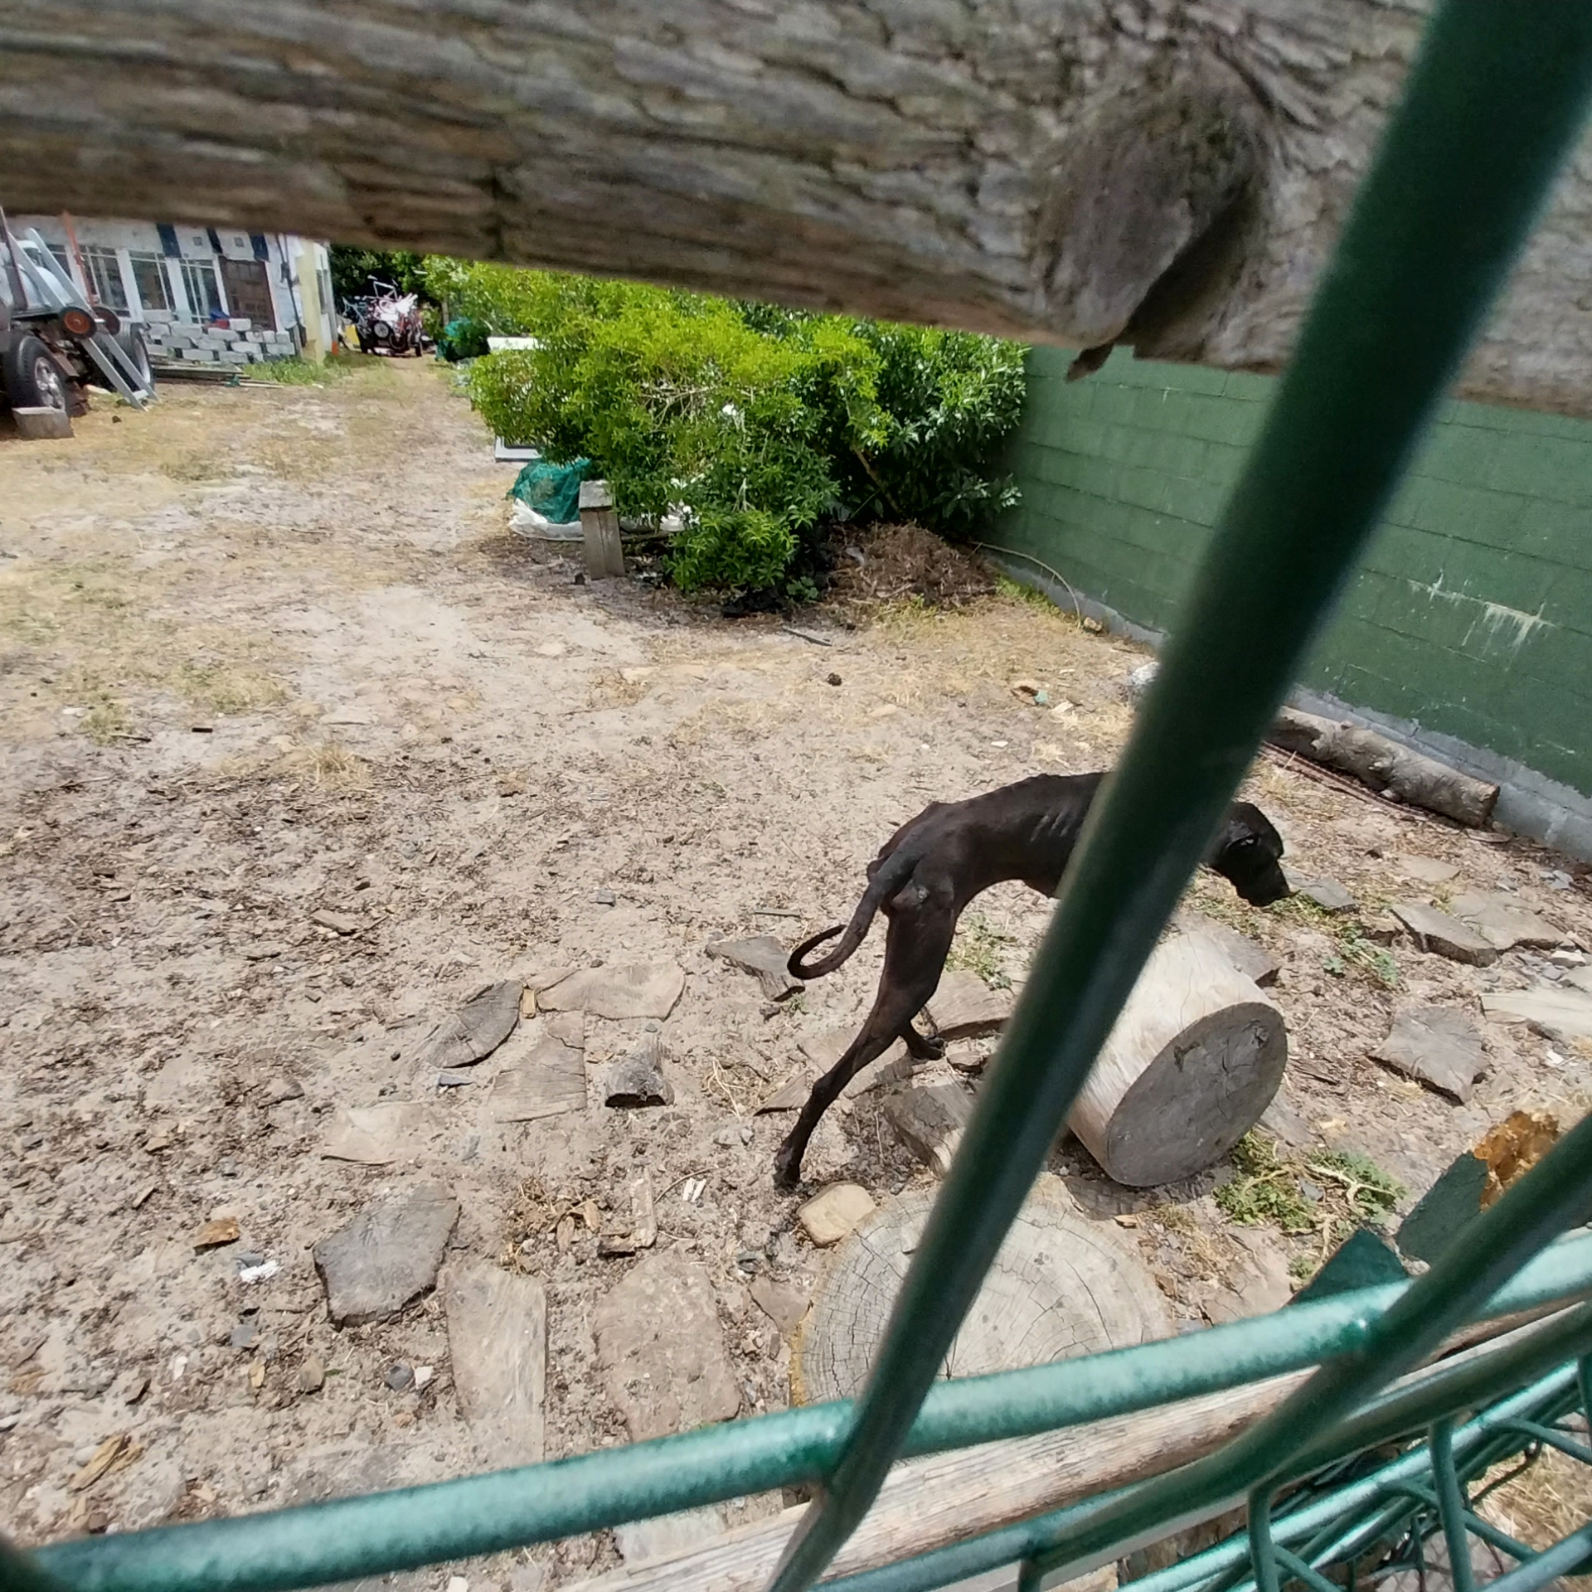
Photographic Evidence - A
Date taken: 24 November 2023
Address: 19 Brookford Road, Lotus River
Taken by: Inspector Theo Arendolf
Taken with: Samsung Galaxy A23 Cellular Phone Camera
Photograph 2: Depicting the protruding hip and pelvic bones, the protruding spinal ridges, the protruding ribcage and the severe abdominal tuck on one of the black dogs seen in Photograph 1.

Slide 3
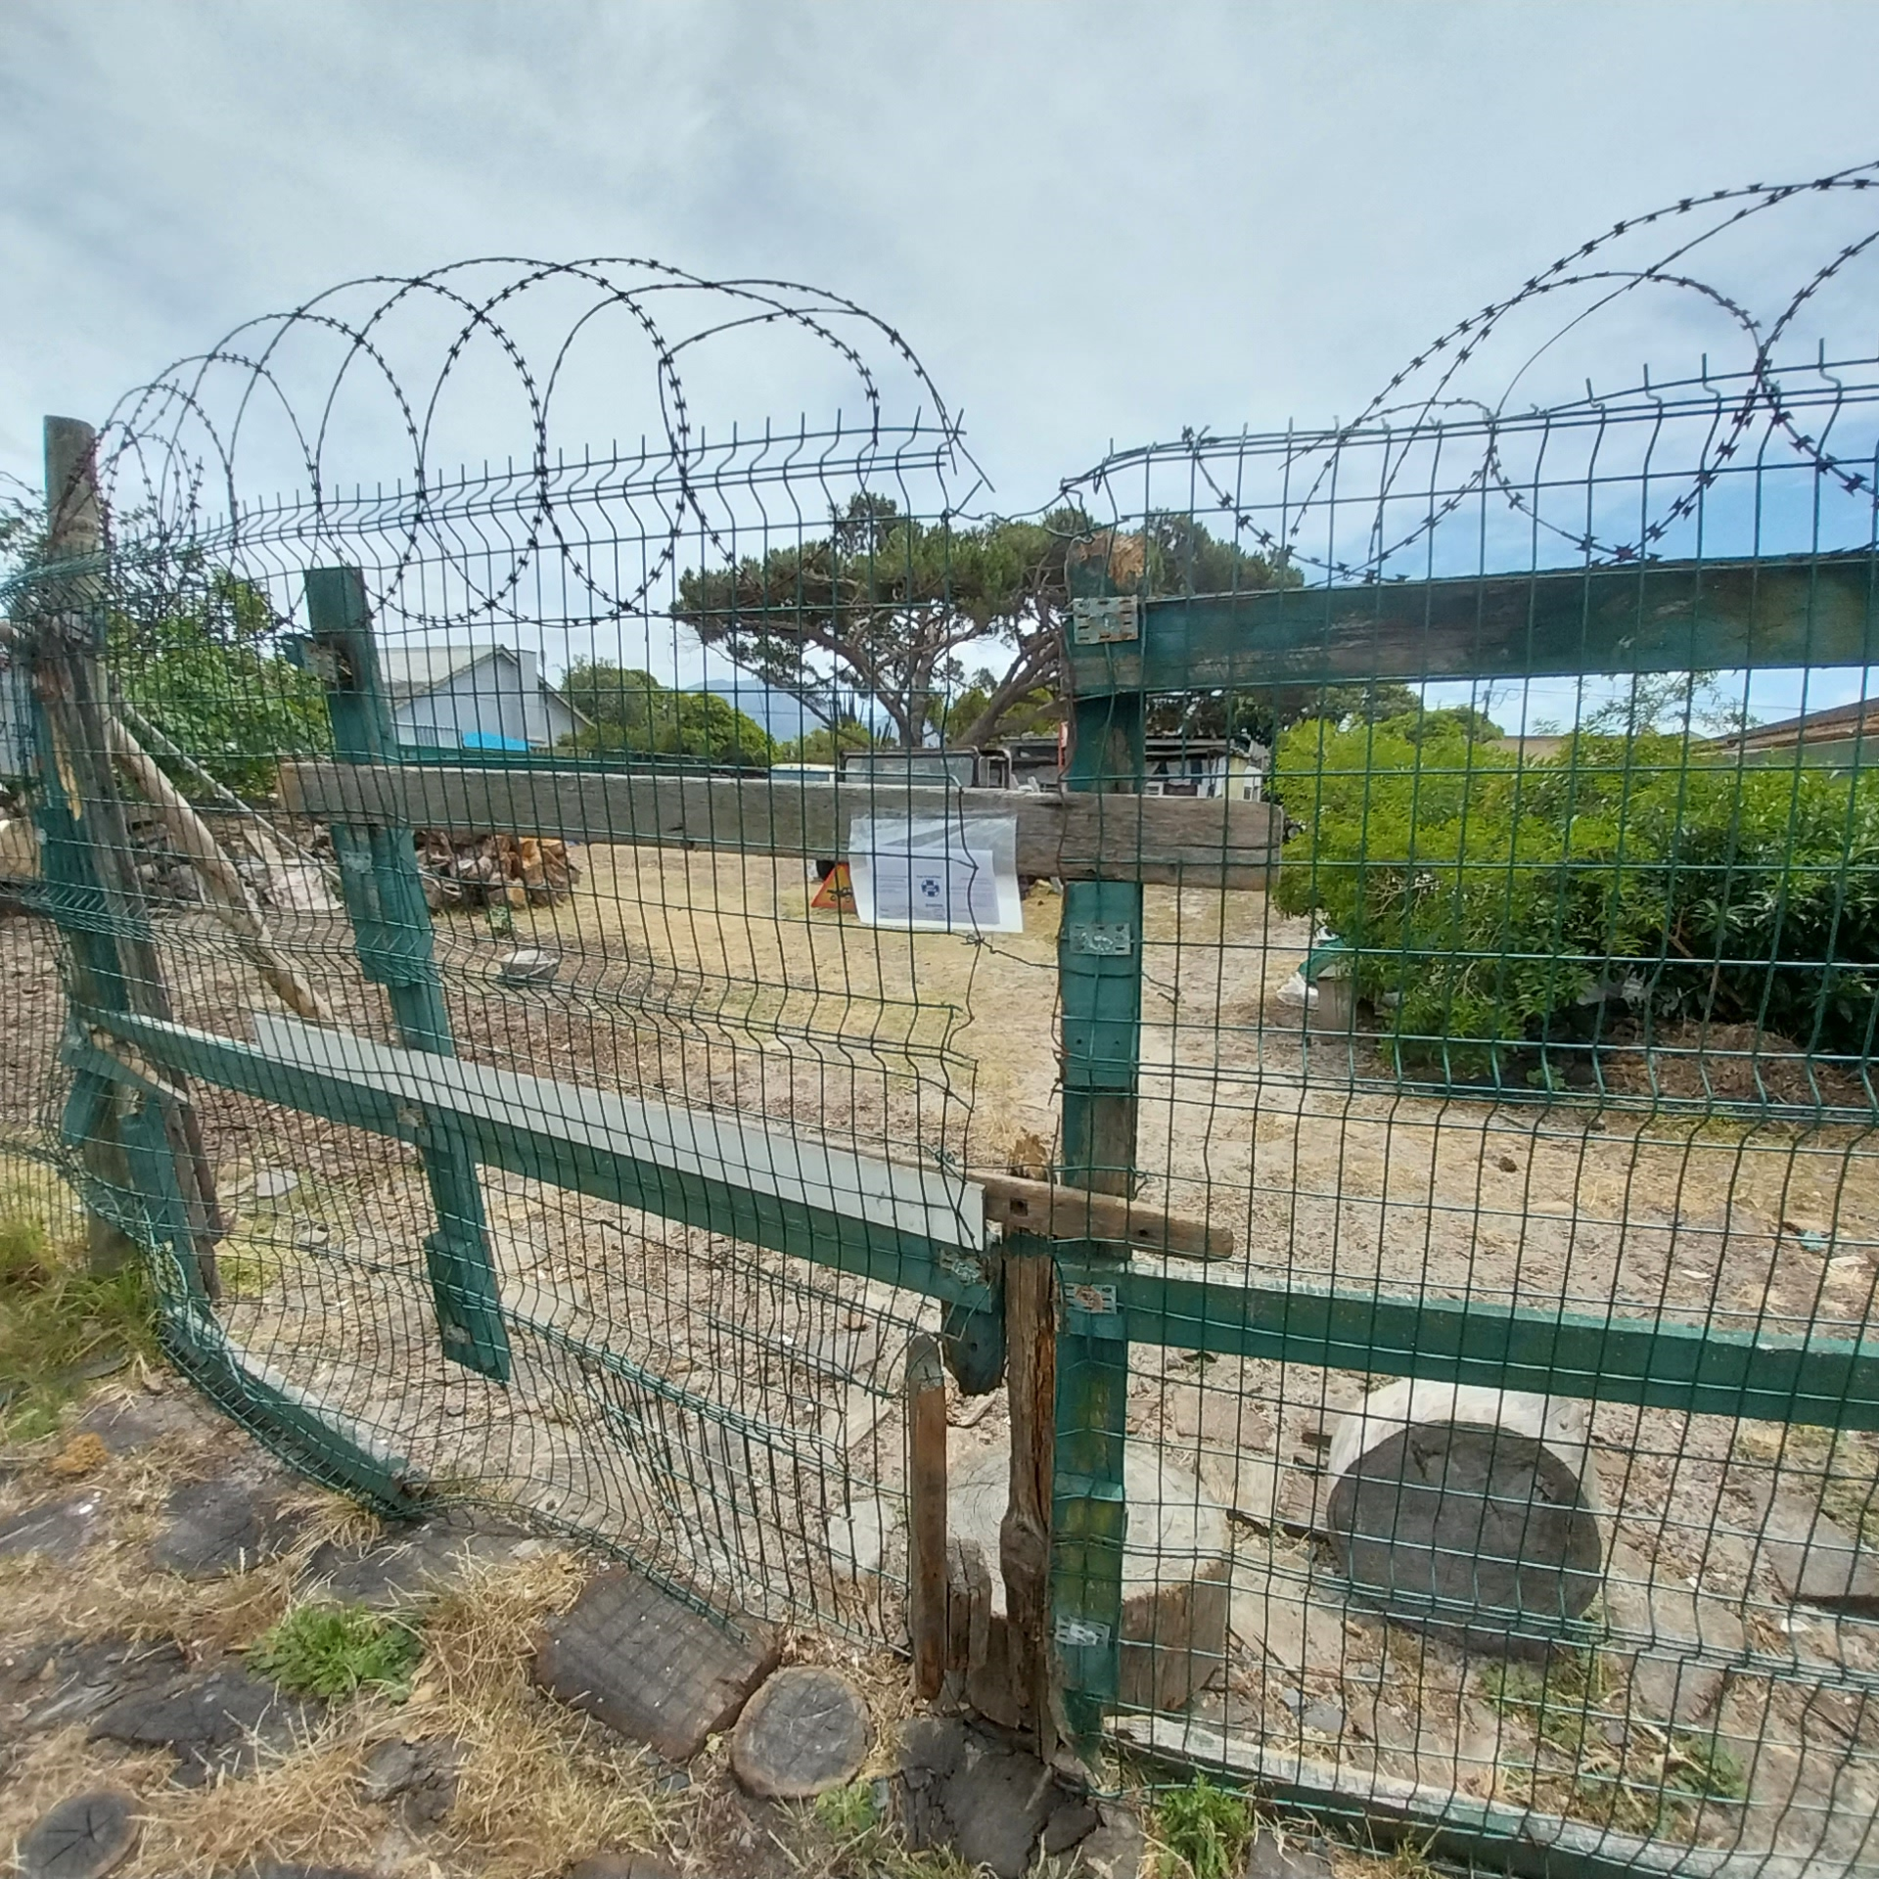
Photographic Evidence - A
Date taken: 24 November 2023
Address: 19 Brookford Road, Lotus River
Taken by: Inspector Theo Arendolf
Taken with: Samsung Galaxy A23 Cellular Phone Camera
Photograph 3: Depicting a warning placed in water-proofing plastic and stuck to the main gate of the property on which the dogs seen in Photographs 1 and 2 are kept.

