Slide 1

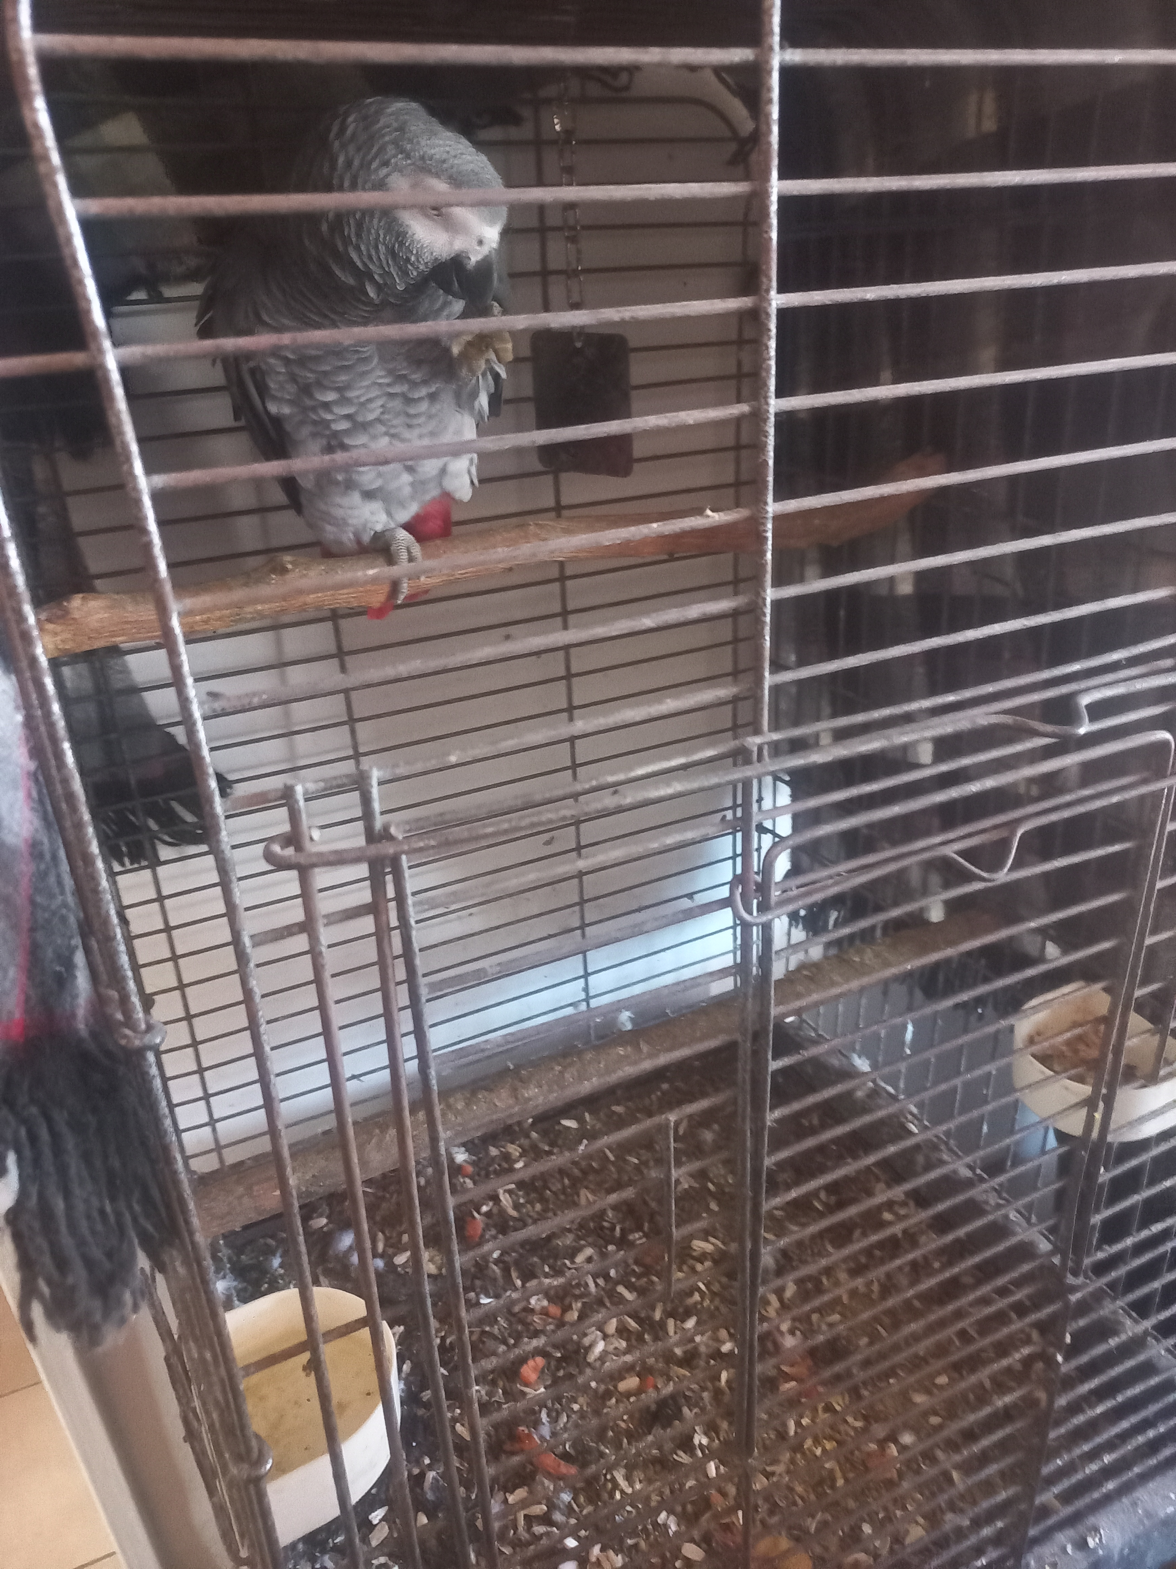
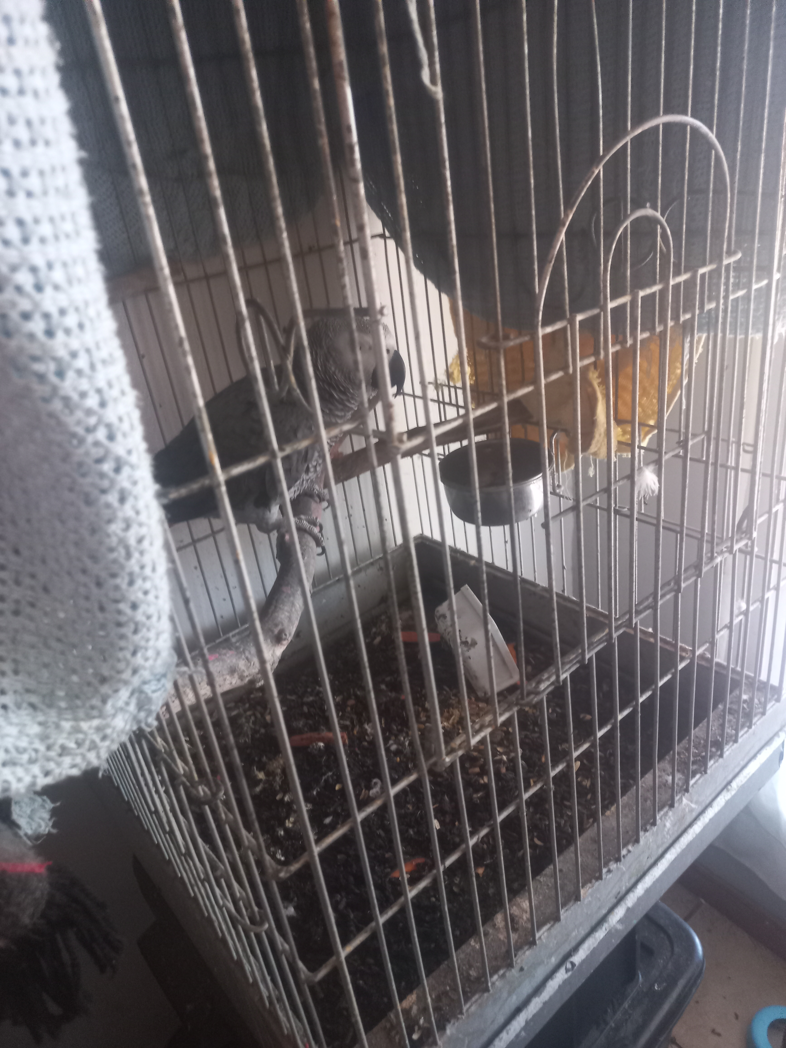
Photographic Evidence A
Date taken: 13 September 2023
Address: 25 4th Avenue, Hazendal, Cape Town
Taken by: Inspector Werner Taljaard
Taken with: Samsung Galaxy A32 Cell Phone
Photograph 1: Depicting an African Grey parrot confined to a cage containing accumulated seed husks, old food, and accumulated faeces. Note the hardened faecal matter lining the bottom perch inside the cage.
Photograph 2: Depicting an African Grey parrot confined to a cage containing accumulated seed husks, old food, and accumulated faeces. Note the faecal matter piling up at the back corner of the cage.

