Slide 1

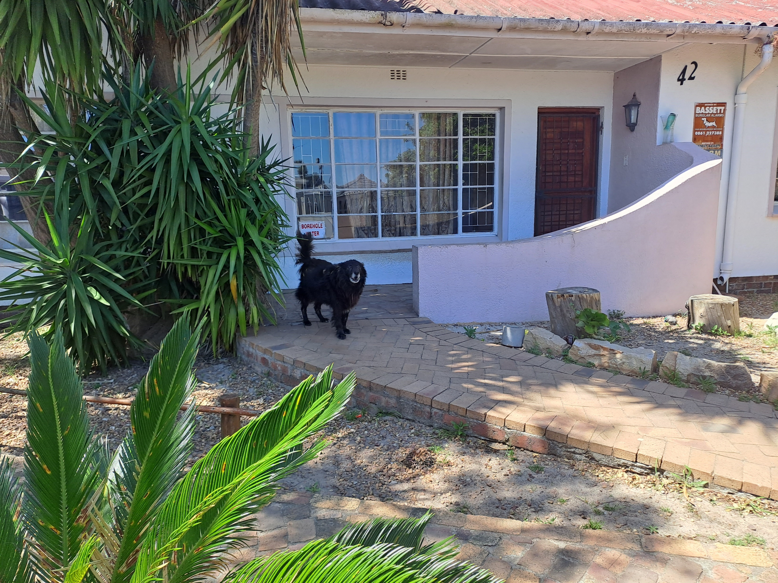
Photographic Evidence C
Date taken: 10 October 2023
Address: 42 Van Der Stel Street, Sunkist
Taken by: Inspector Lee Prins
Taken with: Samsung Galaxy A23 Cellular Phone Camera
1
Photograph 1: Depicting one of the dogs kept at the property seen in Photographic evidence A.

Slide 2
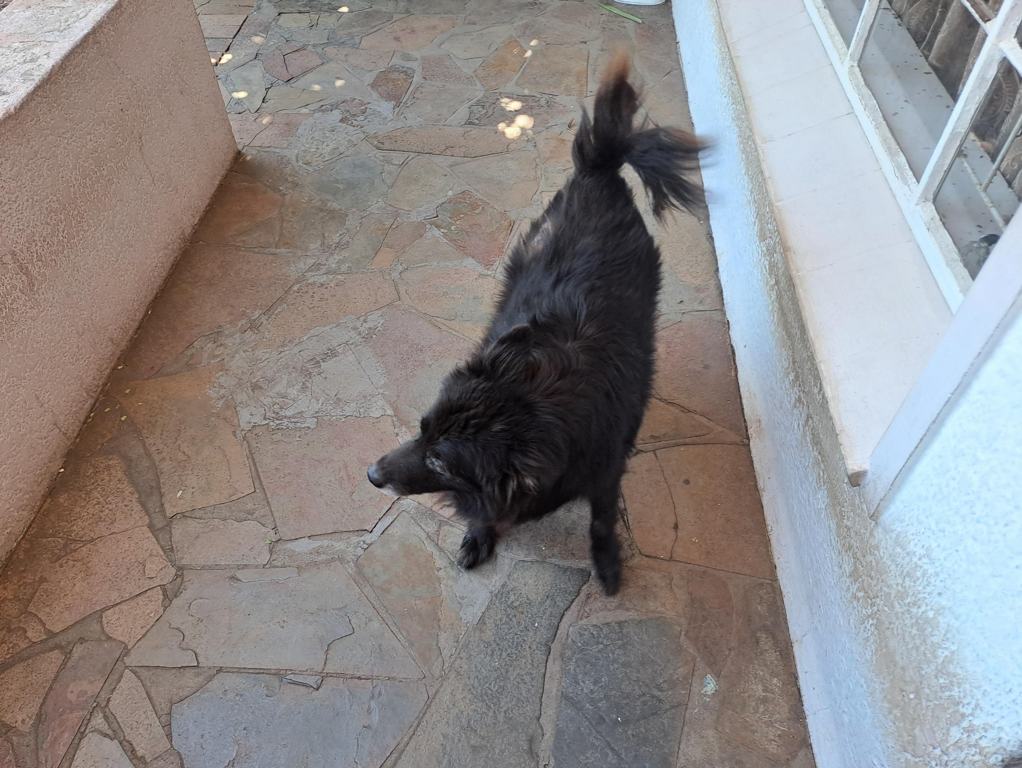
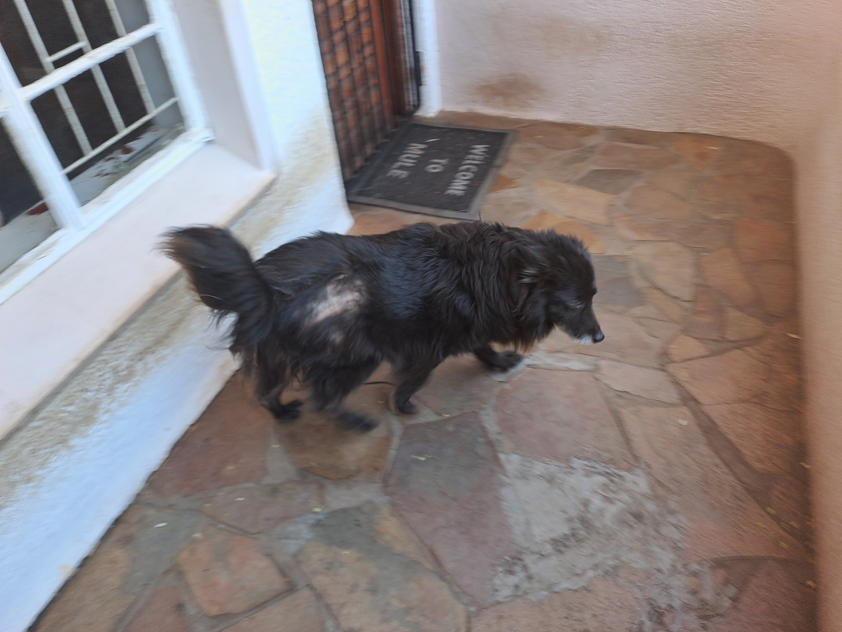
Photographic Evidence C
Date taken: 10 October 2023
Address: 42 Van Der Stel Street, Sunkist
Taken by: Inspector Lee Prins
Taken with: Samsung Galaxy A23 Cellular Phone Camera
2
Photograph 2: Depicting a close up of the dog seen in Photograph 1. Note the hair loss and crusty skin on the dogs right hip of the dog.
3
Photograph 3: Depicting another view of the dog seen in Photograph 1. Note the hair loss on his right hip.

Slide 3
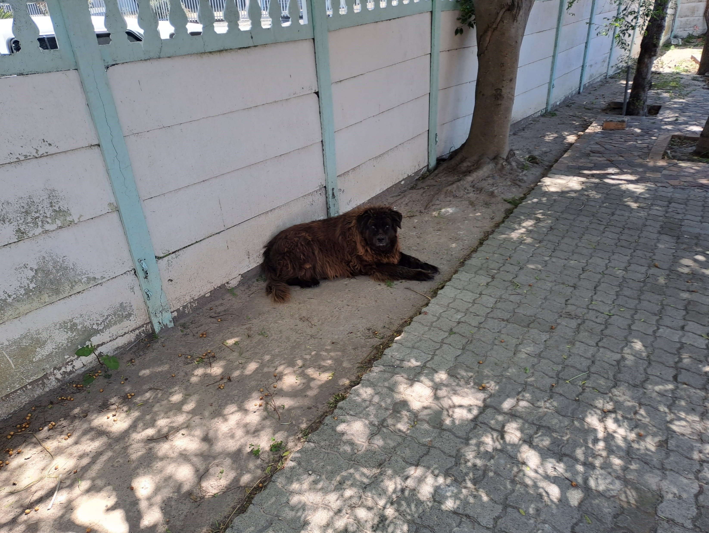
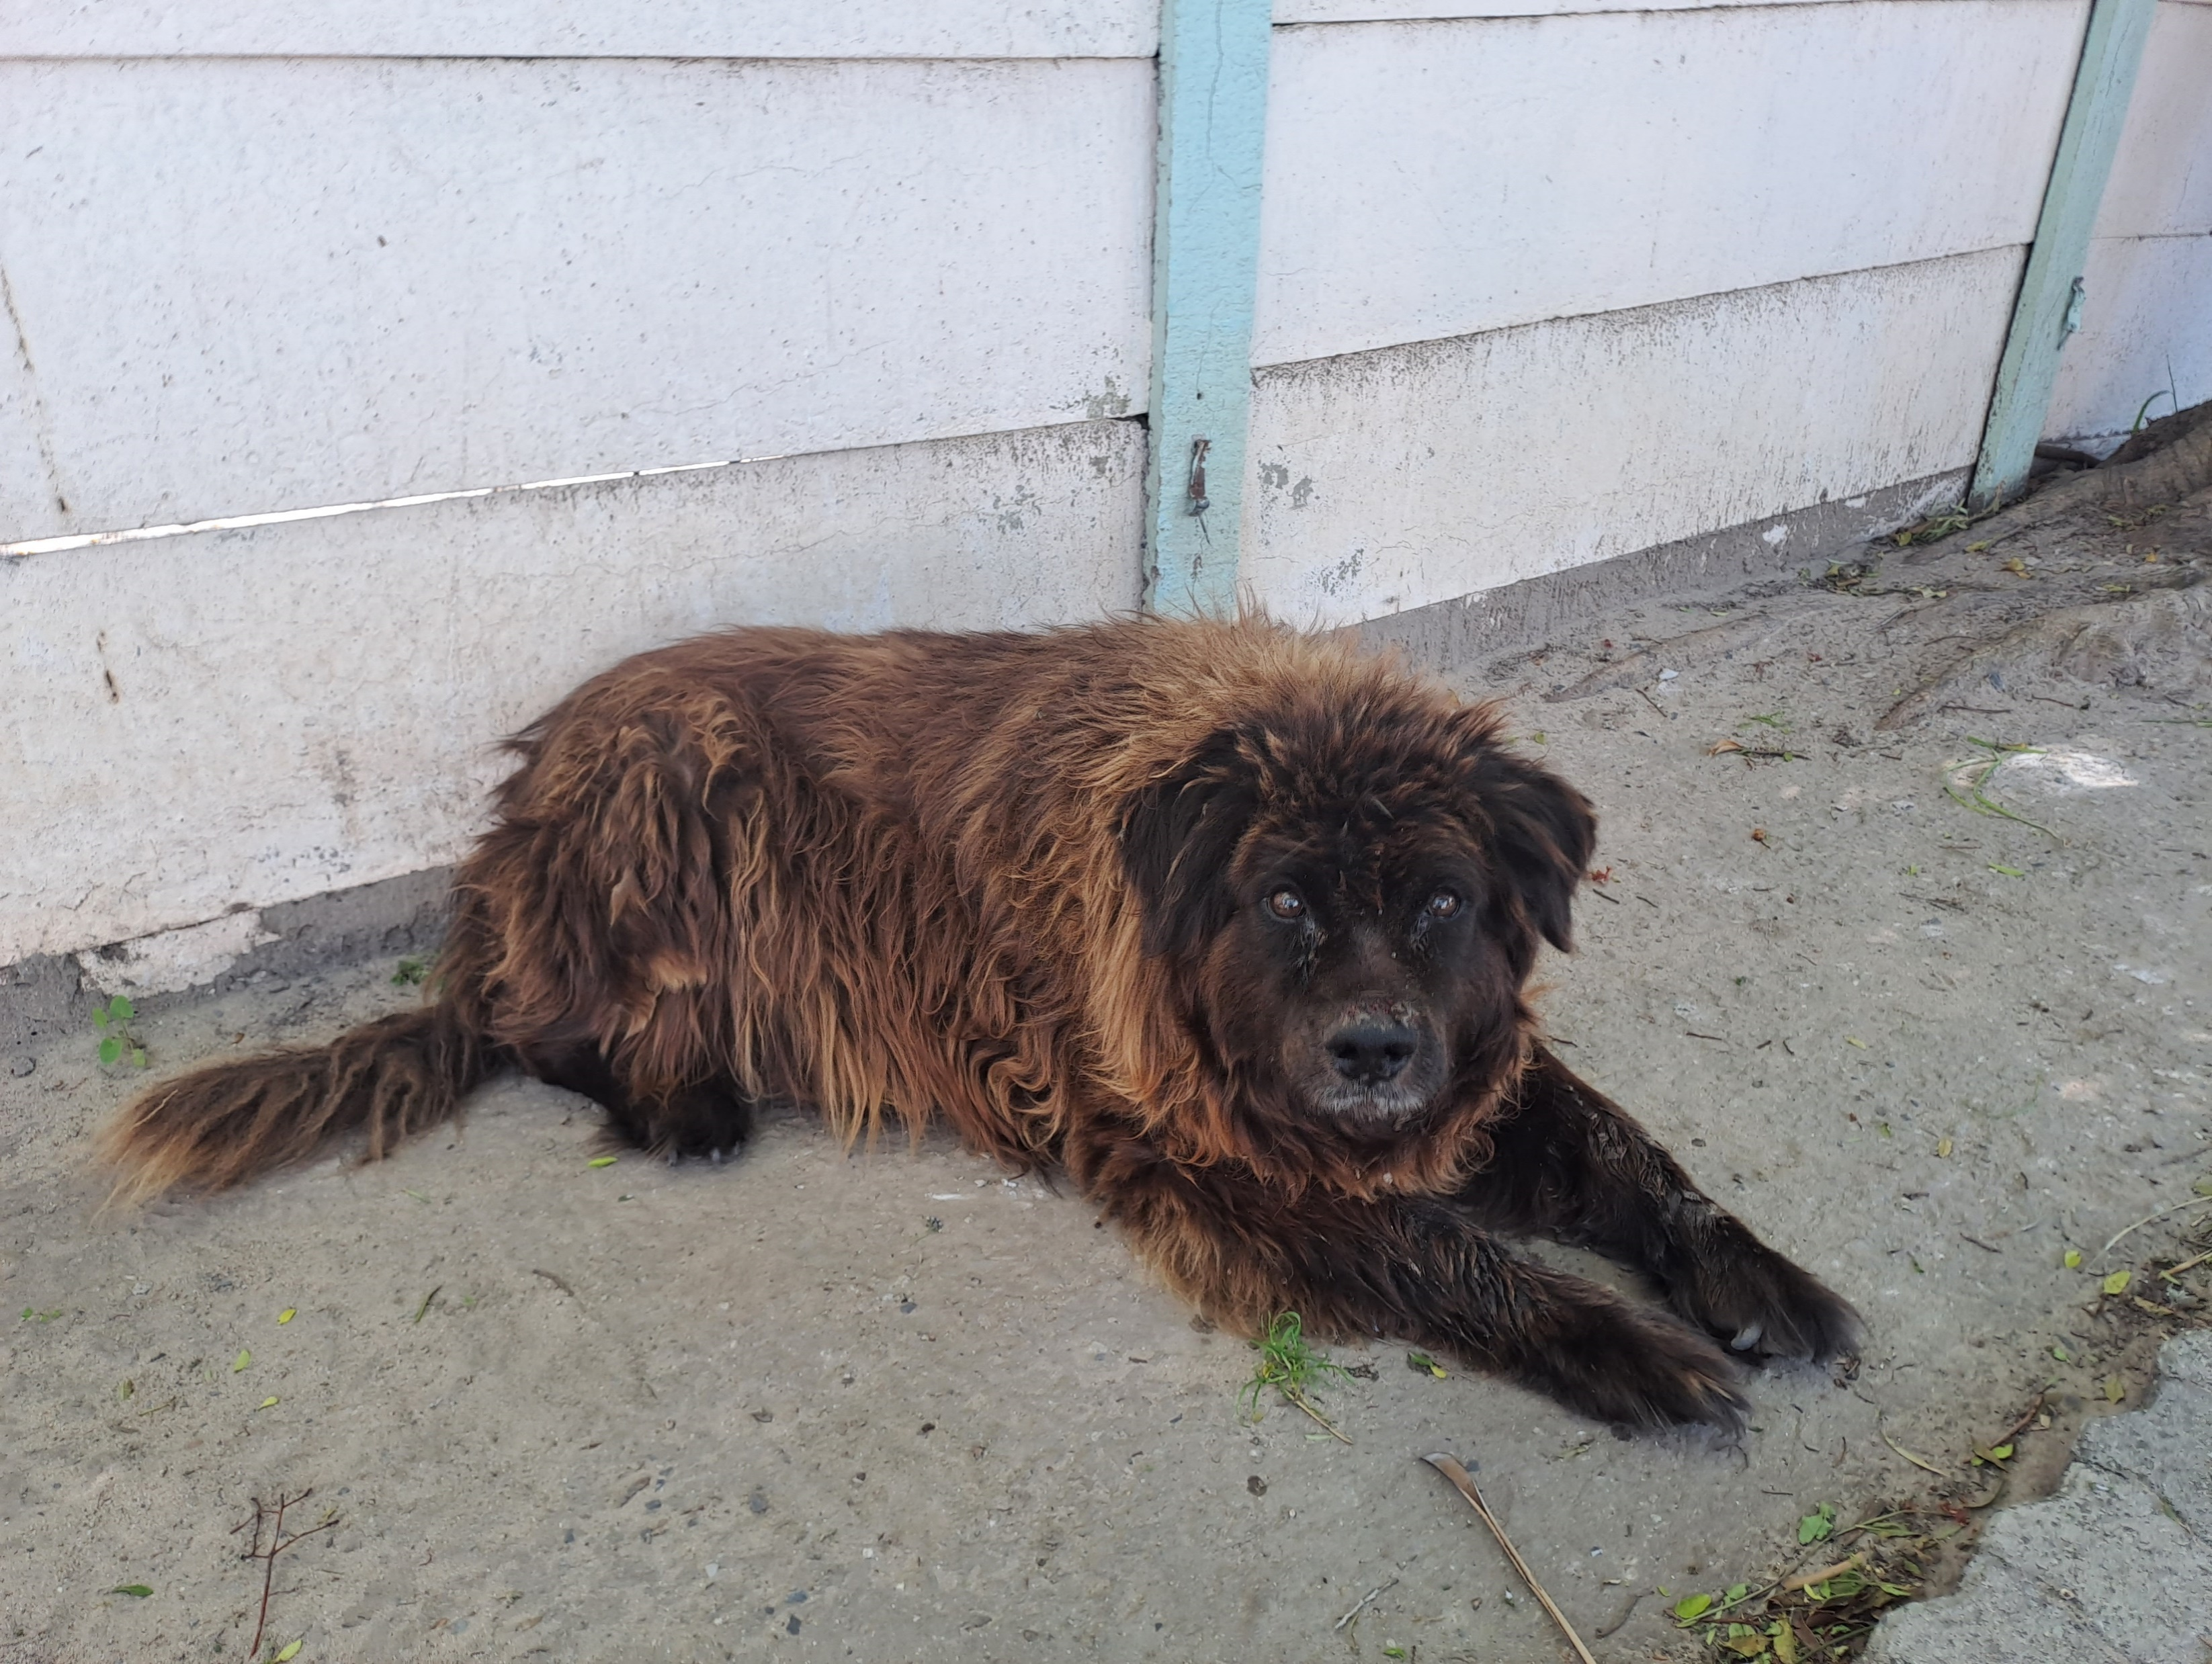
Photographic Evidence C
Date taken: 10 October 2023
Address: 42 Van Der Stel Street, Sunkist
Taken by: Inspector Lee Prins
Taken with: Samsung Galaxy A23 Cellular Phone Camera
4
Photograph 4: Depicting the other dog found on the property mentioned above.
5
Photograph 5: Depicting a close up of the dog seen in Photograph 5.

Slide 4
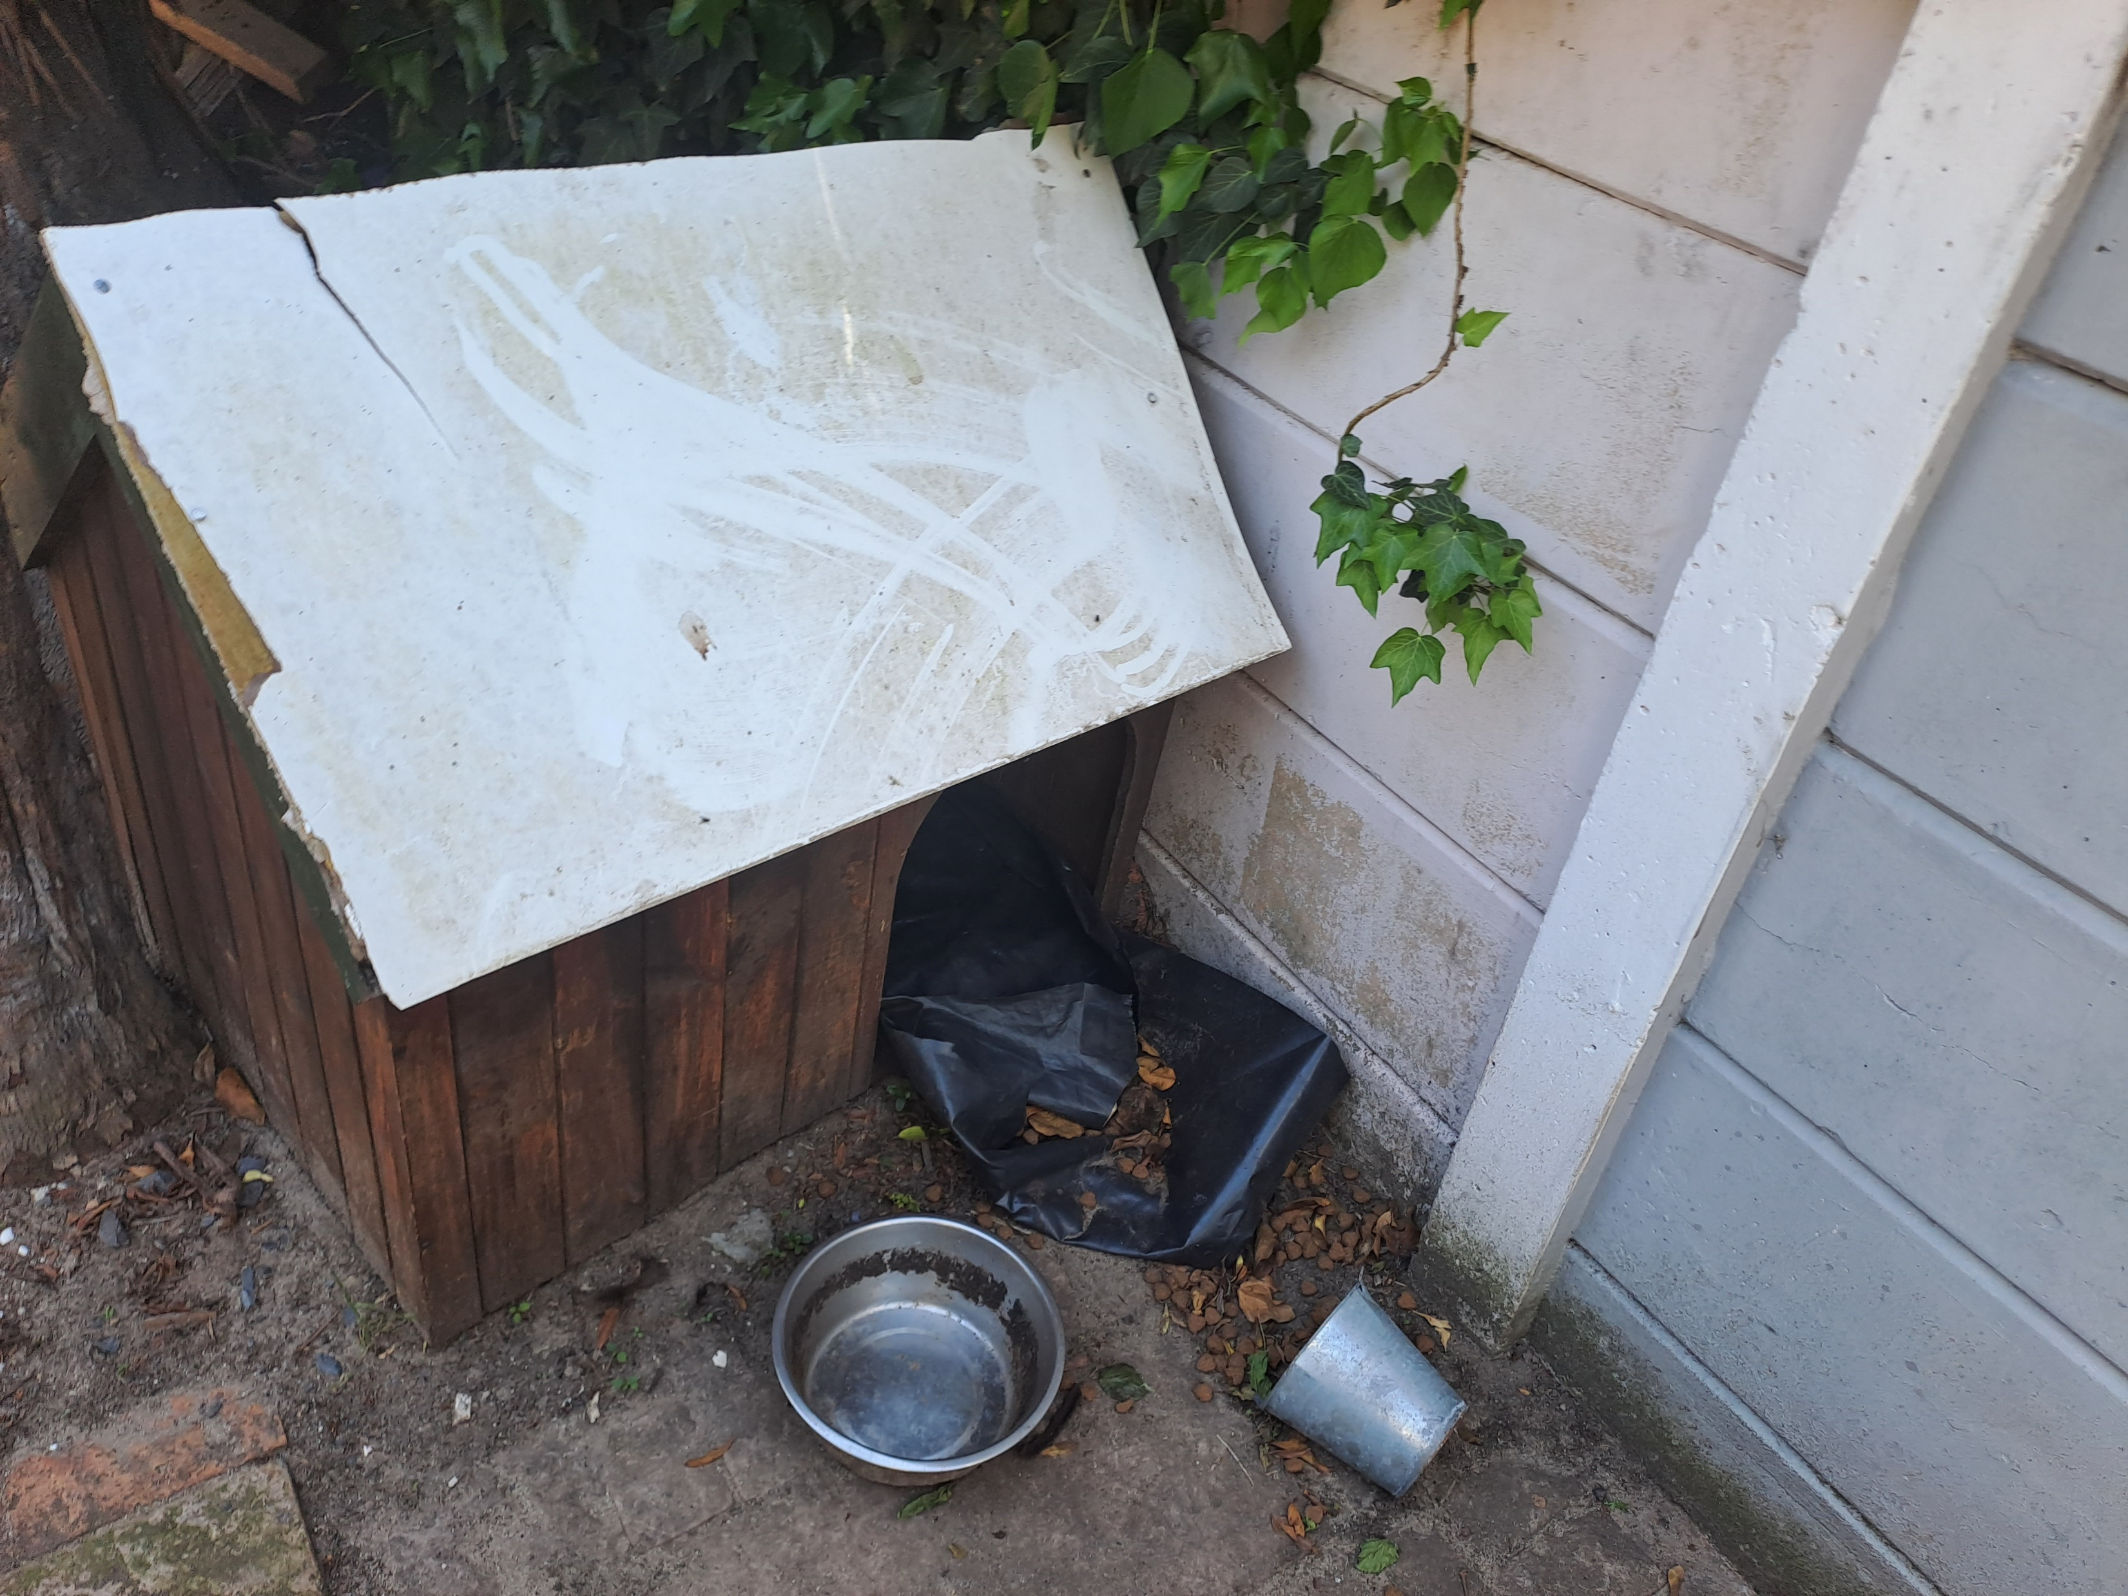
Photographic Evidence C
Date taken: 10 October 2023
Address: 42 Van Der Stel Street, Sunkist
Taken by: Inspector Lee Prins
Taken with: Samsung Galaxy A23 Cellular Phone Camera
6
Photograph 6: Depicting the shelter and empty water container of the dogs seen in previous Photographs. Note that there was no water on the property during the time of the inspection.

Slide 5
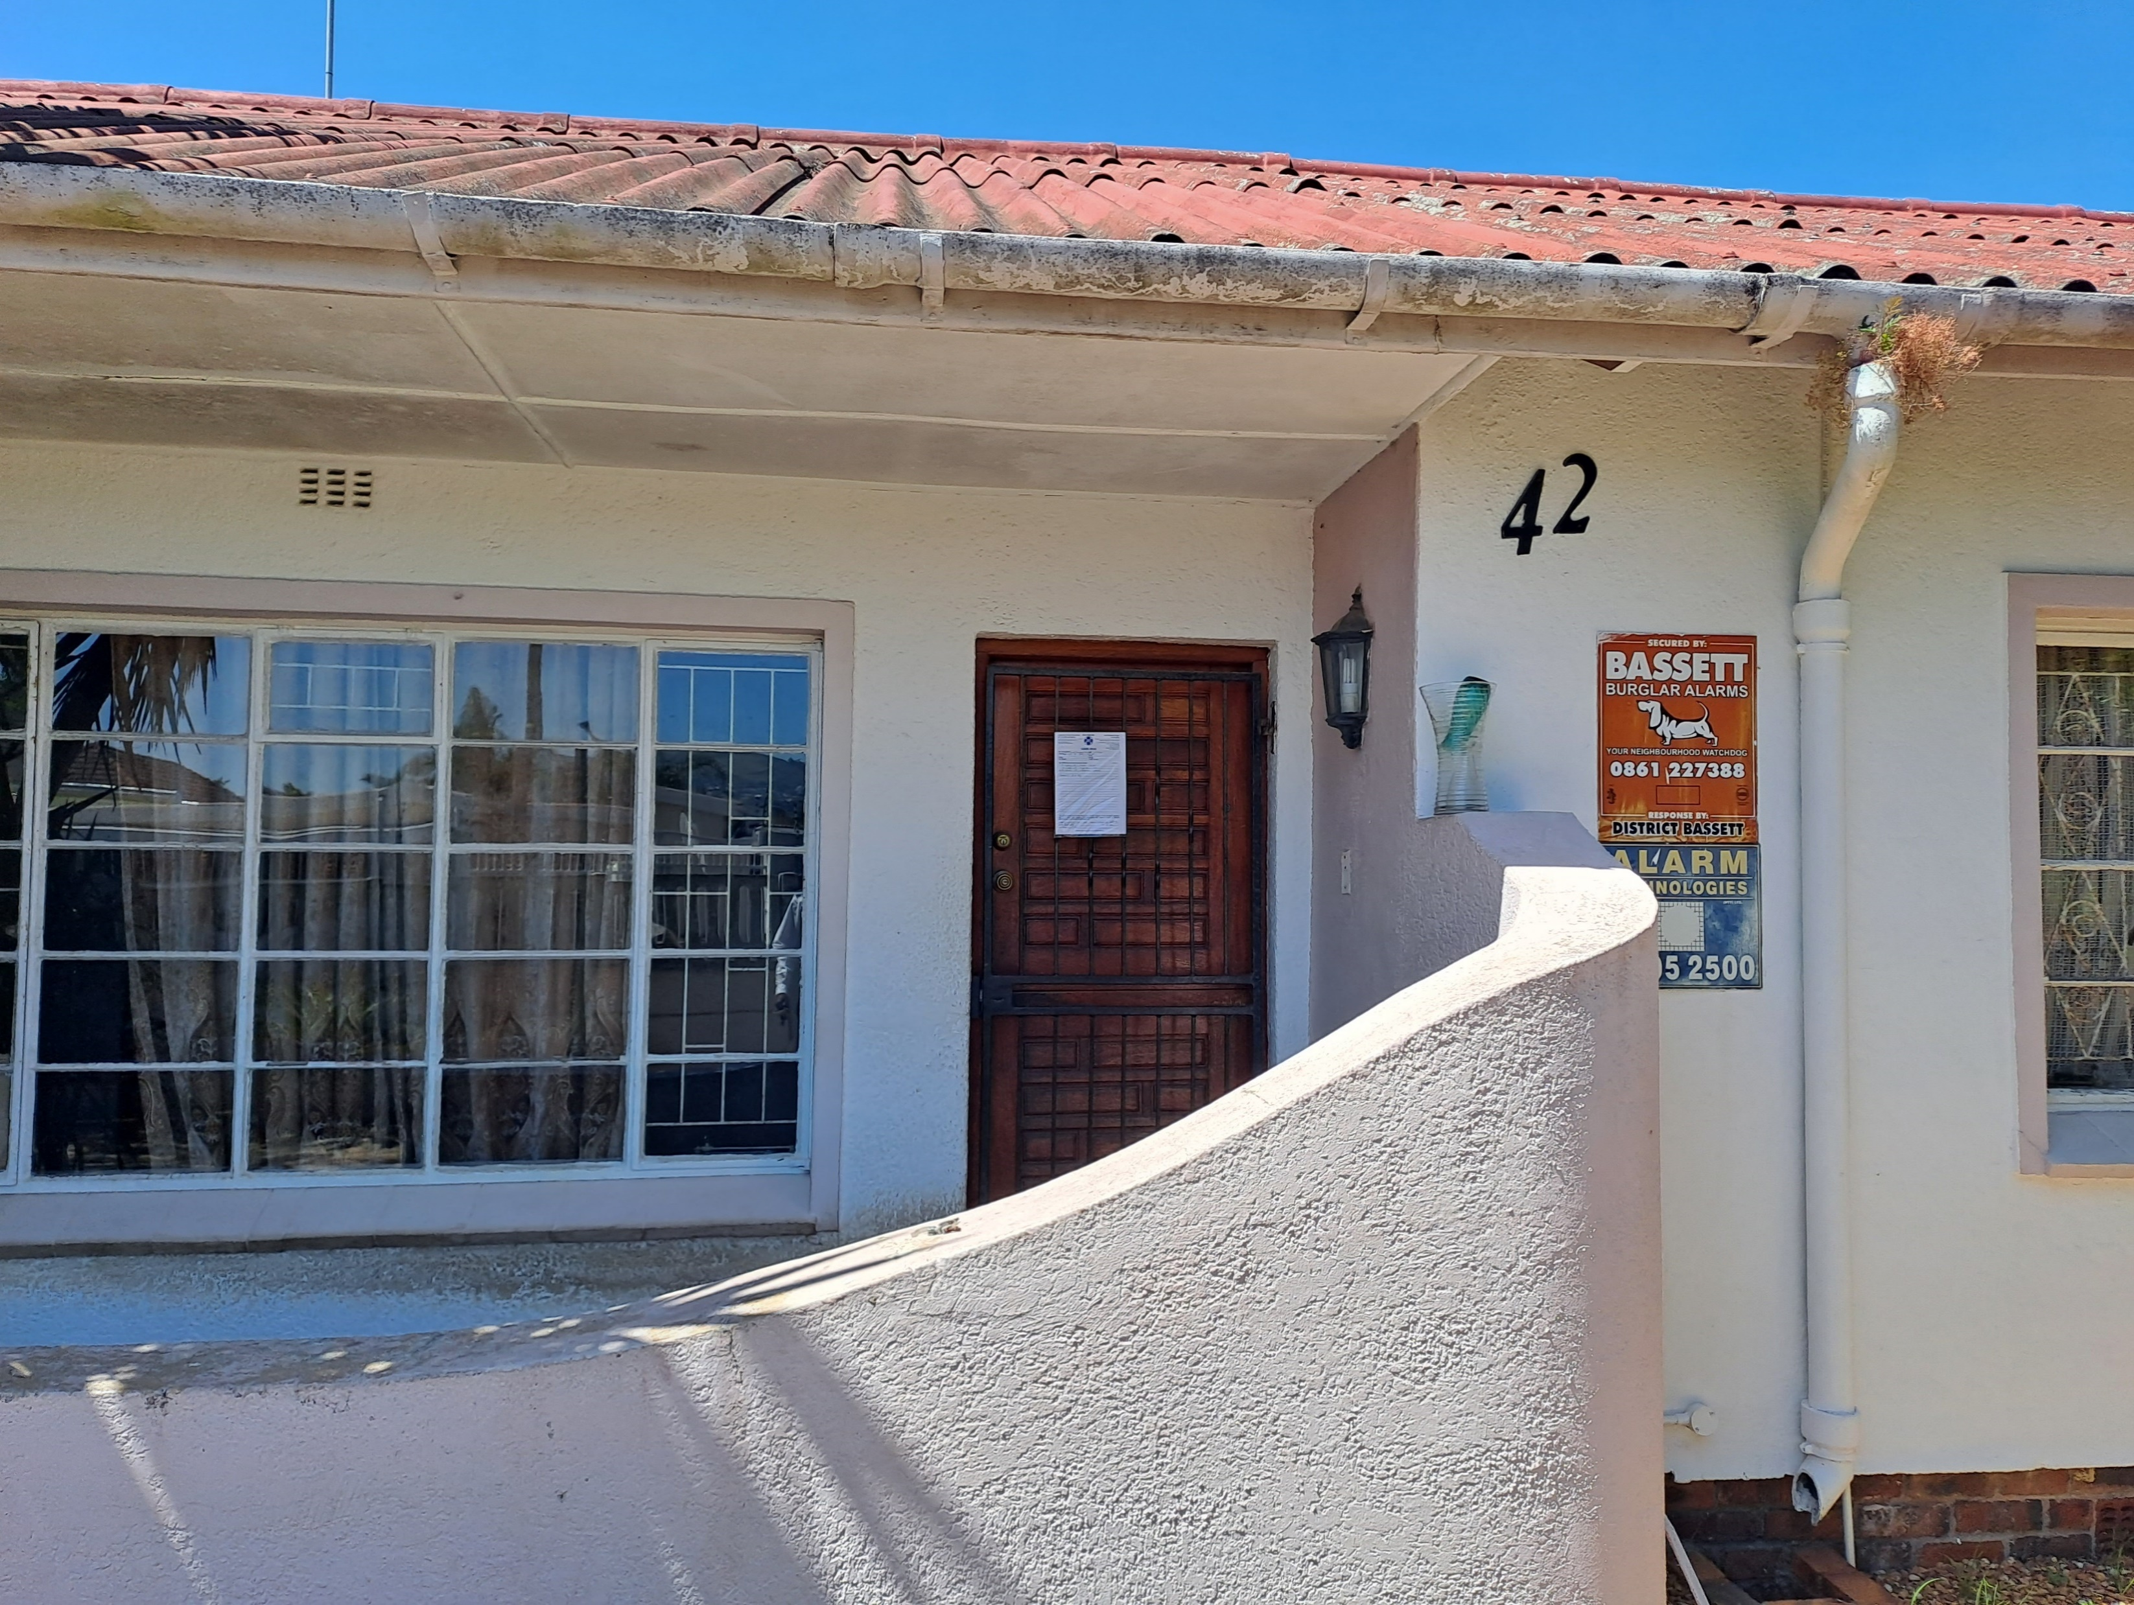
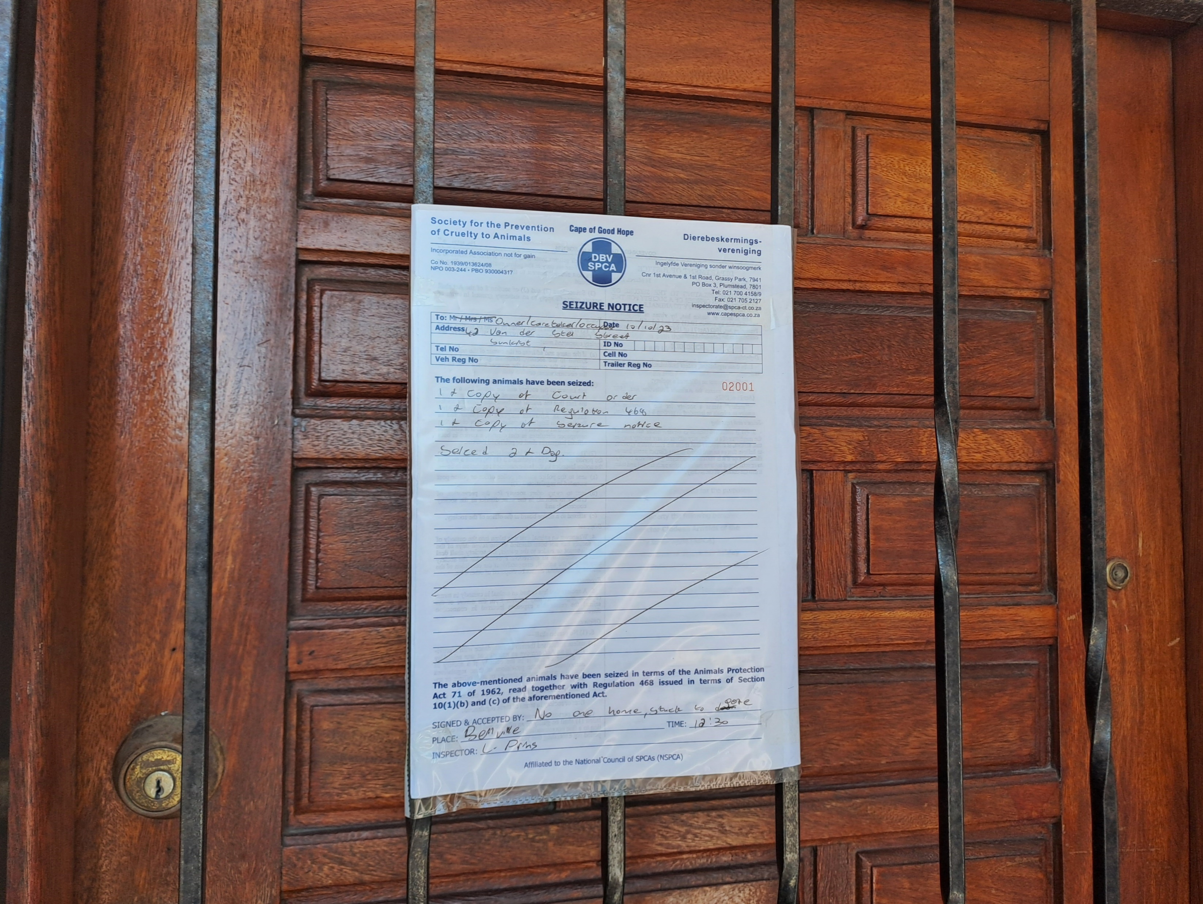
Photographic Evidence C
Date taken: 10 October 2023
Address: 42 Van Der Stel Street, Sunkist
Taken by: Inspector Lee Prins
Taken with: Samsung Galaxy A23 Cellular Phone Camera
7
Photograph 7: Depicting an overall view of the one door of the house where the seizure notice had been left.
8
Photograph 8: Depicting a close up of the seizure notice seen in Photograph 7.

