Slide 1

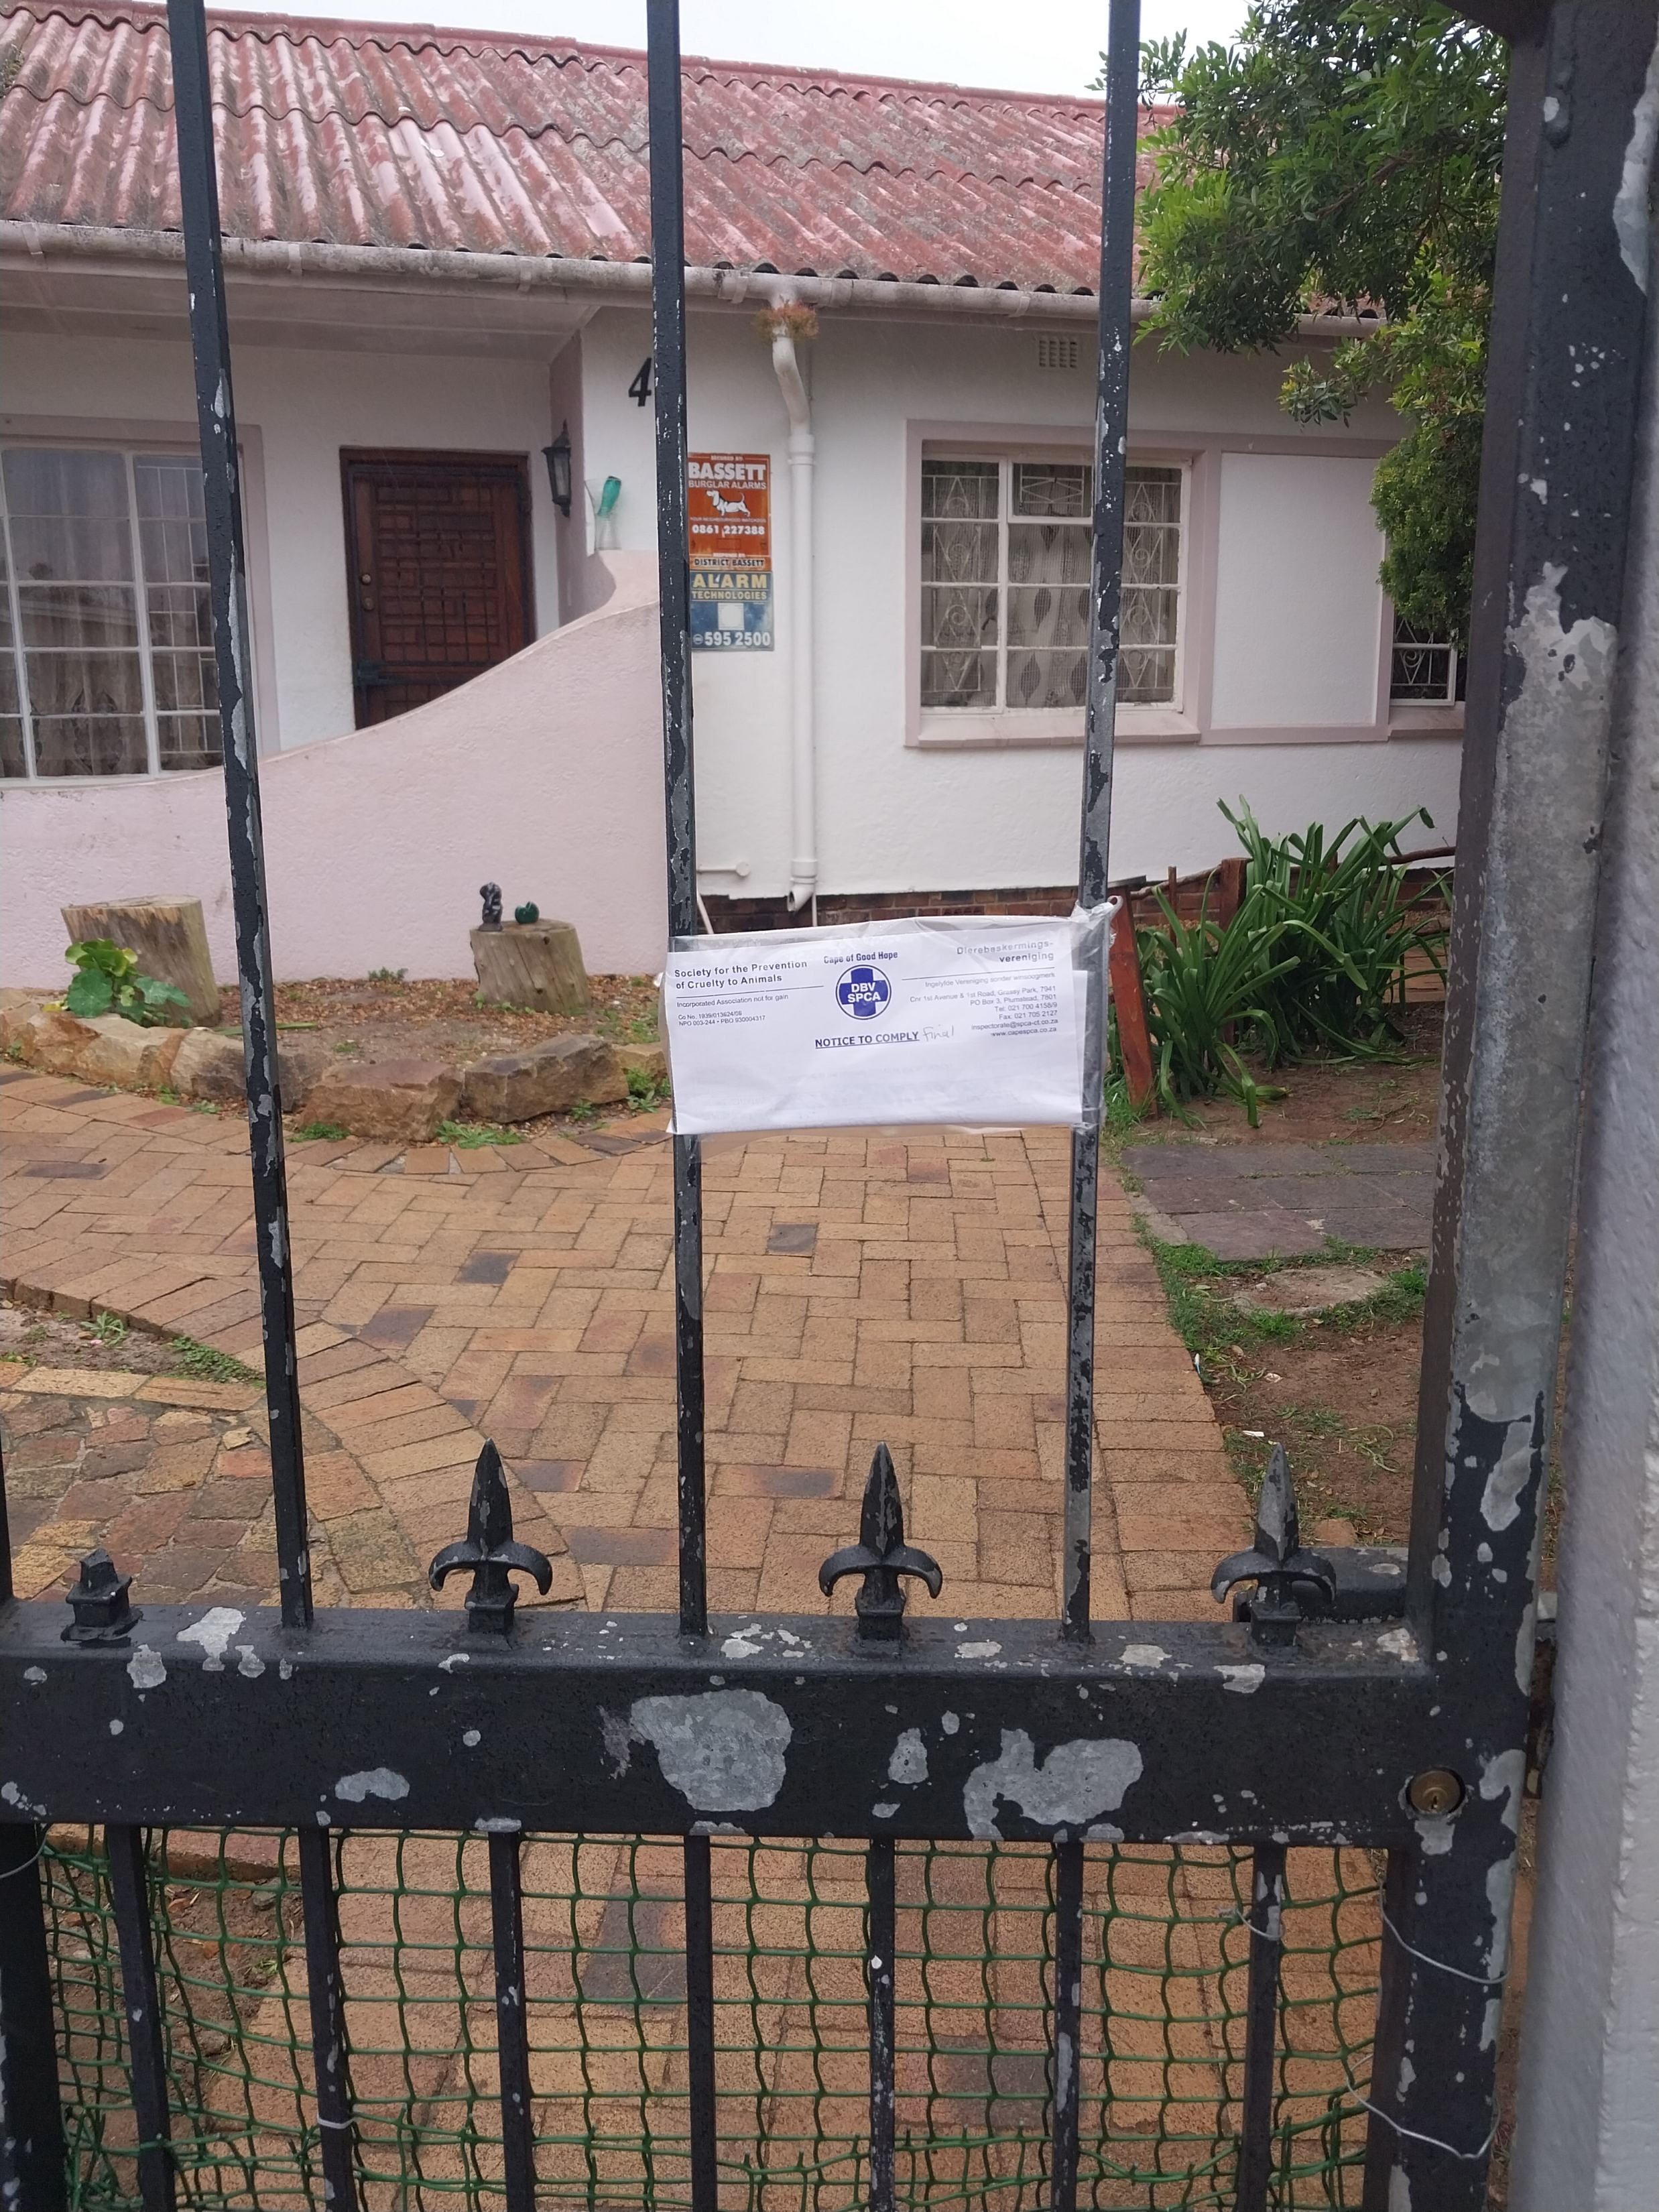
Photographic Evidence B
Date taken: 21 September 2023
Address: 42 Van Der Stel Street, Sunkist
Taken by: Cadet Inspector Clodeen Arnolds
Taken with: Samsung Galaxy A23 Cellular Phone Camera
1
Photograph 1: Depicting the final notice to comply left on the gate of 42 Van Der Stel Street, Sunkist on 21 September 2023.

