Slide 1

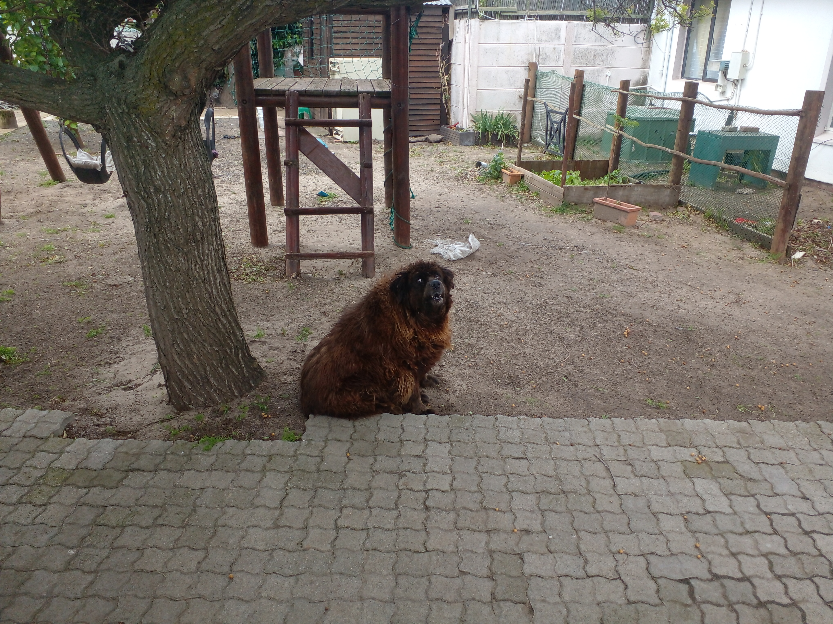
Photographic Evidence A
Date taken: 16 September 2023
Address: 42 Van Der Stel Street, Sunkist
Taken by: Cadet Inspector Clodeen Arnolds
Taken with: Samsung Galaxy A23 Cellular Phone Camera
1
Photograph 1: Depicting a dog with a severely matted coat.

