Slide 1

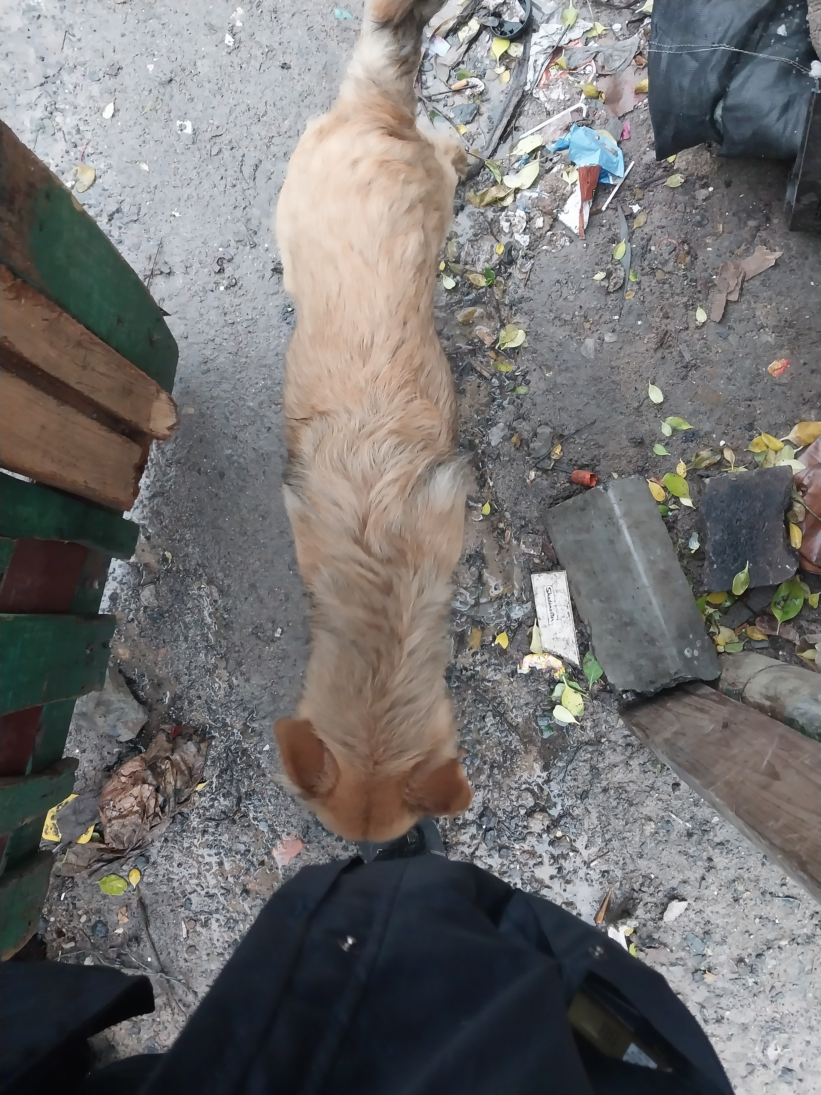
Photographic Evidence F
Date taken: 08 June 2023
Address: 6066 Leonard Doman Road, Macassar
Taken by: Trainee Inspector Clodeen Arnolds
Taken with: Samsung Galaxy A23 Cellular Phone Camera
1
Photograph 1: Depicting on of the dogs seen in Photographic evidence A. Note that this dog lost condition since the first inspection carried out on 23 February 2023.

Slide 2
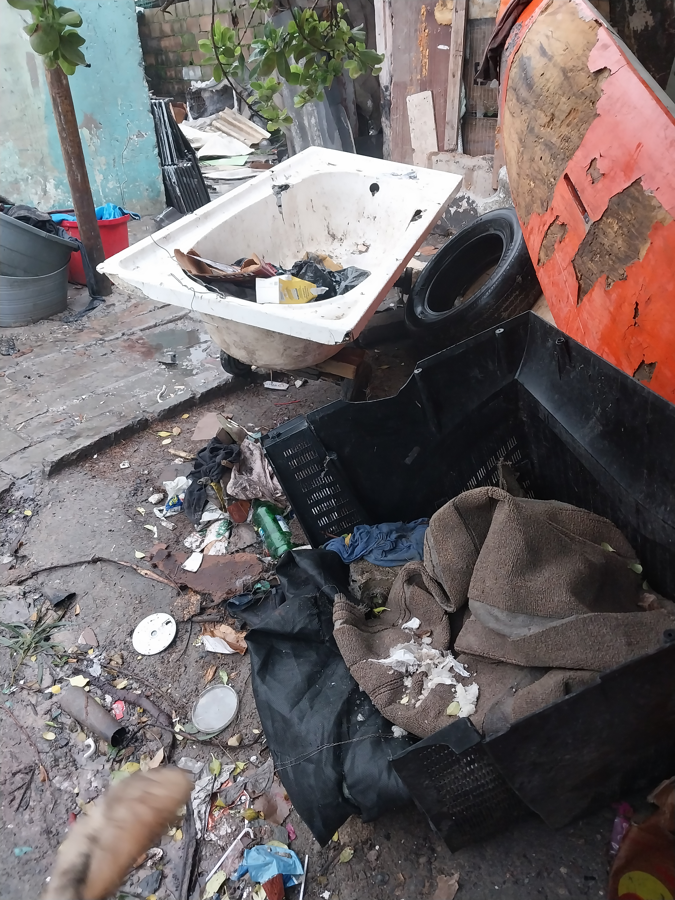
Photographic Evidence F
Date taken: 08 June 2023
Address: 6066 Leonard Doman Road, Macassar
Taken by: Trainee Inspector Clodeen Arnolds
Taken with: Samsung Galaxy A23 Cellular Phone Camera
2
Photograph 2: Depicting the living conditions of the dogs seen in Photographic evidence A. Note the rubbish, rubble and hazardous objects within their living environment.

Slide 3
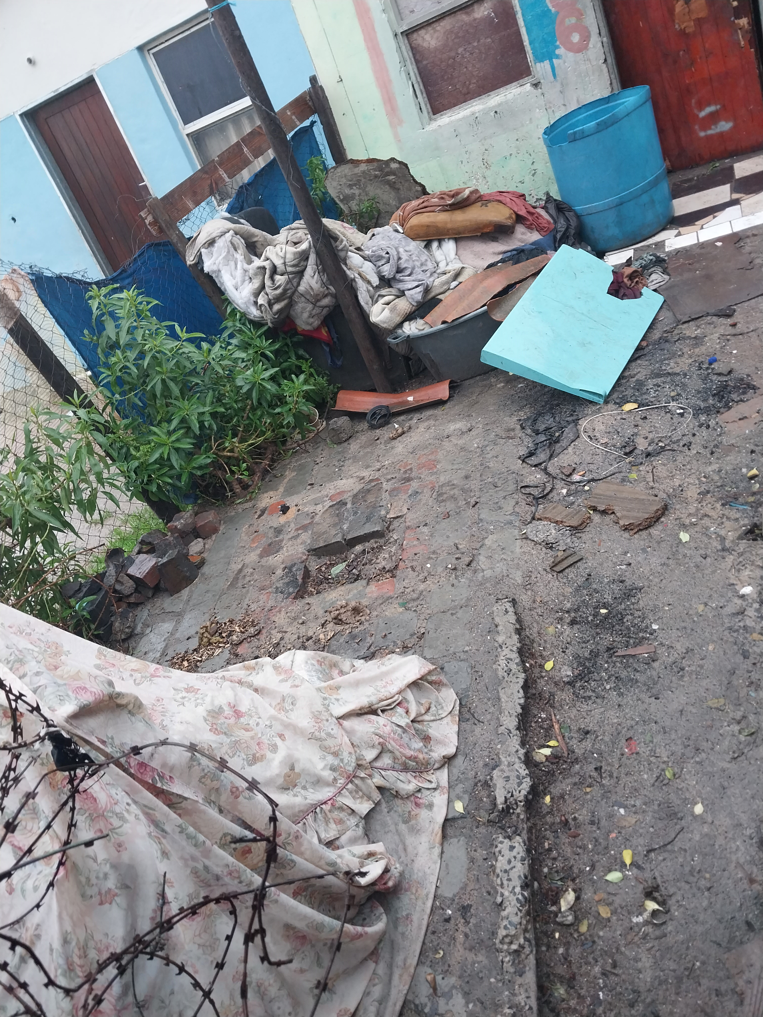
Photographic Evidence F
Date taken: 08 June 2023
Address: 6066 Leonard Doman Road, Macassar
Taken by: Trainee Inspector Clodeen Arnolds
Taken with: Samsung Galaxy A23 Cellular Phone Camera
3
Photograph 3: Depicting another view of the living environment of the dogs seen in Photographic evidence A. Note the rubble and hazardous objects within their living environment.

Slide 4
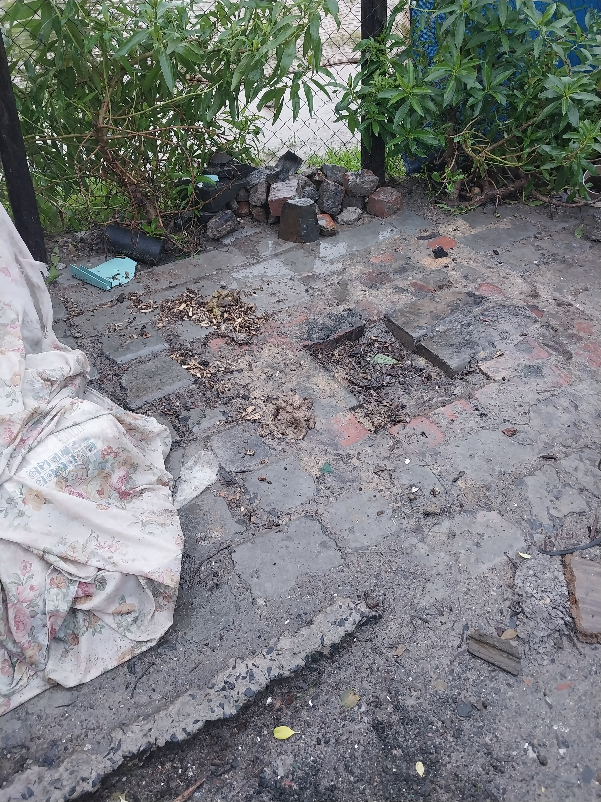
Photographic Evidence F
Date taken: 08 June 2023
Address: 6066 Leonard Doman Road, Macassar
Taken by: Trainee Inspector Clodeen Arnolds
Taken with: Samsung Galaxy A23 Cellular Phone Camera
4
Photograph 4: Depicting a close up of the rubble referred to in Photograph 3.

Slide 5
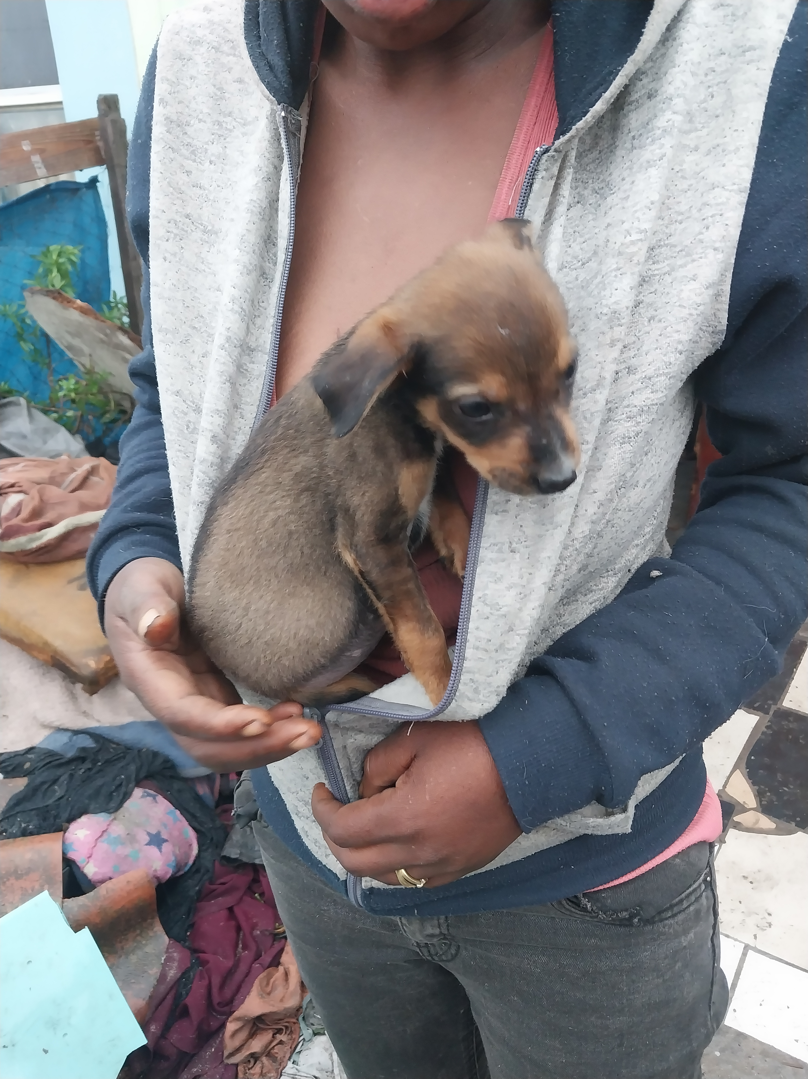
Photographic Evidence F
Date taken: 08 June 2023
Address: 6066 Leonard Doman Road, Macassar
Taken by: Trainee Inspector Clodeen Arnolds
Taken with: Samsung Galaxy A23 Cellular Phone Camera
5
Photograph 5: Depicting a puppy found on the same property seen in Photograph 1 and in Photographic evidence A.

