Slide 1

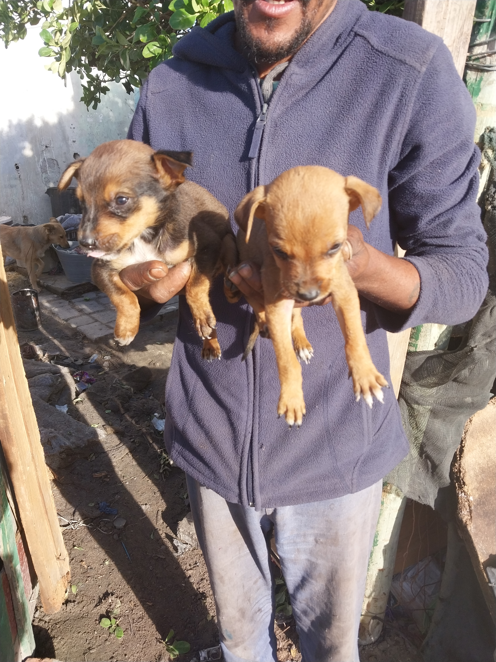
Photographic Evidence E
Date taken: 16 May 2023
Address: 6066 Leonard Doman Road, Macassar
Taken by: Trainee Inspector Clodeen Arnolds
Taken with: Samsung Galaxy A23 Cellular Phone Camera
1
Photograph 1: Depicting two puppies found on the same property seen in Photographic evidence A.

Slide 2
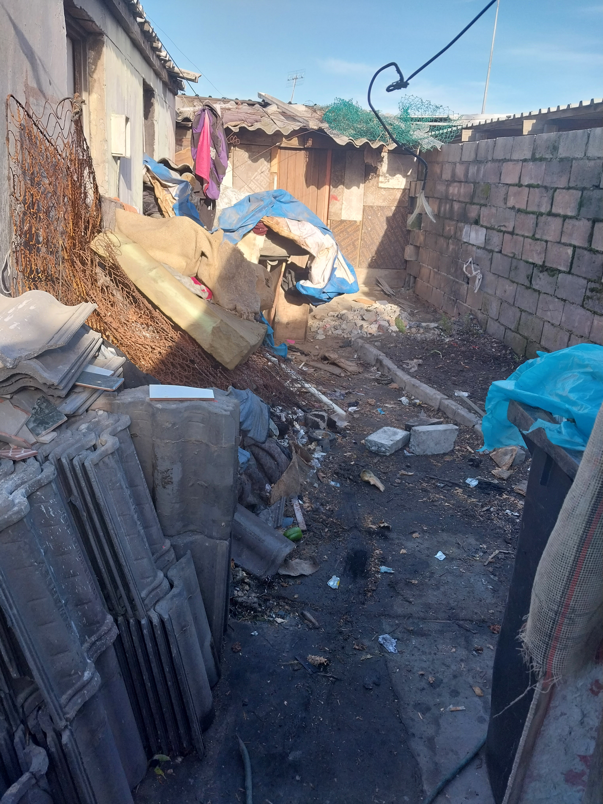
Photographic Evidence E
Date taken: 16 May 2023
Address: 6066 Leonard Doman Road, Macassar
Taken by: Trainee Inspector Clodeen Arnolds
Taken with: Samsung Galaxy A23 Cellular Phone Camera
2
Photograph 2: Depicting the living area of the animals referred to in Photographic evidence A. Note the rubble, rubbish and hazardous objects within their living area.

Slide 3
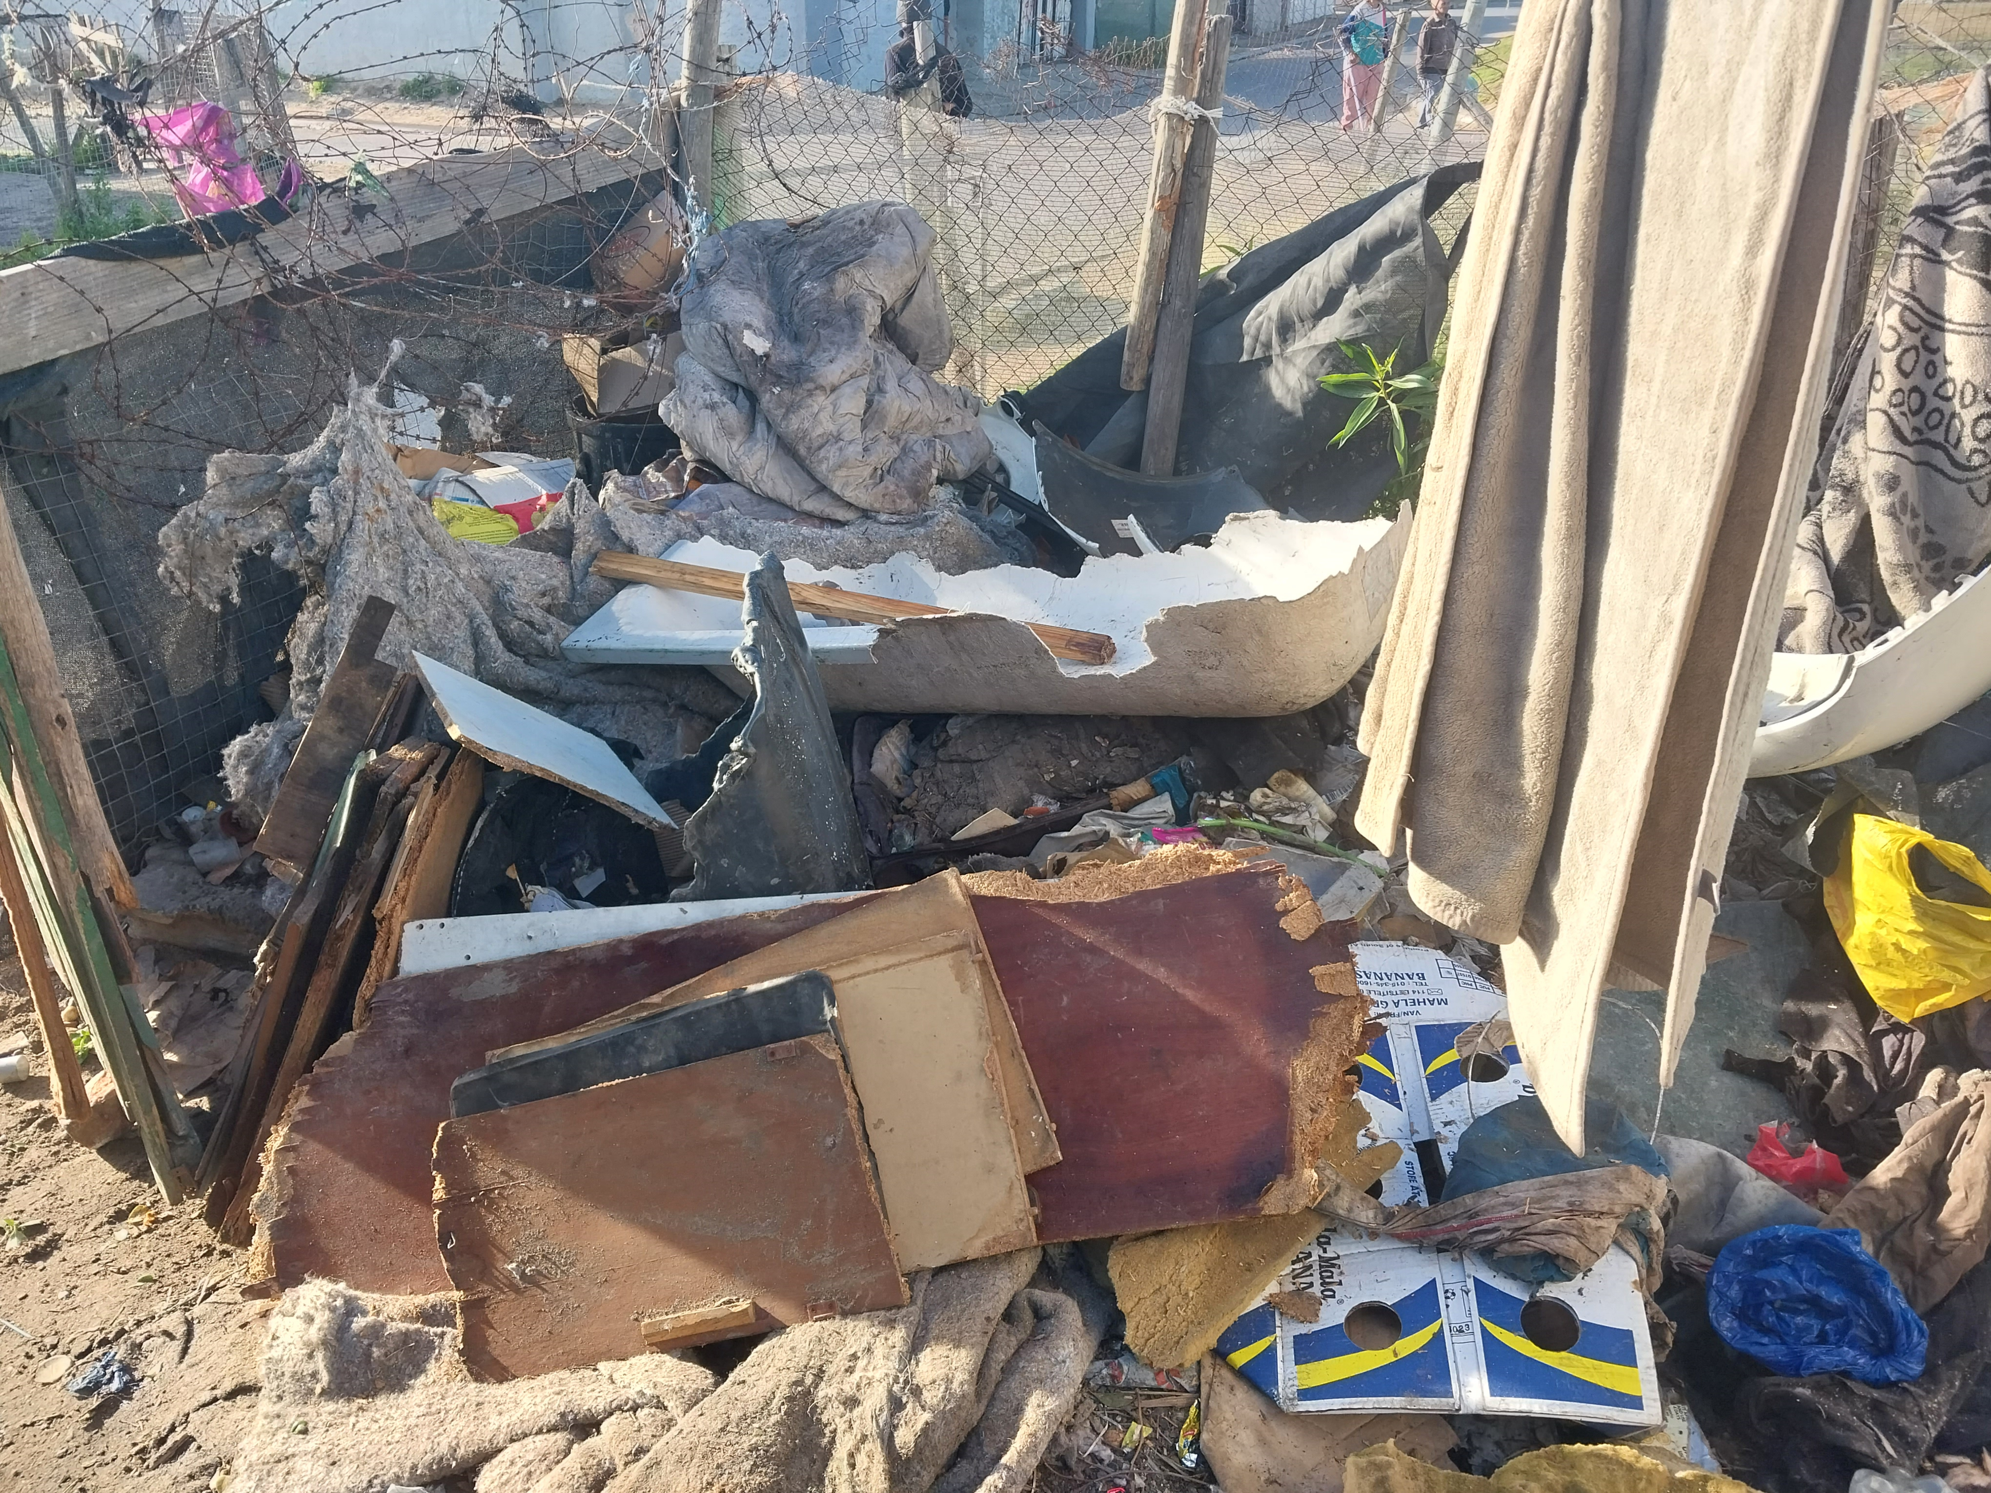
Photographic Evidence E
Date taken: 16 May 2023
Address: 6066 Leonard Doman Road, Macassar
Taken by: Trainee Inspector Clodeen Arnolds
Taken with: Samsung Galaxy A23 Cellular Phone Camera
3
Photograph 3: Depicting a different view of the dogs’ living conditions.

