Slide 1

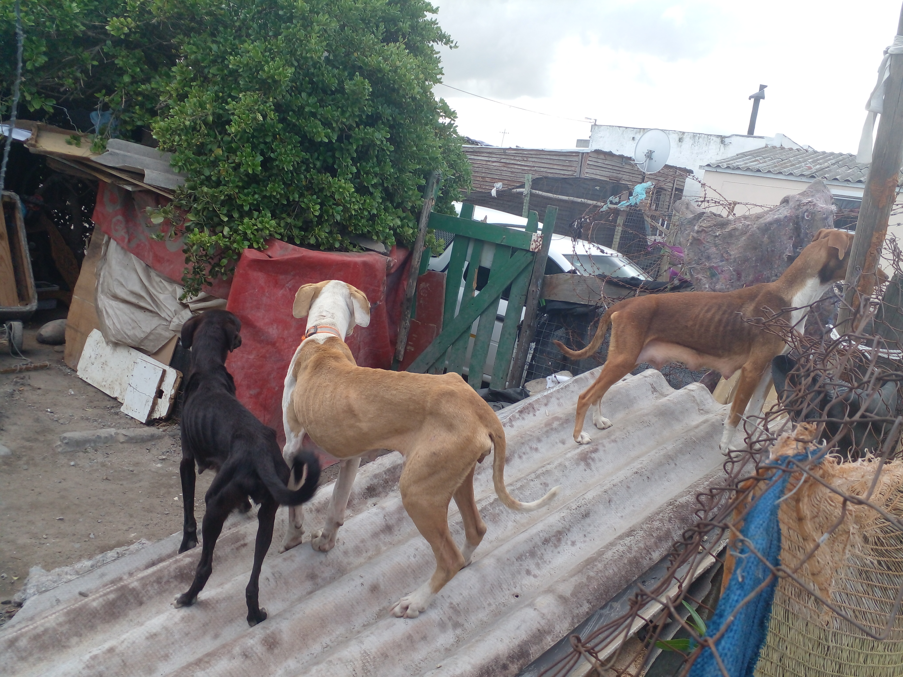
Photographic Evidence D
Date taken: 13 April 2023
Address: 6066 Leonard Doman Road, Macassar
Taken by: Inspector Lwazi Ntungele
Taken with: Samsung Galaxy A23 Cellular Phone Camera
1
Photograph 1: Depicting an overall view of three of the dogs seen in Photographic evidence A. Sone their general lean appearance and the visibility of their ribs, spines and hip bones as well as the loss of muscle around their hind legs.

Slide 2
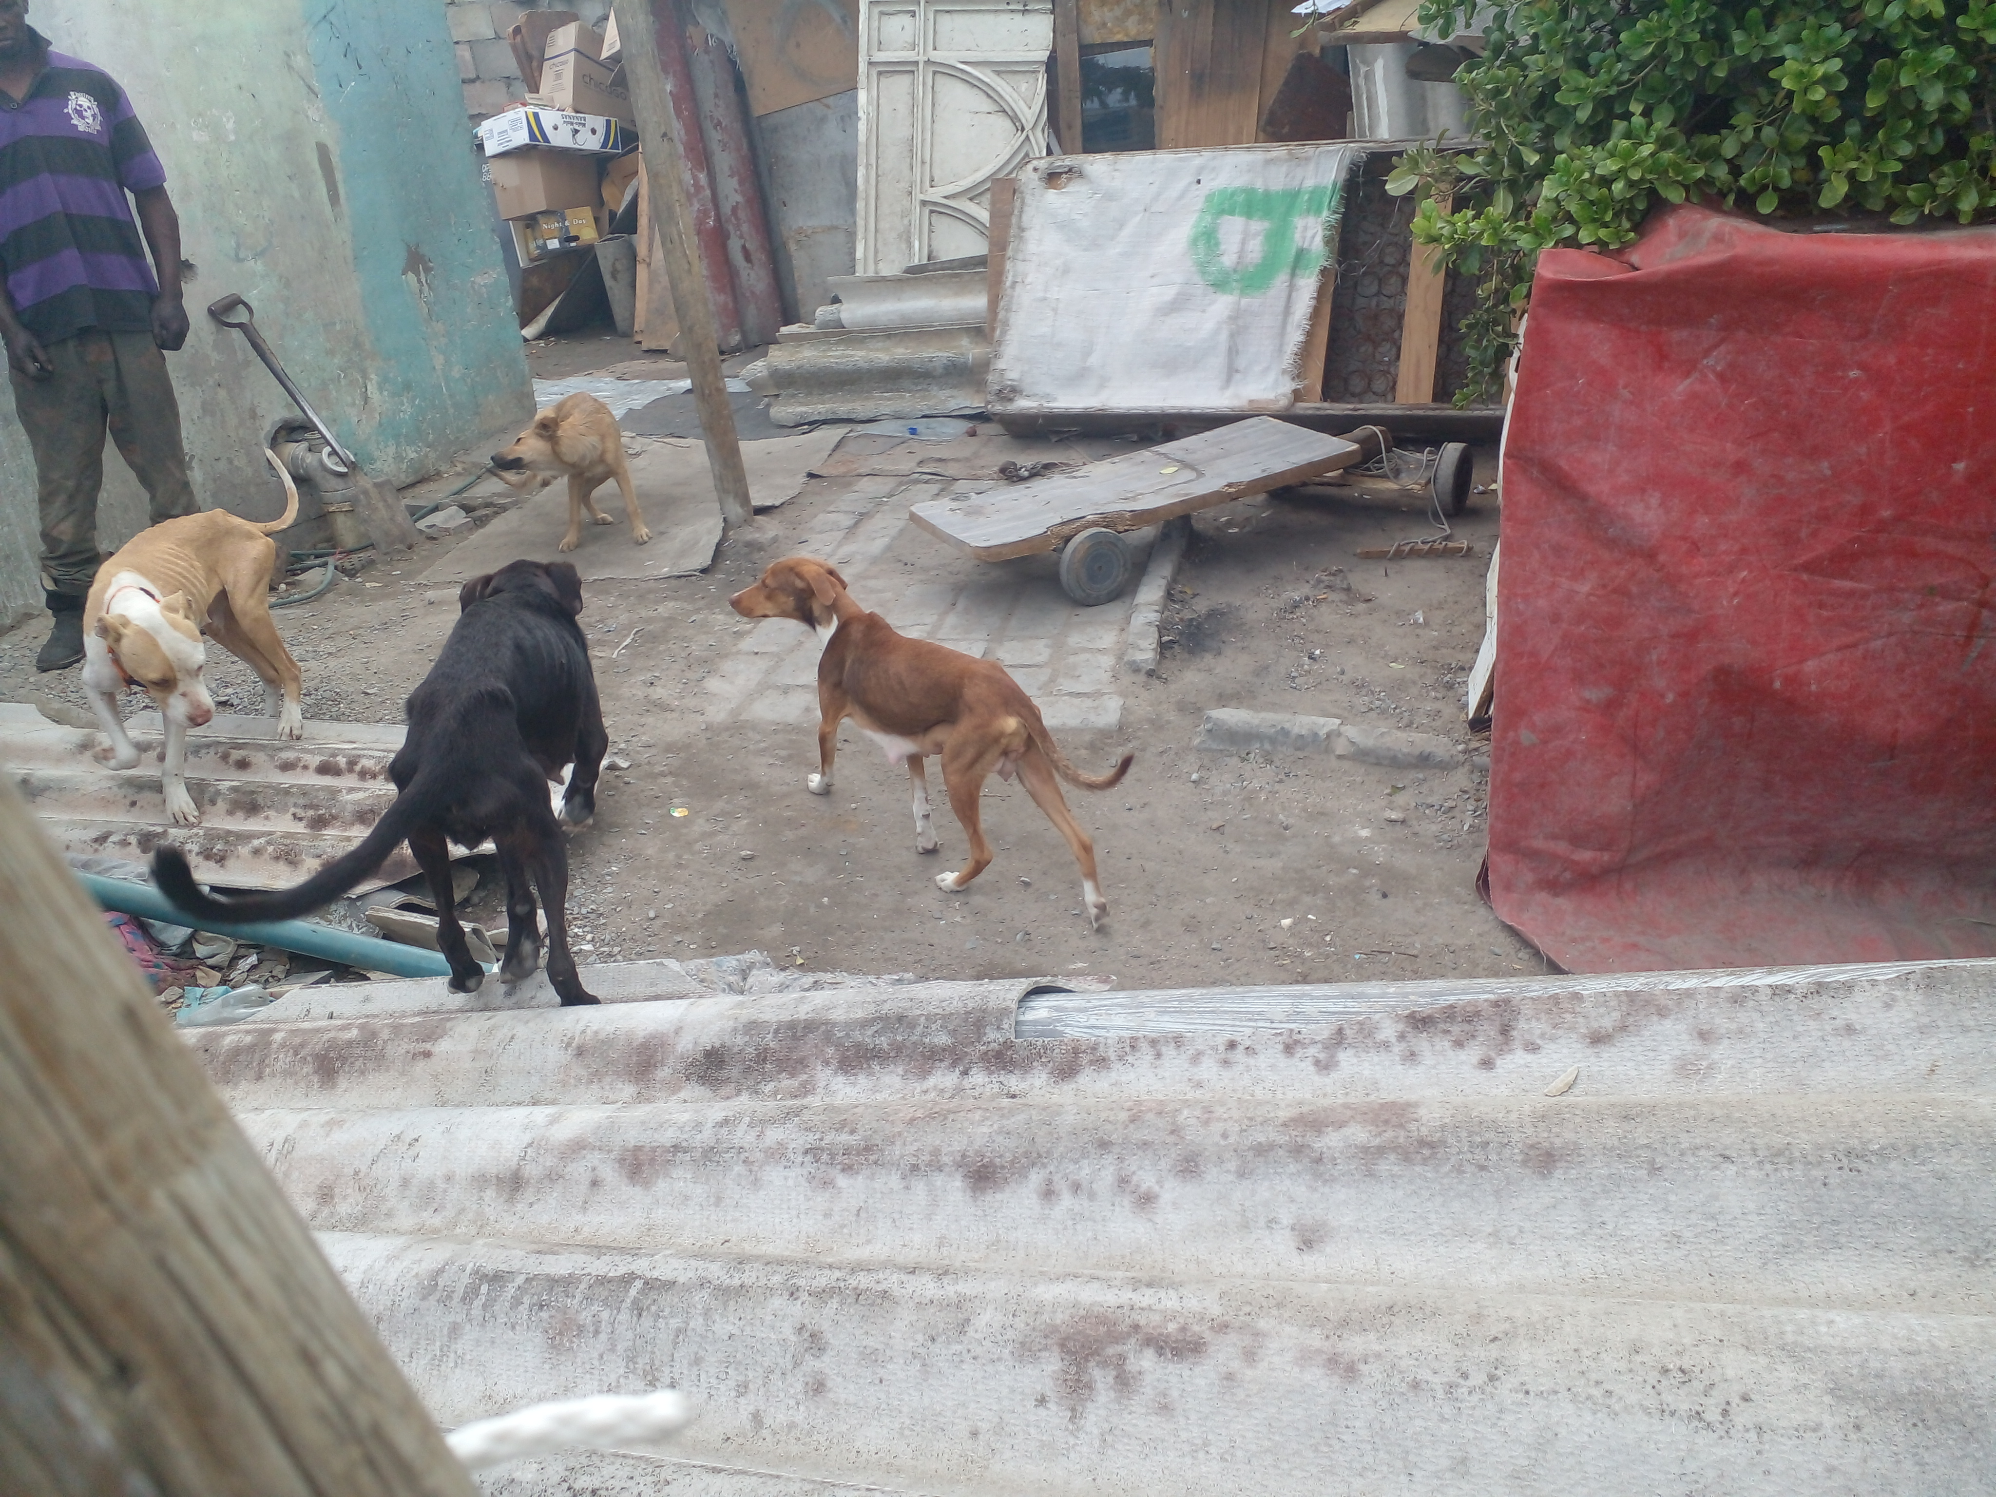
Photographic Evidence D
Date taken: 13 April 2023
Address: 6066 Leonard Doman Road, Macassar
Taken by: Inspector Lwazi Ntungele
Taken with: Samsung Galaxy A23 Cellular Phone Camera
2
Photograph 2: Depicting a different view of the dogs seen in Photograph 1.

Slide 3
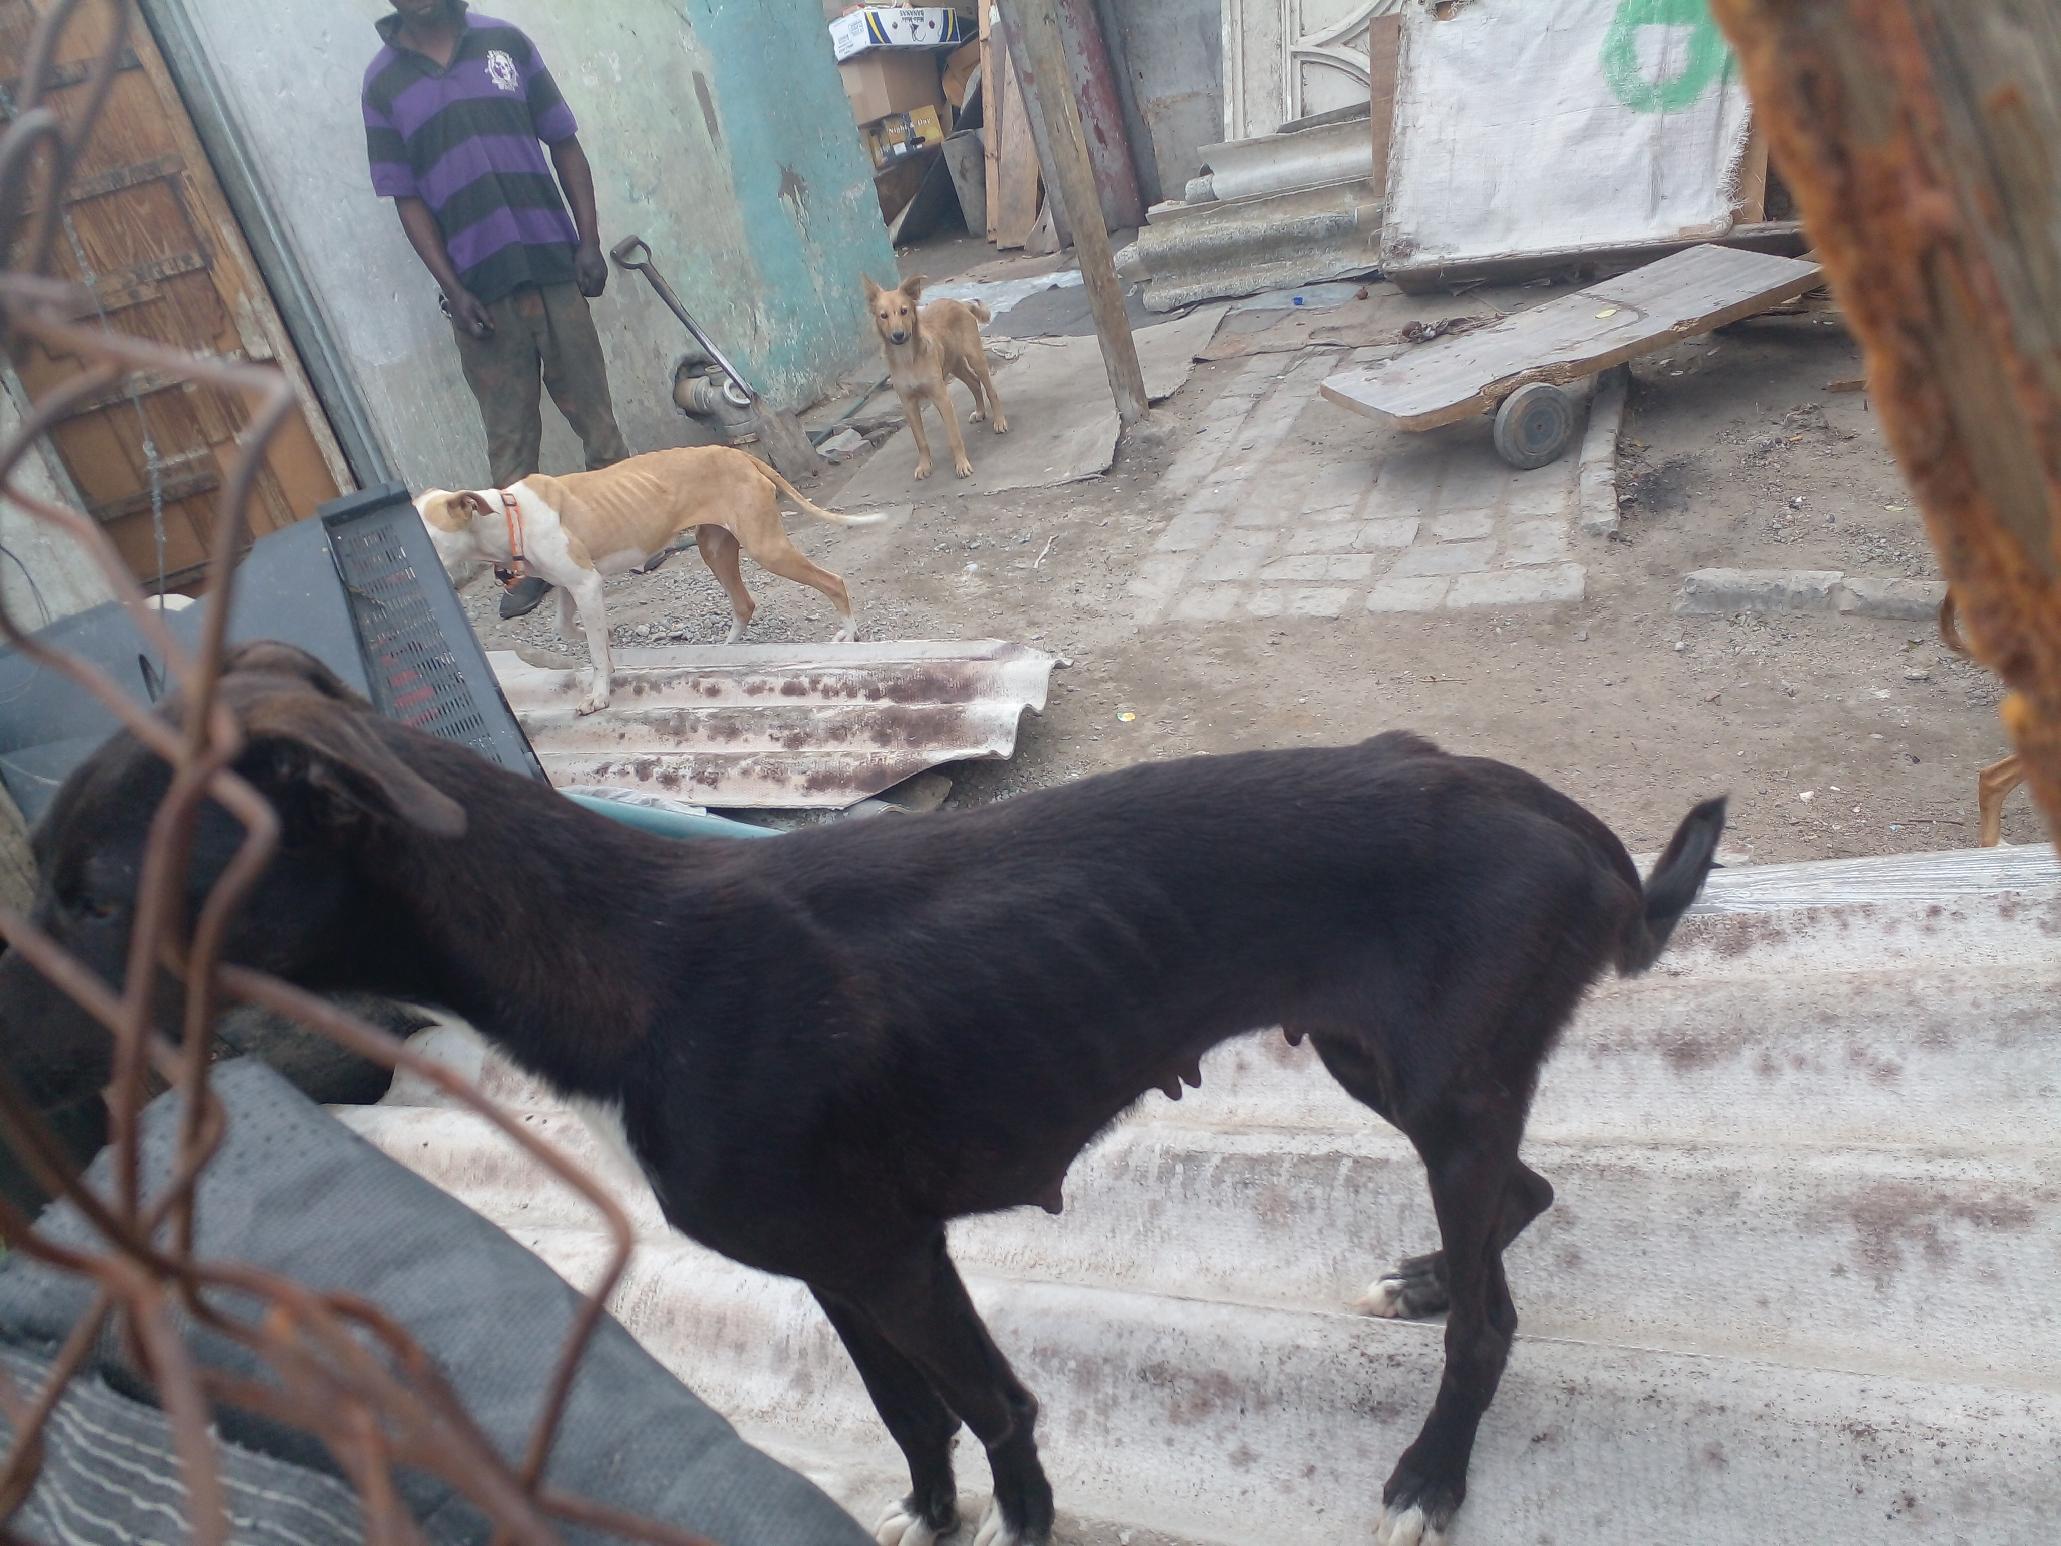
Photographic Evidence D
Date taken: 13 April 2023
Address: 6066 Leonard Doman Road, Macassar
Taken by: Inspector Lwazi Ntungele
Taken with: Samsung Galaxy A23 Cellular Phone Camera
3
Photograph 3: Depicting a close up of one of the dogs (black and white) seen in Photograph 1. Note this dogs lean appearance, the visibility of her ribs, spine and hip bones as well as the loss of muscle around her hind legs.

Slide 4
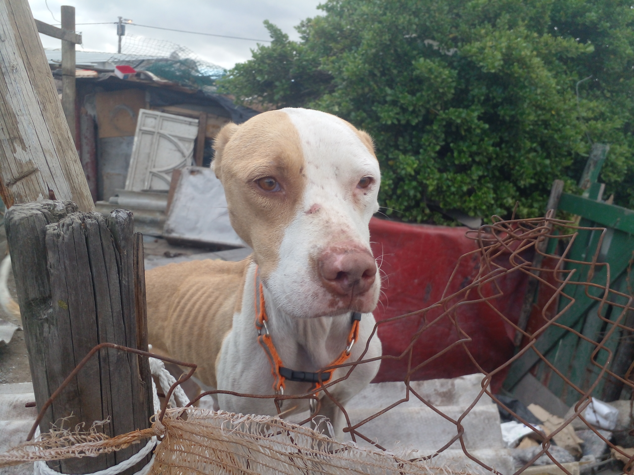
Photographic Evidence D
Date taken: 13 April 2023
Address: 6066 Leonard Doman Road, Macassar
Taken by: Inspector Lwazi Ntungele
Taken with: Samsung Galaxy A23 Cellular Phone Camera
4
Photograph 4: Depicting a close up of one of the dogs (tan and white) seen in Photograph 1. Note this dogs lean appearance and the visibility of his ribs and spine.

Slide 5
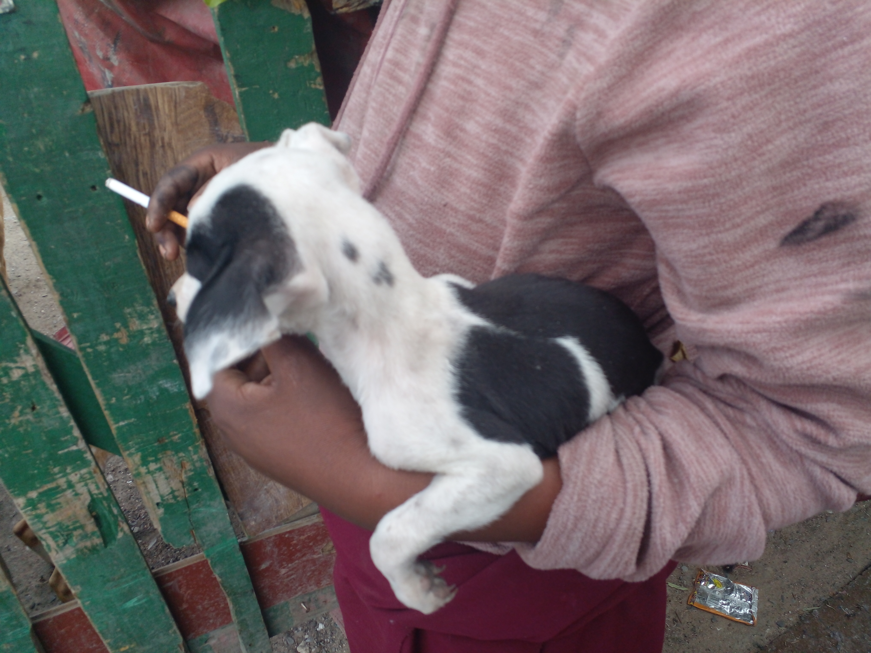
Photographic Evidence D
Date taken: 13 April 2023
Address: 6066 Leonard Doman Road, Macassar
Taken by: Inspector Lwazi Ntungele
Taken with: Samsung Galaxy A23 Cellular Phone Camera
5
Photograph 5: Depicting a white and black puppy found on the same property as the other dogs seen in Photograph 1.

