Slide 1

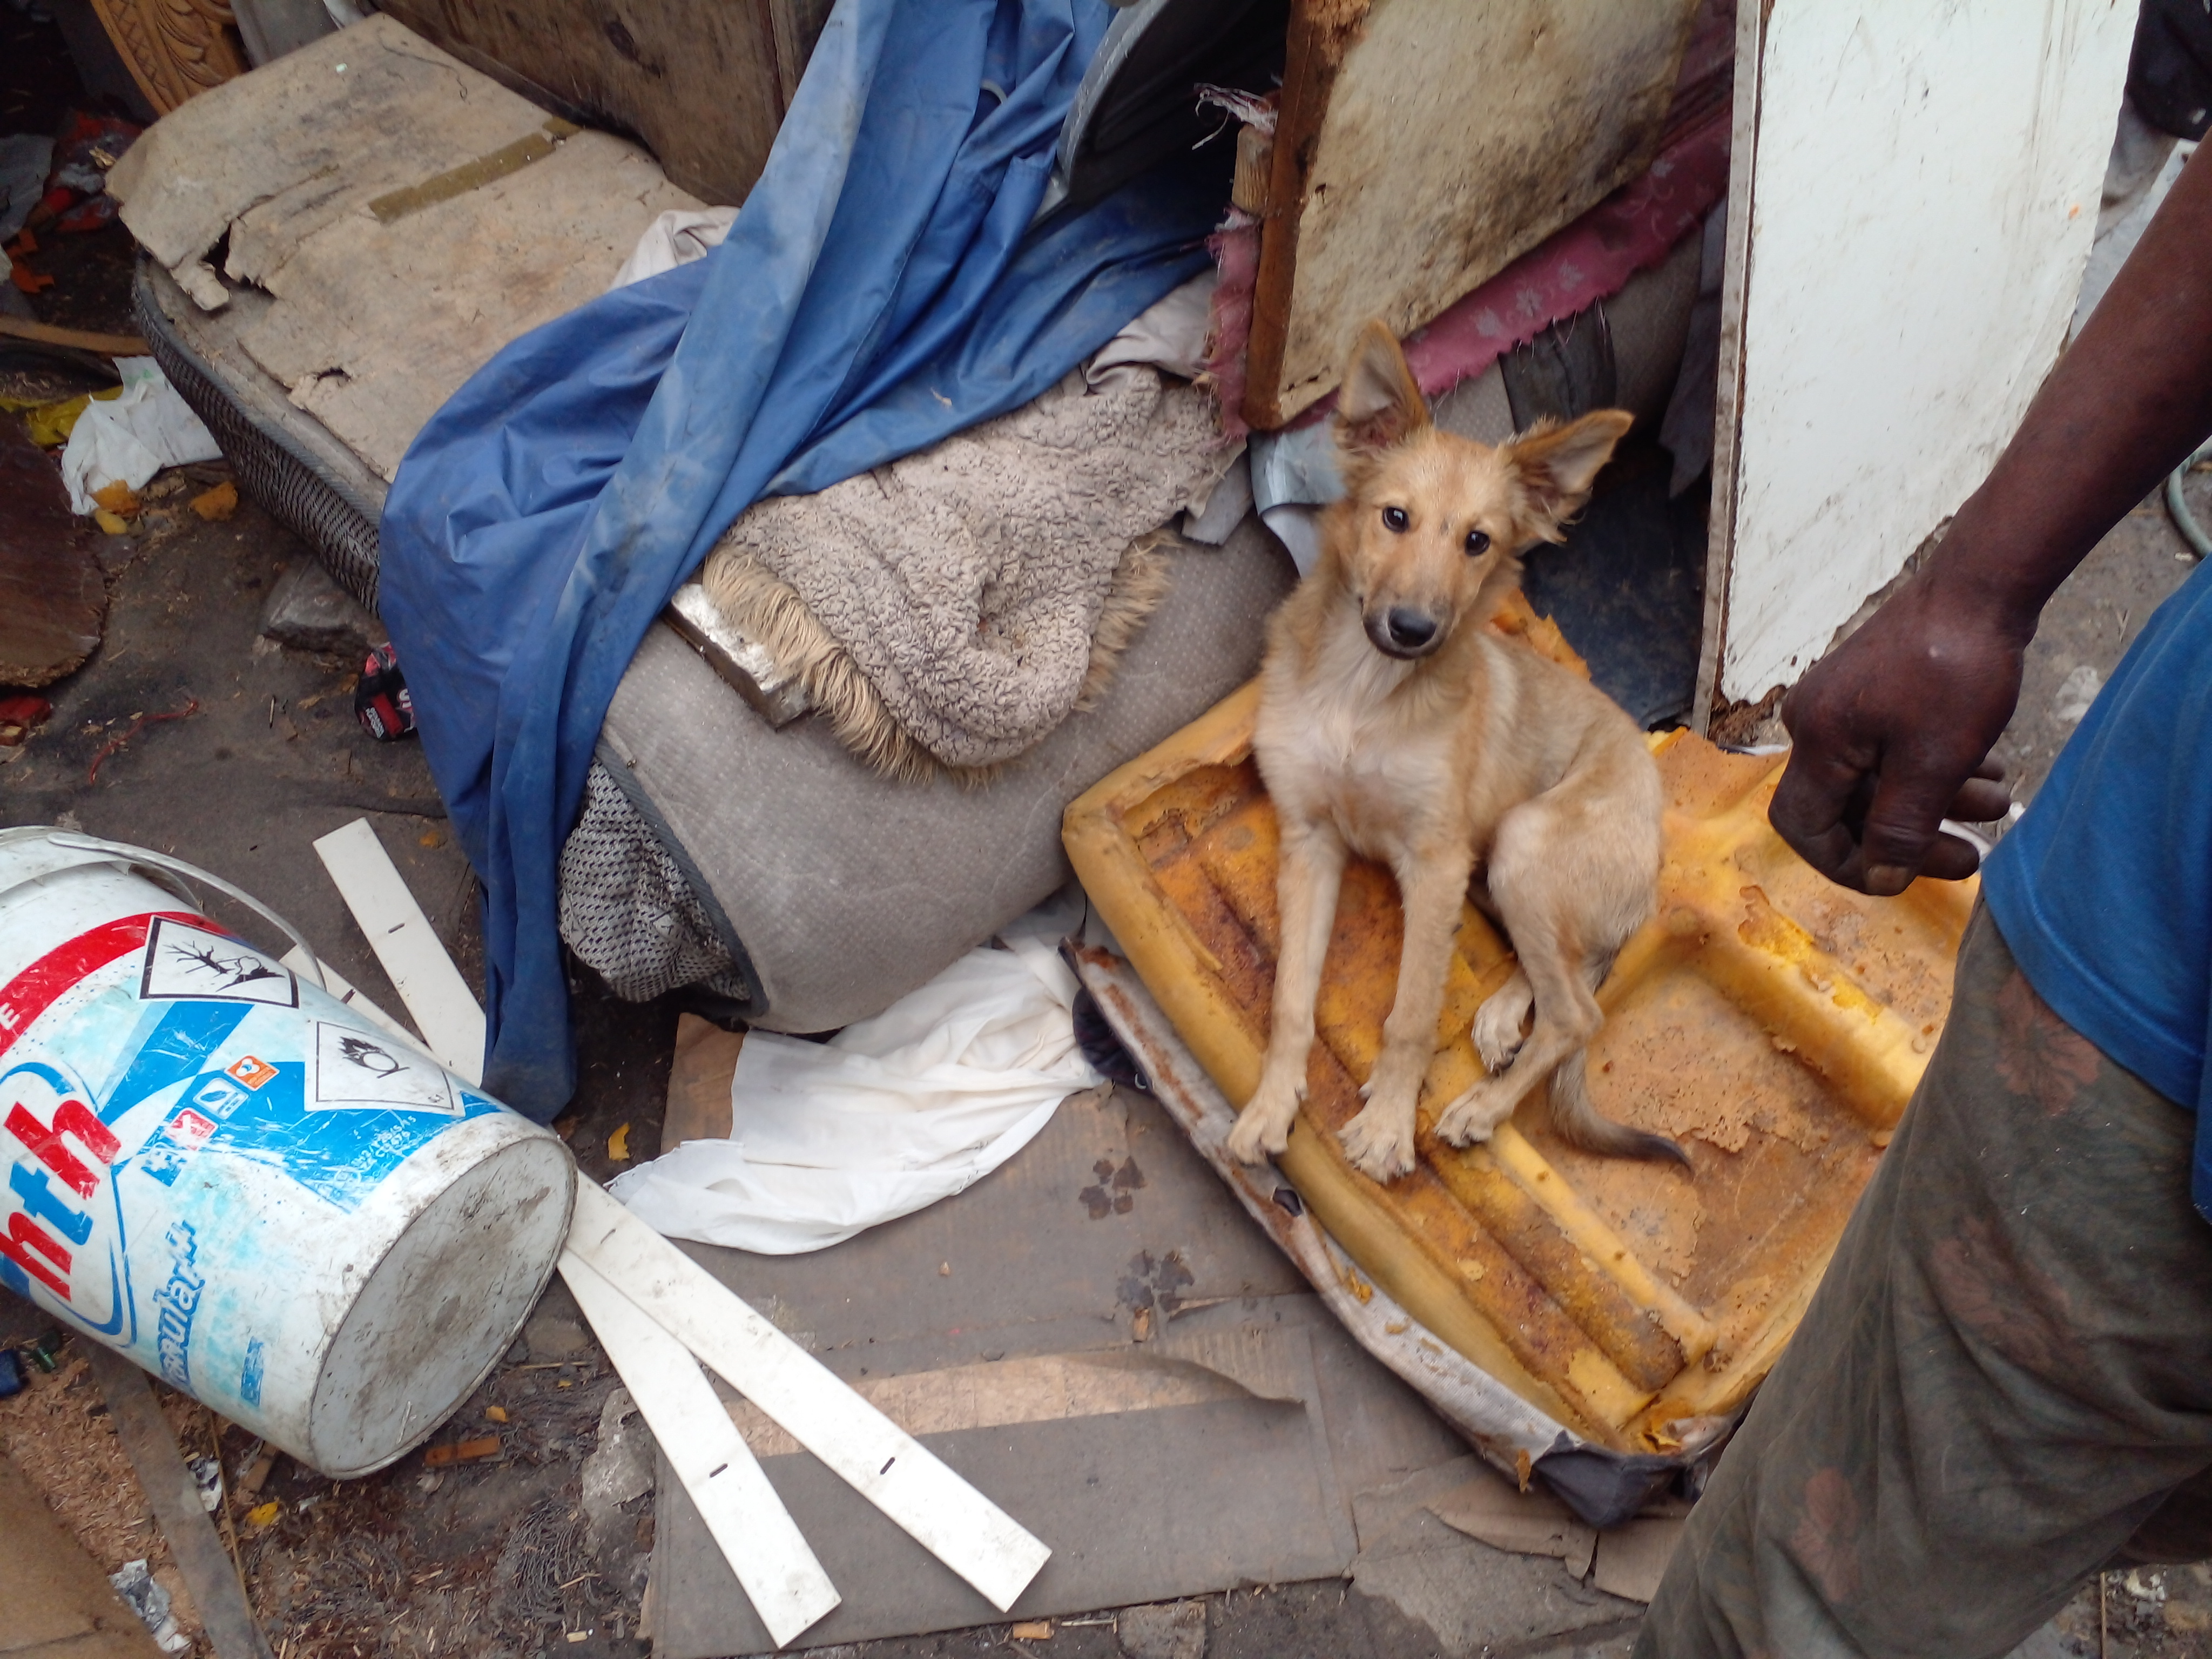
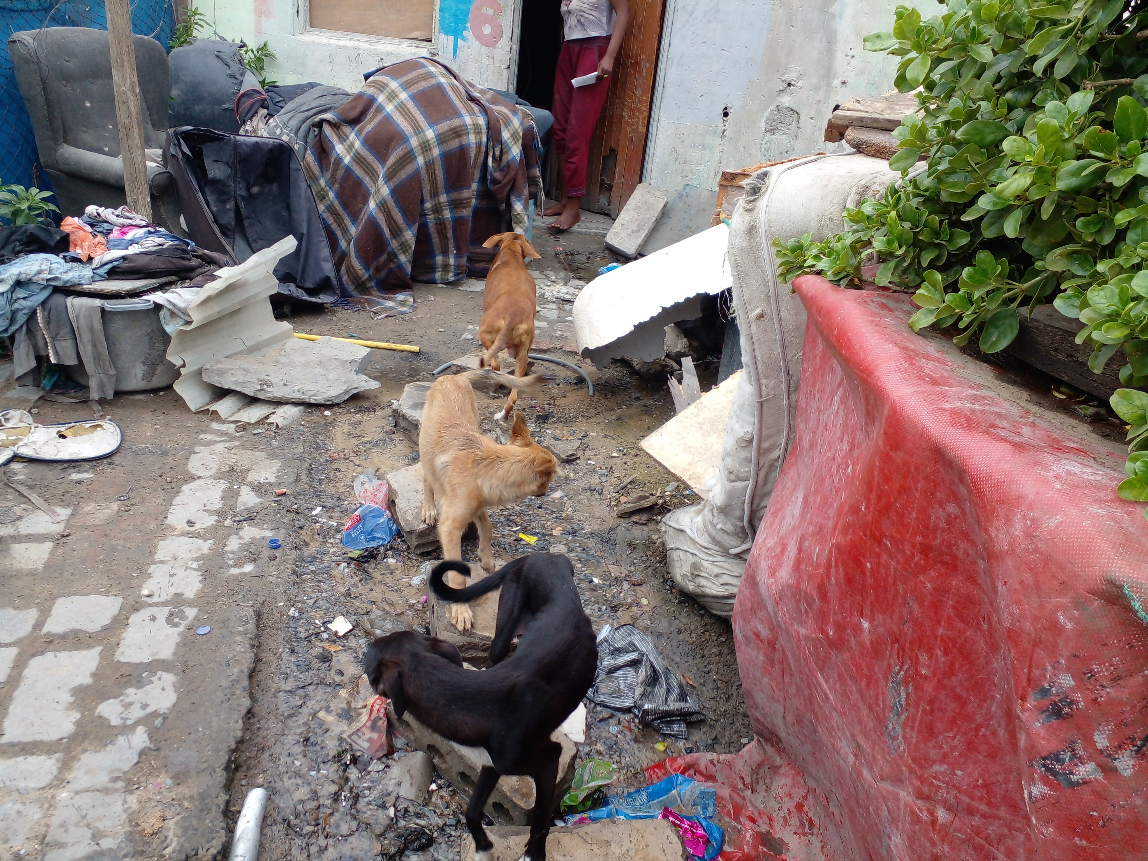
Photographic Evidence B
Date taken: 23 March 2023
Address: 6066 Leonard Doman Road, Macassar
Taken by: Inspector Lwazi Ntungele
Taken with: Samsung Galaxy A23 Cellular Phone Camera
1
Photograph 1: Depicting the dog seen in Photograph 1 in the album labelled “Photographic Evidence A”. The dog is lying on top of old, dirty sponge and the area contains various old discarded items and litter, including rusted wiring
2
Photograph 2: Depicting three of the dogs kept on the property (one of which is depicted in Photograph 1). Note the protruding ribs and hips and overall lack of fat and muscle of the black dog as well as the rubbish, rubble, and litter in the area in which the dogs are kept.

Slide 2
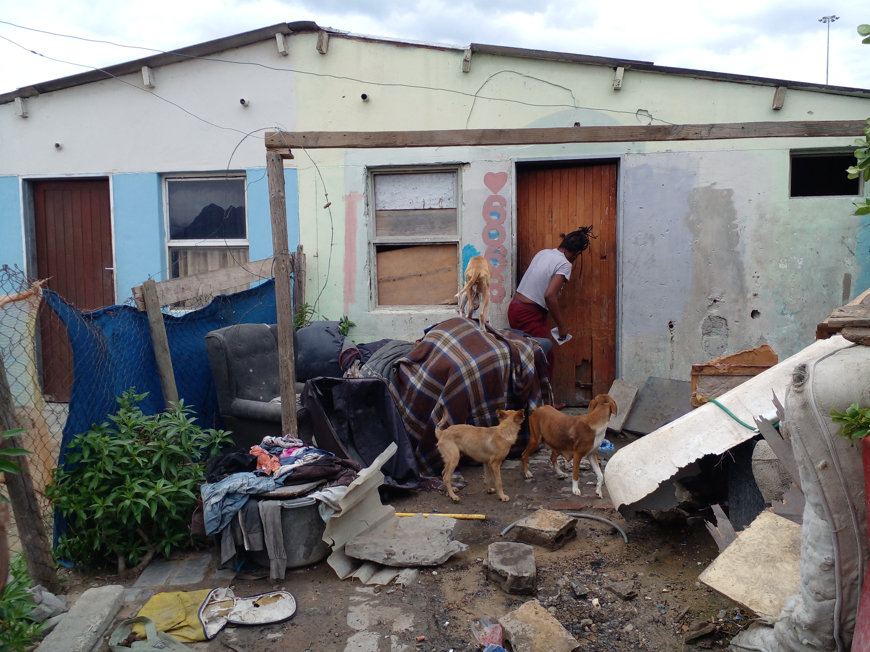
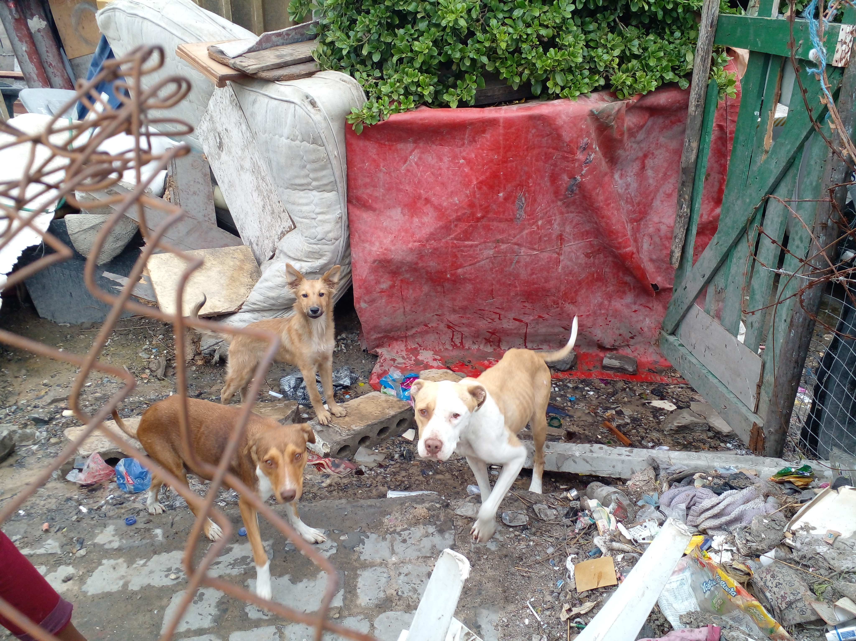
Photographic Evidence B
Date taken: 23 March 2023
Address: 6066 Leonard Doman Road, Macassar
Taken by: Inspector Lwazi Ntungele
Taken with: Samsung Galaxy A23 Cellular Phone Camera
3
Photograph 3: Depicting three of the dogs kept on the property. Note the underweight standing on top of something and to the left of the woman. The dog’s spine, hip, and pelvic bones are protruding and the dog’s hind legs lack muscle.
4
Photograph 4: Depicting the dogs seen in Photograph 3. Note the protruding ribs and pelvic bones of the two (2) dogs in the foreground of the photograph. Additional to their protruding bones, they lack overall fat and muscle.

