Slide 1

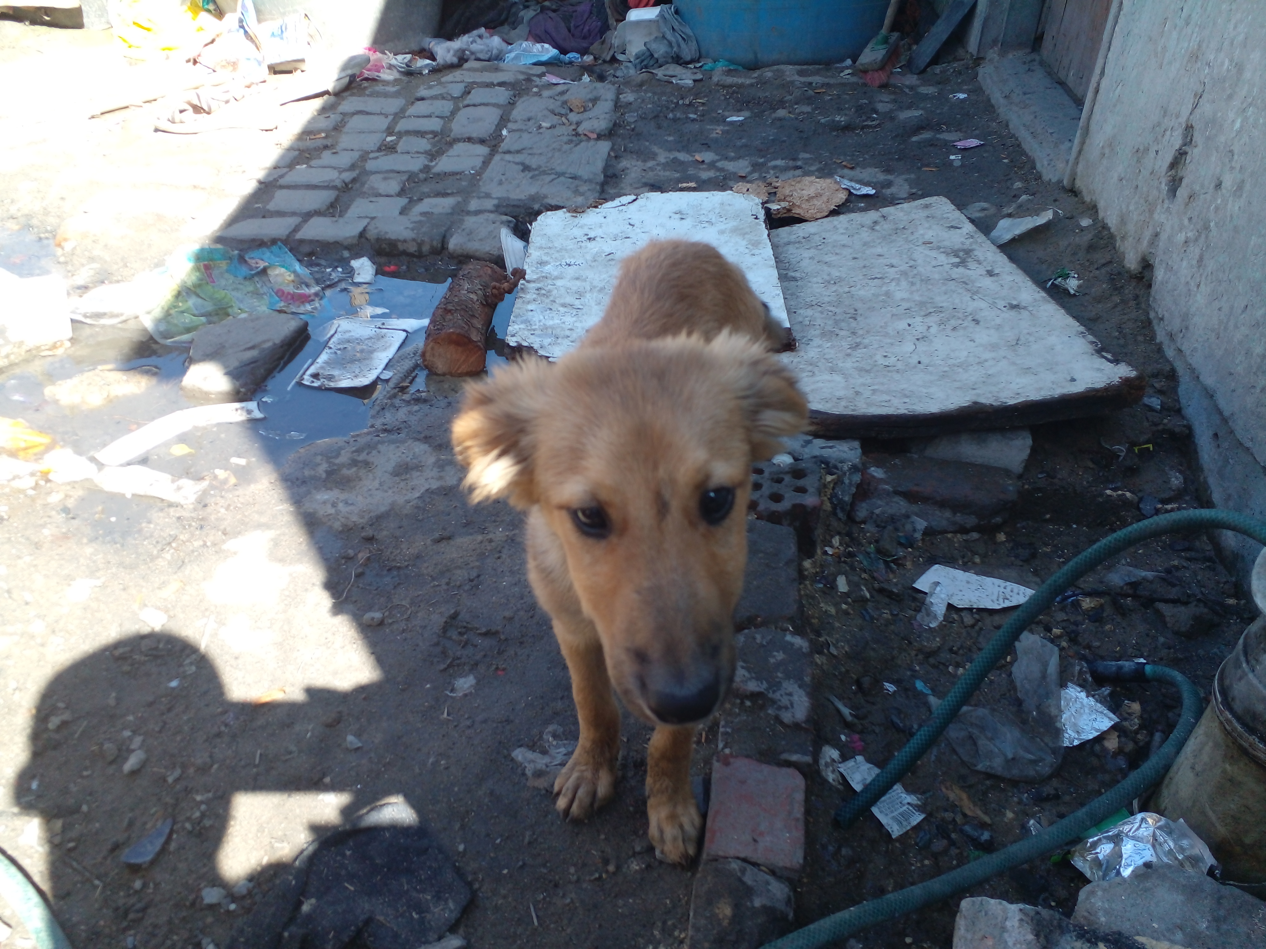
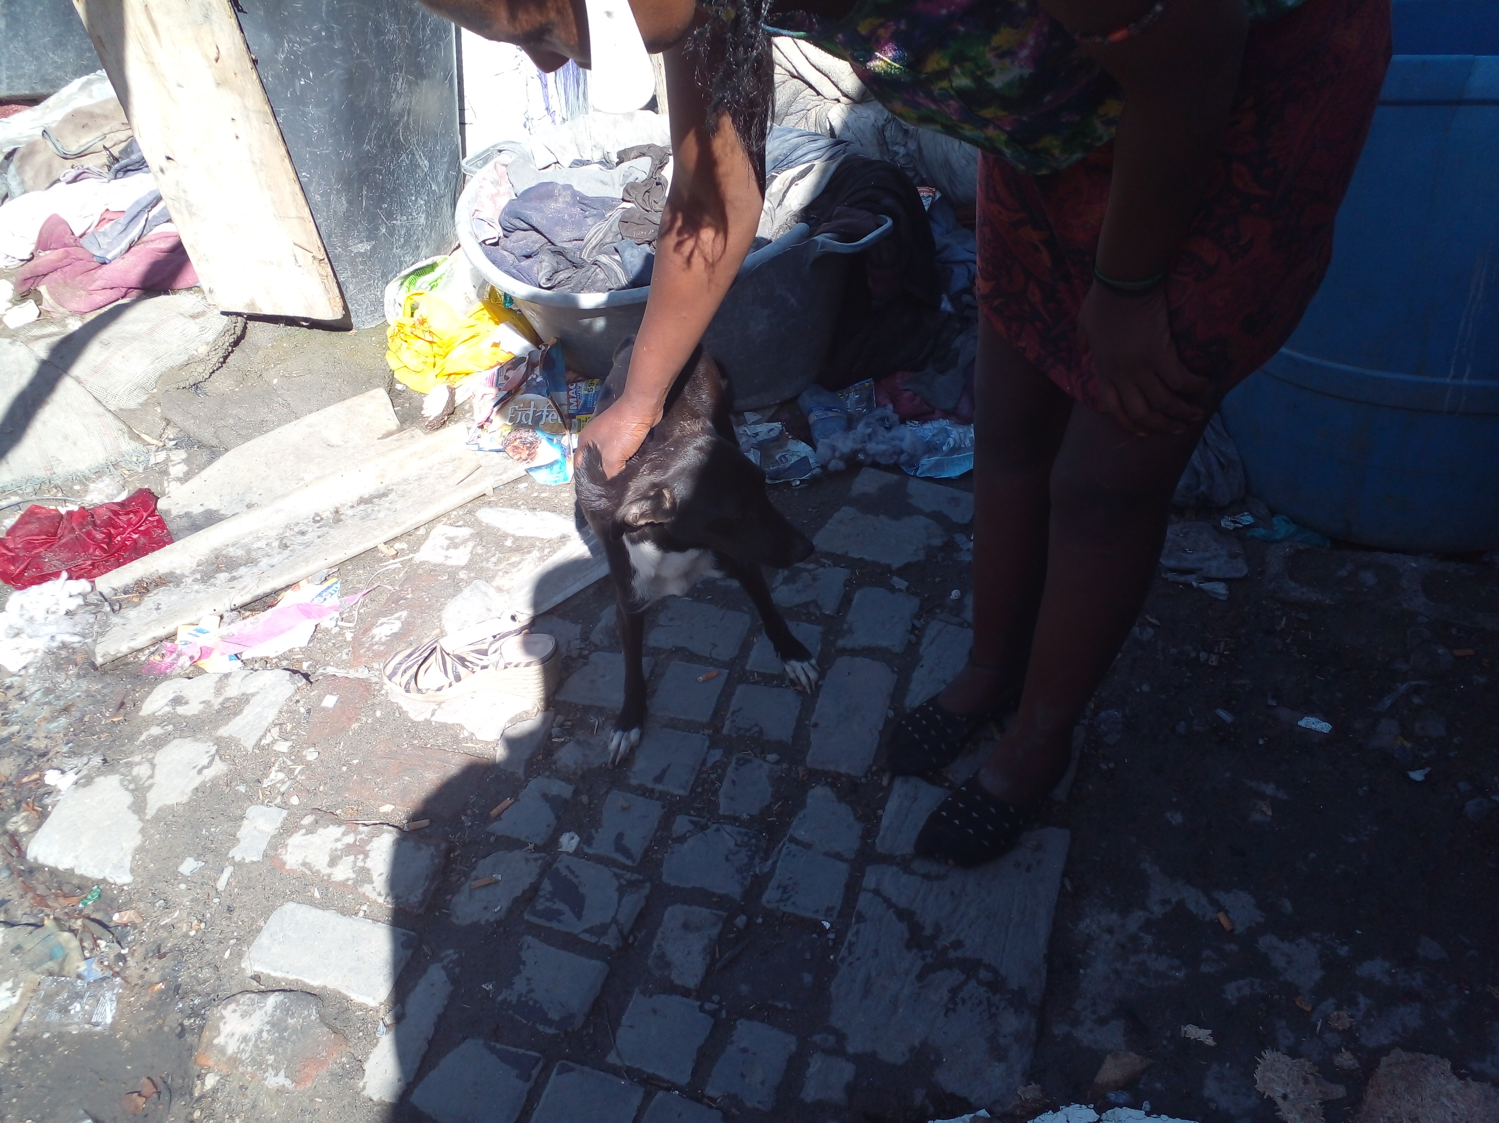
Photographic Evidence A
Date taken: 23 February 2023
Address: 6066 Leonard Doman Road, Macassar
Taken by: Inspector Lwazi Ntungele
Taken with: Samsung Galaxy A23 Cellular Phone Camera
1
Photograph 1: Depicting one of the dog’s kept in a dirty area on the above-mentioned property (6066 Leonard Doman Road, Macassar). Note the various litter and rubbish around the dog.
2
Photograph 2: Depicting another dog kept in a dirty area on the above-mentioned property (6066 Leonard Doman Road, Macassar). Note the various litter and rubbish around the dog.

Slide 2
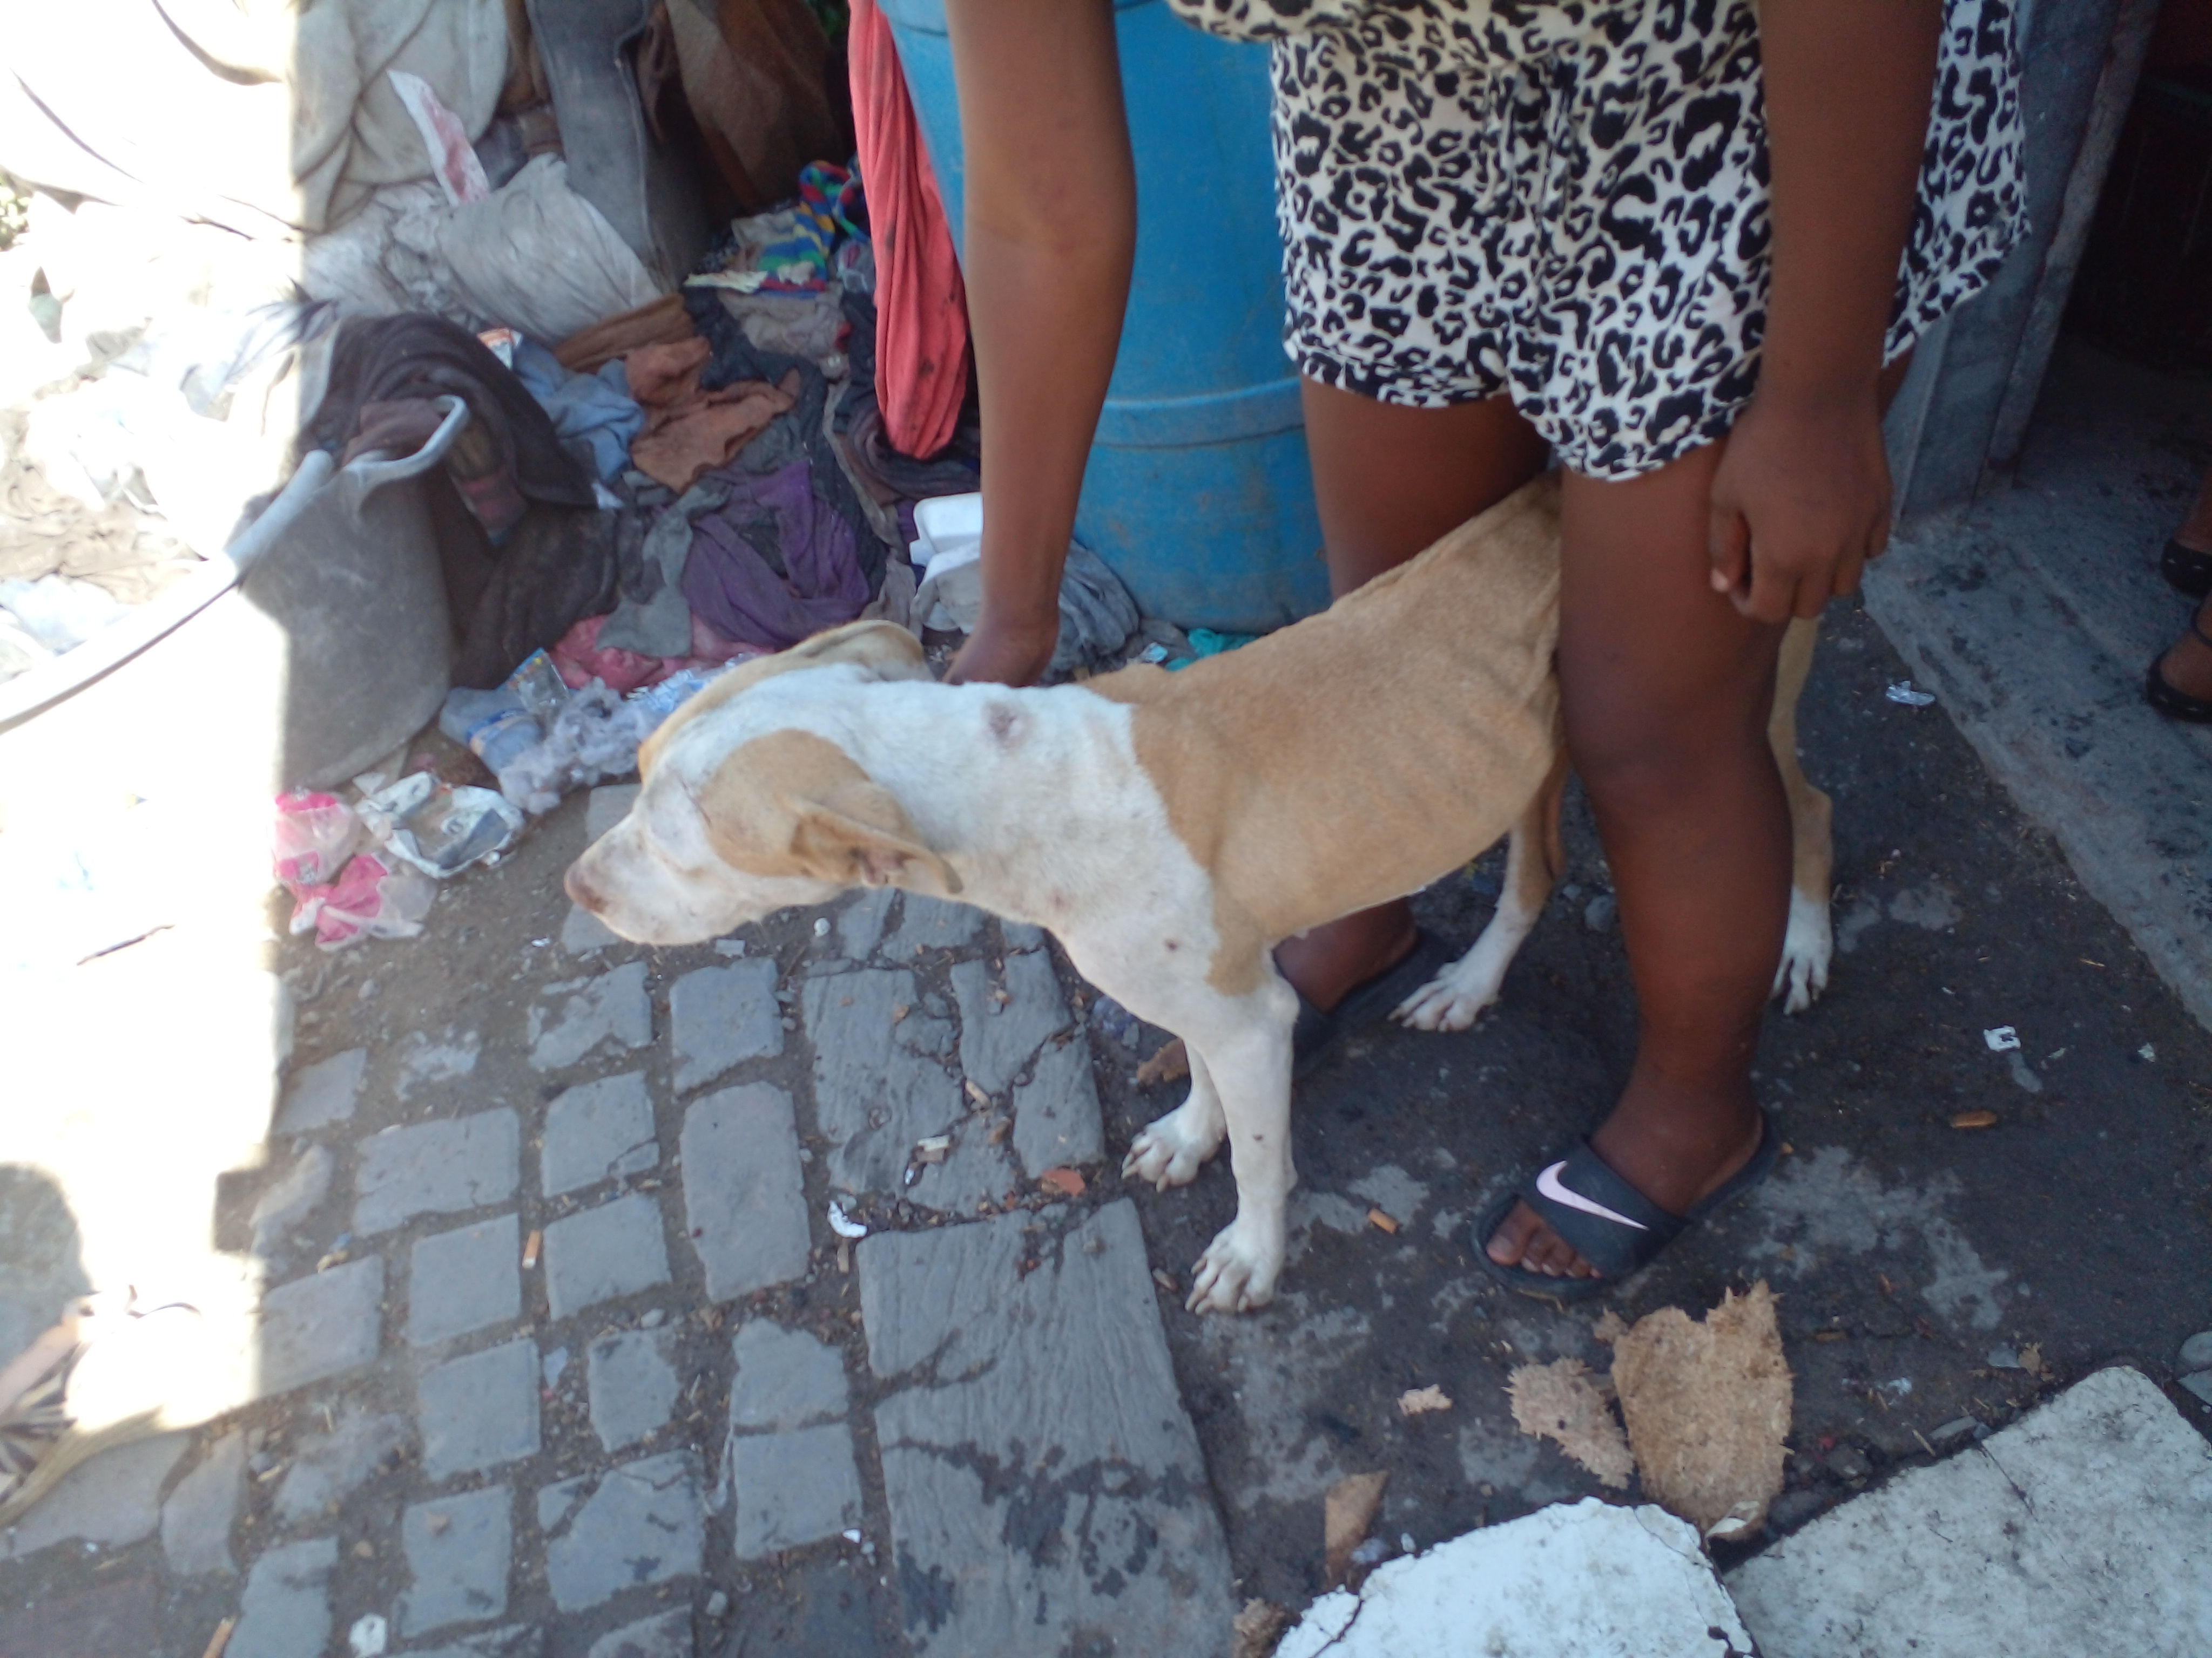
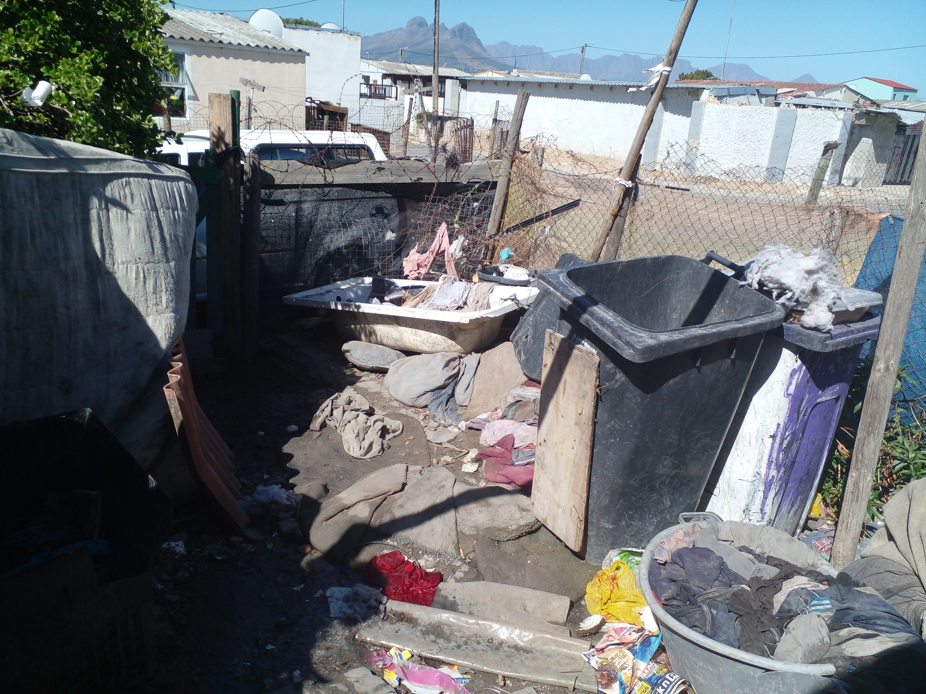
Photographic Evidence A
Date taken: 23 February 2023
Address: 6066 Leonard Doman Road, Macassar
Taken by: Inspector Lwazi Ntungele
Taken with: Samsung Galaxy A23 Cellular Phone Camera
3
Photograph 3: Depicting a third dog kept in a dirty area on the above-mentioned property (6066 Leonard Doman Road, Macassar). Note the dog’s protruding ribs and spine and its overall lack of fat and muscle. Note the various litter and rubbish around the dog.
4
Photograph 4: Depicting some of the accumulated rubbish, rubble, and litter on the above-mentioned property on which the dogs seen in Photographs 1 to 3 are kept.

